Slide 1
Eye conditions
Kingston Education Centre

Slide 2
Lesson Objectives
To gain knowledge of the structure of the eye and be able to label a diagram of the eye.
To be able to identify different common eye conditions and their management.
To be able to list the possible activities of daily living that eye conditions may effect for people.

Slide 3
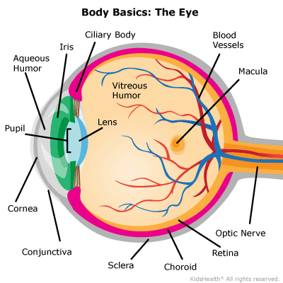
The Structure of the eye

Slide 4
Functions of eye structures
Iris: regulates the amount of light that enters your eye. It forms the coloured, visible part of your eye in front of the lens. Light enters through a central opening called the pupil.
Pupil: the circular opening in the centre of the iris through which light passes into the lens of the eye. The iris controls widening and narrowing (dilation and constriction) of the pupil.
Cornea: the transparent circular part of the front of the eyeball. It refracts the light entering the eye onto the lens, which then focuses it onto the retina. The cornea contains no blood vessels and is extremely sensitive to pain.
Lens: a transparent structure situated behind your pupil. It is enclosed in a thin transparent capsule and helps to refract incoming light and focus it onto the retina. A cataract is when the lens becomes cloudy, and a cataract operation involves the replacement of the cloudy lens with an artificial plastic lens.
Choroid: the middle layer of the eye between the retina and the sclera. It also contains a pigment that absorbs excess light so preventing blurring of vision.
Ciliary body: the part of the eye that connects the choroid to the iris.
Retina: a light sensitive layer that lines the interior of the eye. It is composed of light sensitive cells known as rods and cones. The human eye contains about 125 million rods, which are necessary for seeing in dim light. Cones, on the other hand, function best in bright light. There are between 6 and 7 million cones in the eye and they are essential for receiving a sharp accurate image and for distinguishing colours. The retina works much in the same way as film in a camera.
Macula: a yellow spot on the retina at the back of the eye which surrounds the fovea.
Fovea: forms a small indentation at the centre of the macula and is the area with the greatest concentration of cone cells. When the eye is directed at an object, the part of the image that is focused on the fovea is the image most accurately registered by the brain.
Optic disc: the visible (when the eye is examined) portion of the optic nerve, also found on the retina. The optic disc identifies the start of the optic nerve where messages from cone and rod cells leave the eye via nerve fibres to the optic centre of the brain. This area is also known as the 'blind spot’.
Optic nerve: leaves the eye at the optic disc and transfers all the visual information to the brain.
Sclera: the white part of the eye, a tough covering with which the cornea forms the external protective coat of the eye.
Rod cells are one of the two types of light-sensitive cells in the retina of the eye. There are about 125 million rods, which are necessary for seeing in dim light.
Cone cells are the second type of light sensitive cells in the retina of the eye. The human retina contains between six and seven million cones; they function best in bright light and are essential for acute vision (receiving a sharp accurate image). It is thought that there are three types of cones, each sensitive to the wavelength of a different primary colour – red, green or blue. Other colours are seen as combinations of these primary colours.

Slide 5
Why is it important to know the structure?
Cornea- corneal abrasion
Macula- macula degeneration
Conjunctiva- conjunctivitis

Slide 6
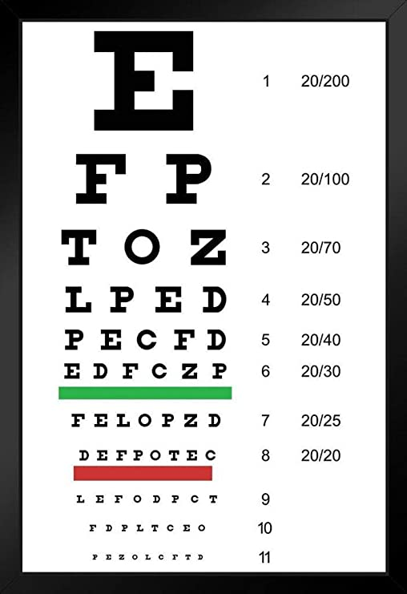
Eye exam
Visual acuity- Snellen Chart
Colour vision assessment
Visual fields
Inspect the external eye
Inspect the pupil
Fluorescence dye
Anaesthetic drops
Short-acting mydriatic eye drops- dilates the pupil
Pupillary reflexes
Eye movements

Slide 7
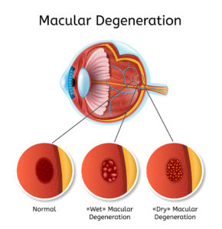
Macular degeneration
The macular lines the back of the eye and is responsible for seeing the fine details clearly.
Age related (55 and older)
Heredity
Smoking
Obesity
Diet
Treatment- Ranibizumab injections

Slide 8
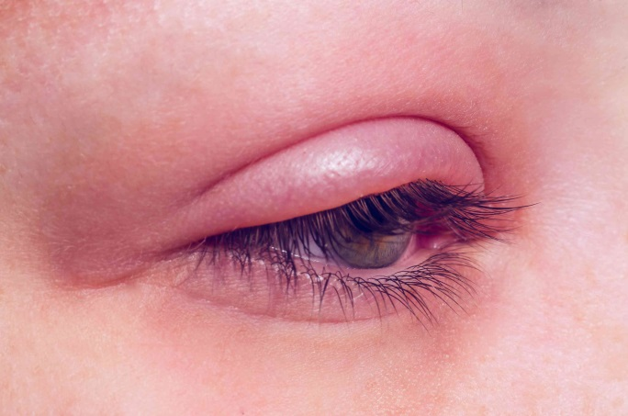
Blepharitis
Blepharitis is an inflammation of the rims of the eyelids, which causes them to become red and swollen.
No contagious
Symptoms- Burning, redness, soreness, crusty eyelashes, itchy eyelids.
Can be chronic.
Treatment- eyelid cleaning, artificial tears, may need antibiotics if infectied.

Slide 9
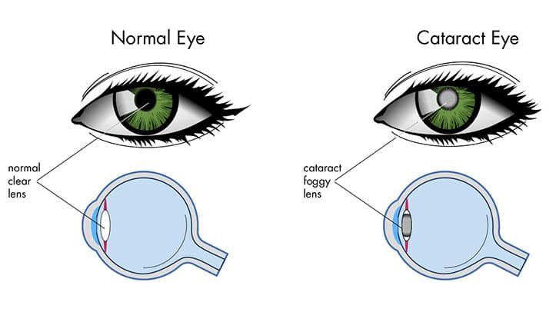
Cataract
Clouding of the lens inside the eye. It causes gradual blurring of vision and often glare.
The lens is clear and helps focus light rays onto the back of the eye. When cataract develops the lens become cloudy and prevents the light rays from passing on to the retina. The picture then becomes dull and fuzzy.
Symptoms- gradual blurred vision.
Age related- any time over the age of 40.
Congenital, drug induced (Steroids), Injury.
Lens replacement surgery.

Slide 10
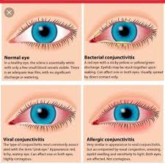
Conjunctivitis- Conjunctiva itis
Viral and bacterial conjunctivitis.
Viral- watery red eyes, no usual visual changes can last 2-3 weeks.
Bacterial- Red eye with sticky yellow discharge.
Viral- Artificial tears and painkillers, cold compress,
Bacterial- antibiotic drops.
Very contagious.

Slide 11
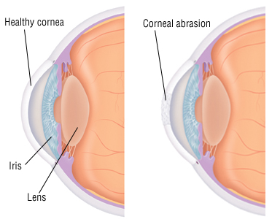
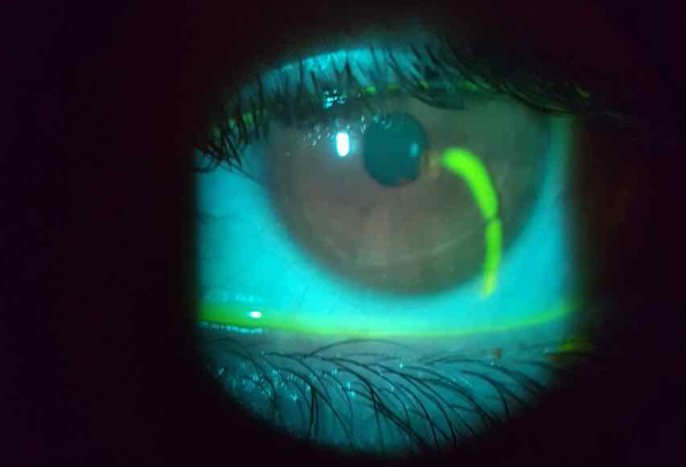
Corneal abrasion
Small scratch on the cornea.
Symptoms- Pain, blurred vision, photosensitive.
Causes- foreign body, injury
Assessment- Opthalmoscope
Treatment- Antibiotic drops, painkillers, cold compress.

Slide 12
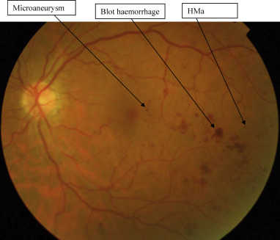
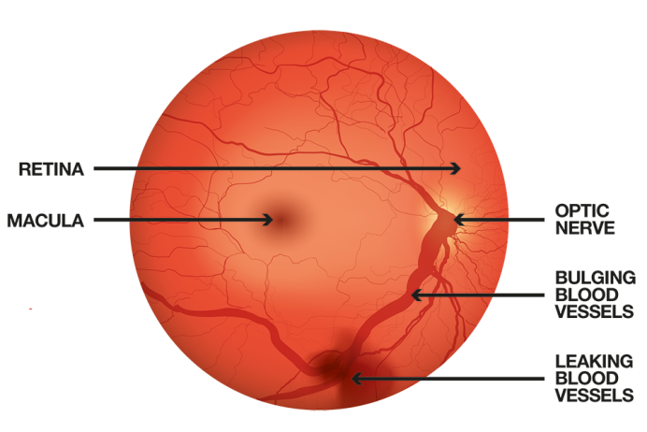
Diabetic retinopathy
Due to high blood sugar levels in the blood- damage is caused to the blood supply to the retina.
Therefore less blood supply to the retina can cause vision changes.
8/10 patients with diabetes can have retinopathy. Many can live with it with no vision changes.
Can become sight threatening.
Eye checks, Diabetic control, laser eye surgery.

Slide 13
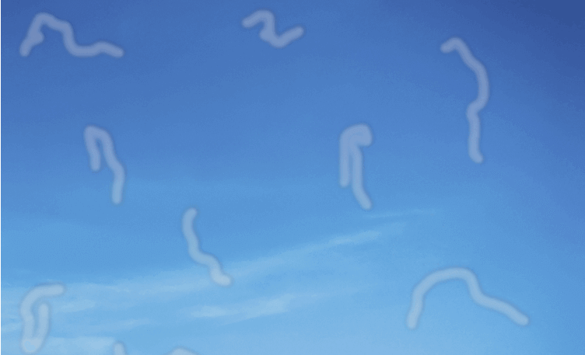
Flashes and floaters
Flashes and floaters happen because of changes in the vitreous, the clear, jelly-like substance that fills the inside of your eyeball.
Common, particularly in people over 50 years of age.
Dark glasses

Slide 14
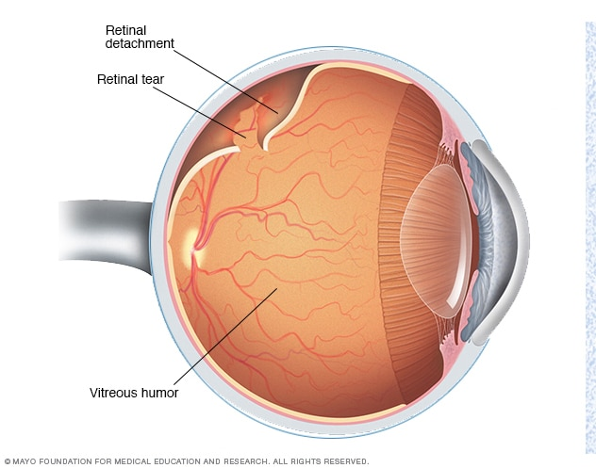
Retinal detachment
RED FLAG
The thin lining at the back of your eye begins to pull away from the blood vessels that supply it.
Symptoms- sudden attachment of floaters, flashes of light, blurred vision.
Retinas detach because they have one or more holes in them, which allows fluid to pass underneath them. This fluid causes the retina to become separated from the supporting and nourishing tissues underneath it.
Leads to blindness
Aging process, Trauma.
Treatment- surgery

Slide 15
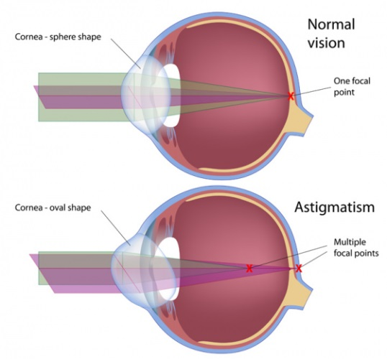
Antistigmatism
The front surface of a normal eye is round like a football, but people with astigmatism have eyes shaped more like an oval rugby ball. This changes the path of light so that the image formed at the back of the eye is not sharply focused.
People with astigmatism will usually also be short or long sighted.
Blurring, distortion, headaches, tired eyes.
Genetic
Surgical procedures, glasses.

Slide 16
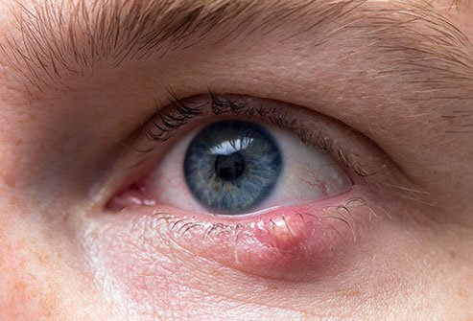
Stye
Small abscess- painful collection of puss on the eyelid. It is an infection at the root of an eyelash.
Small painful red lump, often with a yellow spot in the middle, on the outside of the eyelid
Symptoms- Watery eye, red eyelid.
Cause- infection with staphylococcus bacteria.
Treatment- warm compress. May expel themselves (like a spot).

Slide 17
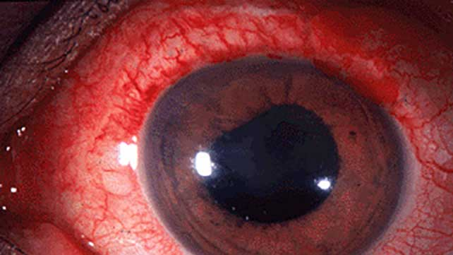
Uveitis
Inflammation of the middle layer of the eye called the uvea.
Causes- autoimmune response.
Uveitis is more common in people aged 20 to 59, but may happen in any age.
Symptoms- Eye pain, eye redness, Photophobia, Blurred vision, Floaters.
Steroid medication.

Slide 18
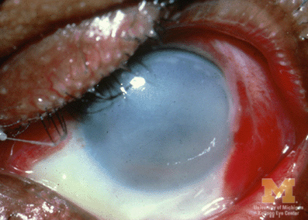
Eye Trauma
Blunt trauma
Chemical burns
Sharp trauma

Slide 19
Activities of daily living
Maintaining a safe environment,
Communication,
Breathing,
Eating and drinking,
Eliminating,
personal cleansing
Dressing,
Controlling body temperature,
Mobilising,
Working and playing,
Expressing sexuality,
Sleeping and dying.

Slide 20
Red flags
Sudden onset
Visual loss
Photophobia
Fever
Recent trauma
Vomiting
Associated red eye
Contact lens wearer
History of malignancy
History of flashers or floaters

Slide 21
Referral options
Ophthalmology
Moorfields eye hospital
A&E
Pharmacy
General practitioner
Walk in centre

Slide 22
Common terms
Dilate
Abrasion
Snellen Chart
Itis
Opthalmic
Subconjunctival haemorrhage

Slide 23
Reflections

Slide 24
Questions

Slide 25
Afternoons work

