Slide 1
Minor Injuries
KEC

Slide 2
Session Objectives
To have a better understanding of minor injuries seen in primary care.
To improve knowledge on the musculoskeletal system.
To be aware of processes involved in determining if further imagery/ tests are needed.
Outline the management of common injuries.
To understand follow up and referral services available in primary care for minor injuries.

Slide 3
What do we see in primary care?
Sprains
Fractures
Dislocations
Wounds
Cellulitis
Burns
Corneal abrasions & foreign bodies in eyes
Foreign bodies
Head injuries
Paronychia

Slide 4
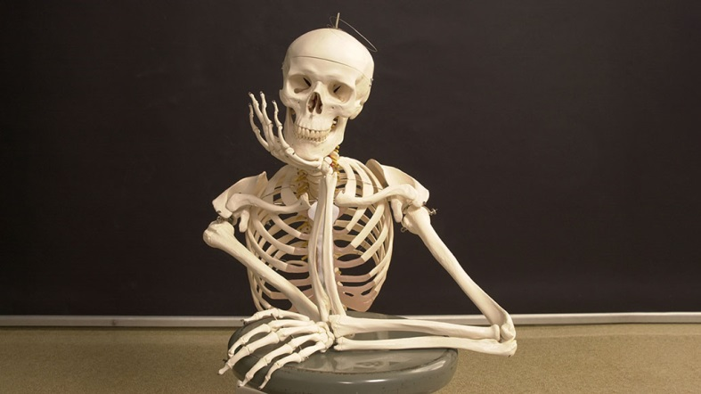
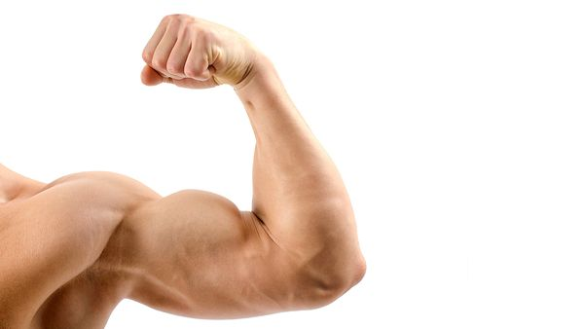
Bones vs. Muscles/Ligaments/Tendons
Fractures #
Dislocations
Osteosarcoma
Sprains
Strains
Tendonitis – plantar fasciitis
Tears – rupture
Bursitis
Infections

Slide 5
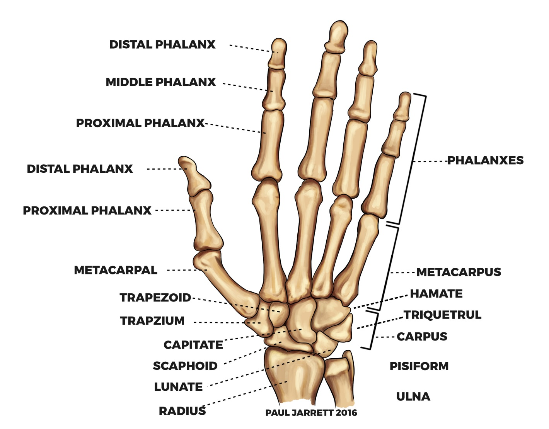
The hand & wrist

Slide 6
Common conditions in primary care
Wrist sprain
FOOSH- ?#
?Scaphoid #
Arthritis
Tendonitis
How do we know if it is a # or a sprain?
How do we know if it is tendonitis?
What could differentiate arthritis and tendonitis?

Slide 7
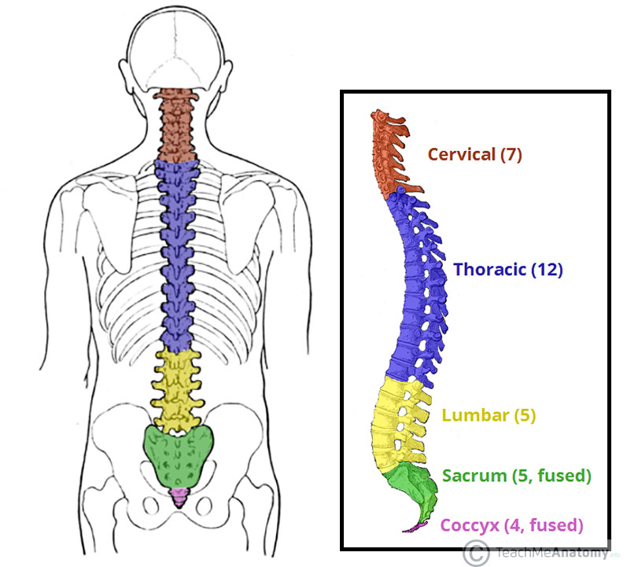
The skull and spine

Slide 8
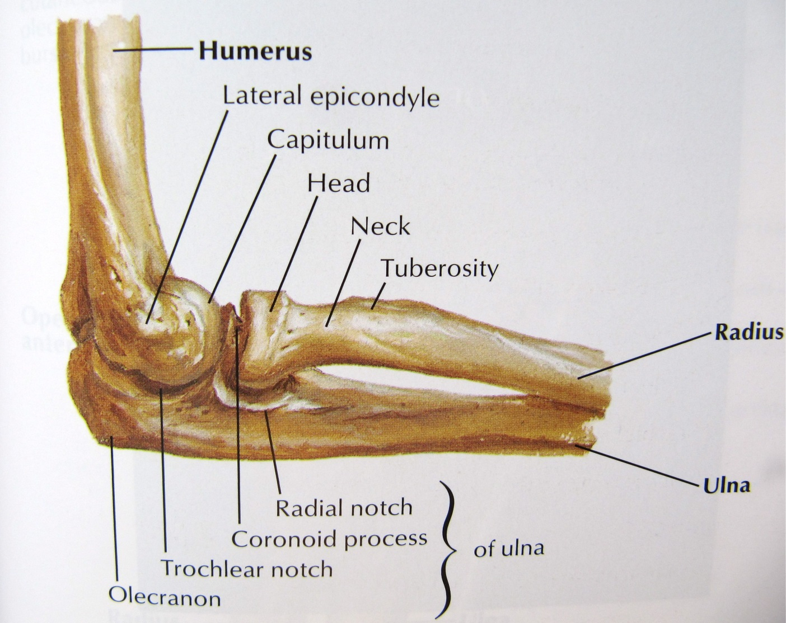
The elbow

Slide 9
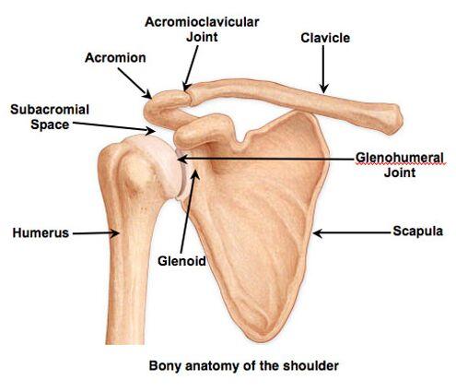
The shoulder

Slide 10
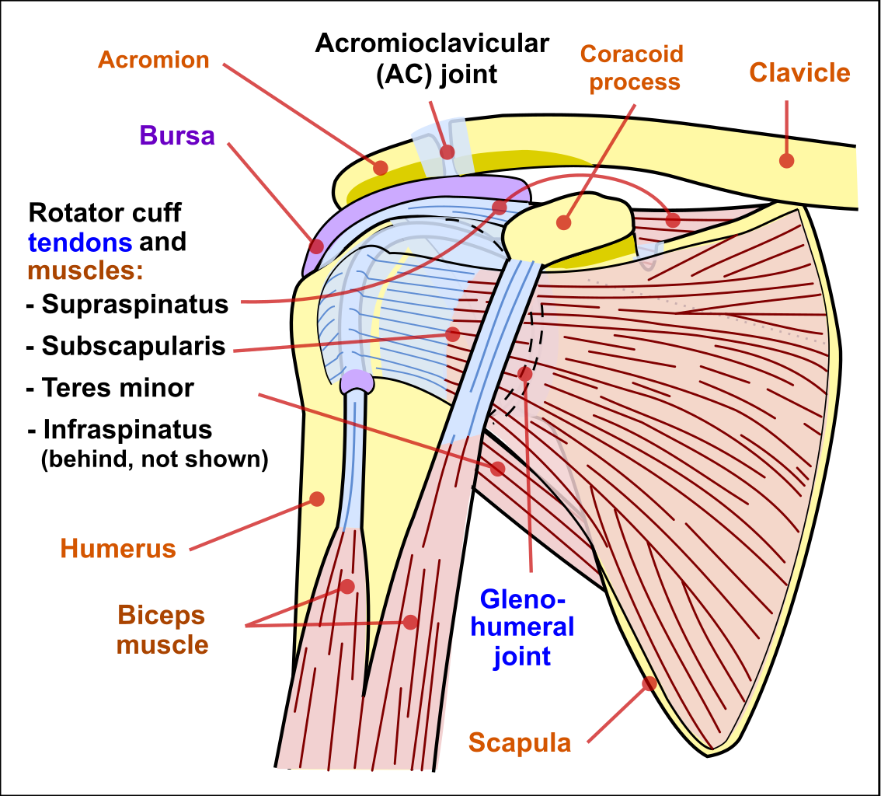
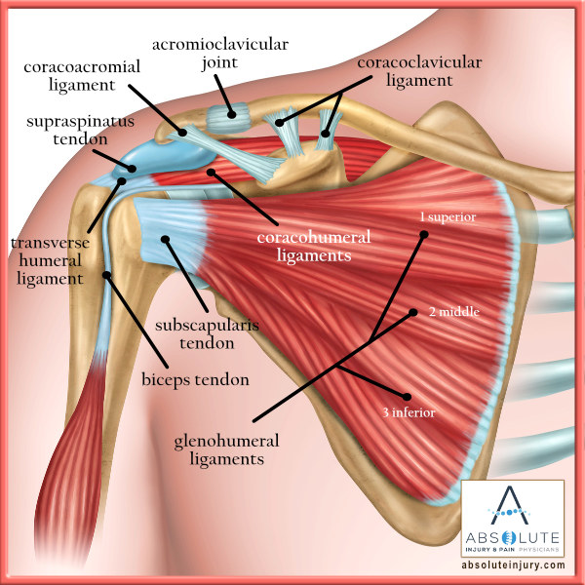
Shoulder muscles/tendons/ligaments
Ligament = bone to bone
Tendon = muscle to bone

Slide 11
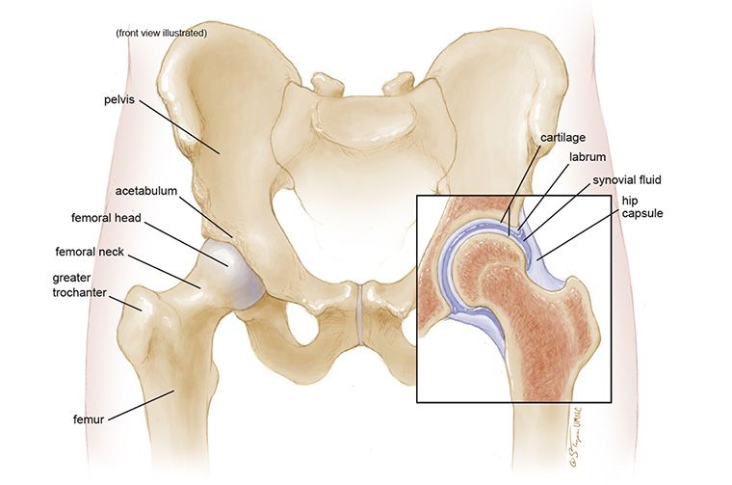
The pelvis and hip

Slide 12
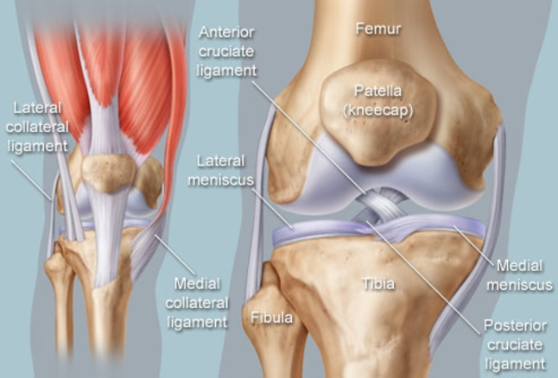
The knee

Slide 13
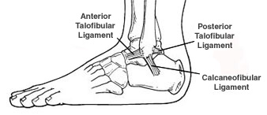
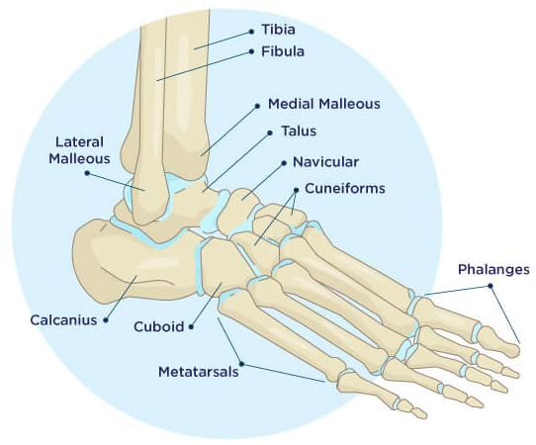
The ankle

Slide 14
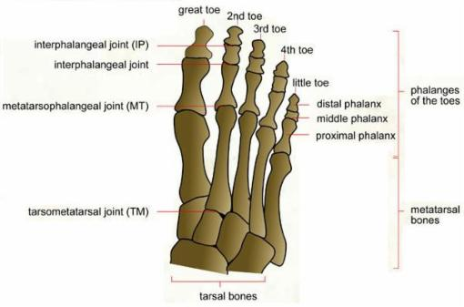
The foot

Slide 15
Take a history
Presenting complaint- SOCRATES/ Pain score
Past medical history
Medications
Allergies
Occupation
Smoking status
Alcohol
Recreational drugs
Social history- Who do they live with? Any children? Any stairs? Do they have carers?
Consider safe guarding
Why are these questions important?

Slide 16
Examinations
Look – Position of the limb/ deformity
Gait- can they weight bear
Swelling/ Bruising
Muscle wasting
Erythema (redness)
Wounds/ Scars
Symmetry

Slide 17
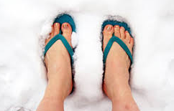
Feel
Temperature
Bony tenderness
Swelling
Crepitus (creaking/ grinding)
Pulses
Sensation
Capillary refill
Reflexes
Nerves

Slide 18
MOVE
Active Movement
Passive movement
Special tests: Knee- Anterior/posterior draw
Stress the MCL/LCL
SLR
Patella tap
Shoulder- Regimental badge sign
Supraspinatus assessment (empty the soup)!
Ankle- Simmonds test
Wrist- Kumar test
ASB tenderness

Slide 19
X-ray rules
Ottawa ankle rules
Ankle x-ray only required if there is pain in the malleolar area and any of:
Bony tenderness along the distal 6cm posterior edge of tibia or tip of medial malleolus
Bony tenderness along the distal 6cm posterior edge of fibula or tip of lateral malleolus
Unable to weight bear immediately and in ED (4 steps)
Just consider that x-rays re not just handed out but must have reasoning. Why?

Slide 20
Bloods?
When do I need to take bloods?

Slide 21
Fractures

Slide 22
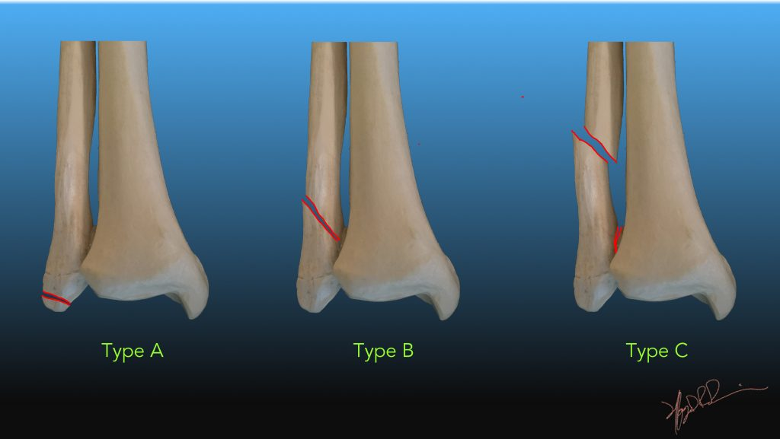
Common #- Webber #

Slide 23
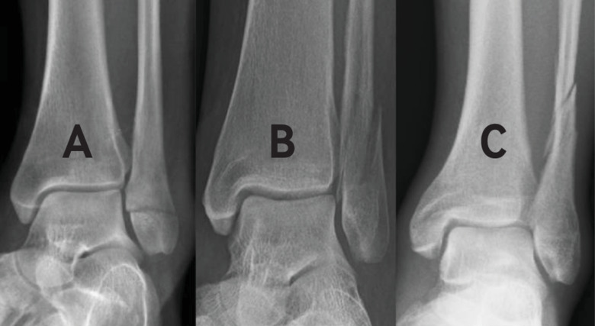
Webber on x-ray- stable and unstable #

Slide 24
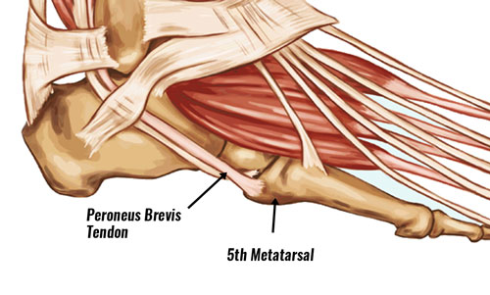
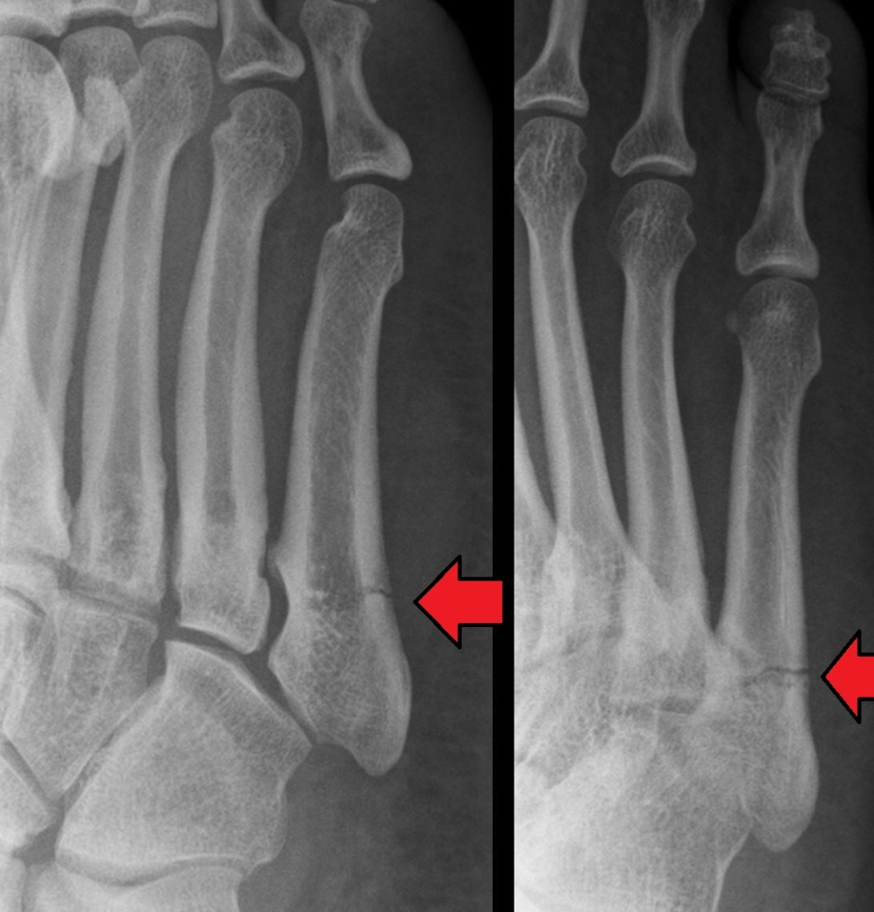
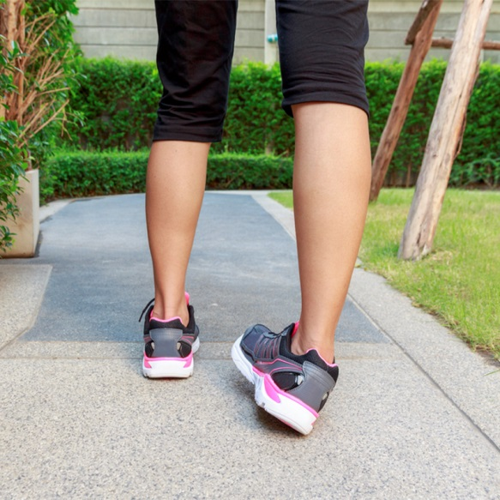
Base of 5th

Slide 25
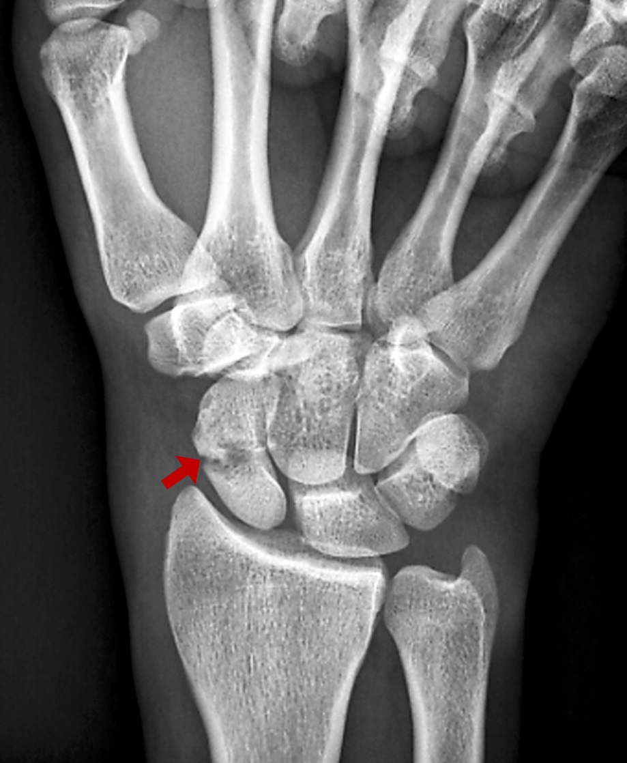
Scaphoid

Slide 26
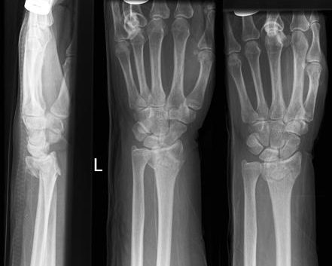
Collies
Apart from the # can you see anything wrong?

Slide 27
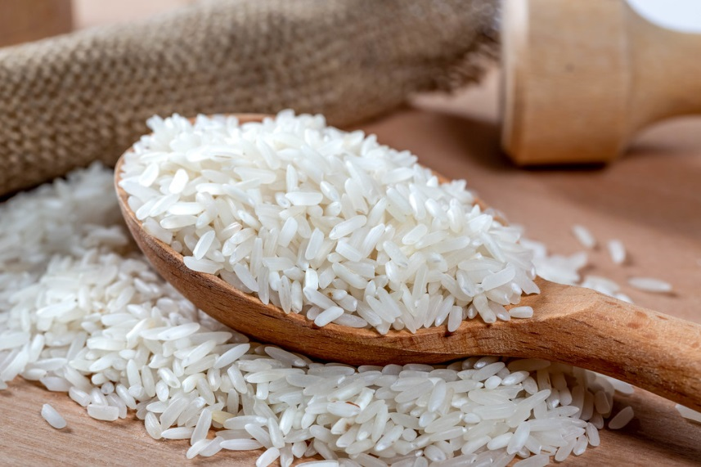
Management plans
What does worsening care advice mean?
RICE
Rest
Ice
Compression ?
Elevation
Patient information leaflet
Worsening advice

Slide 28
Wound care management plans…
What would a wound care management plan include?

Slide 29
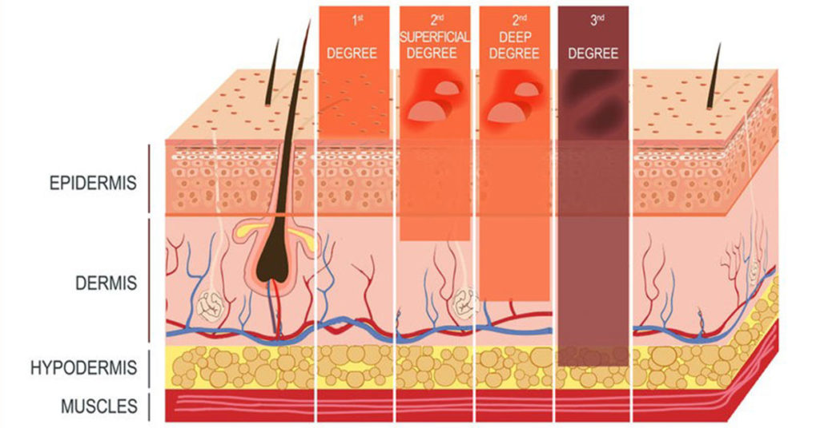
Burns
Burns referrals depend on the degree of burn, how the burn was sustained and the amount of skin affected.

Slide 30
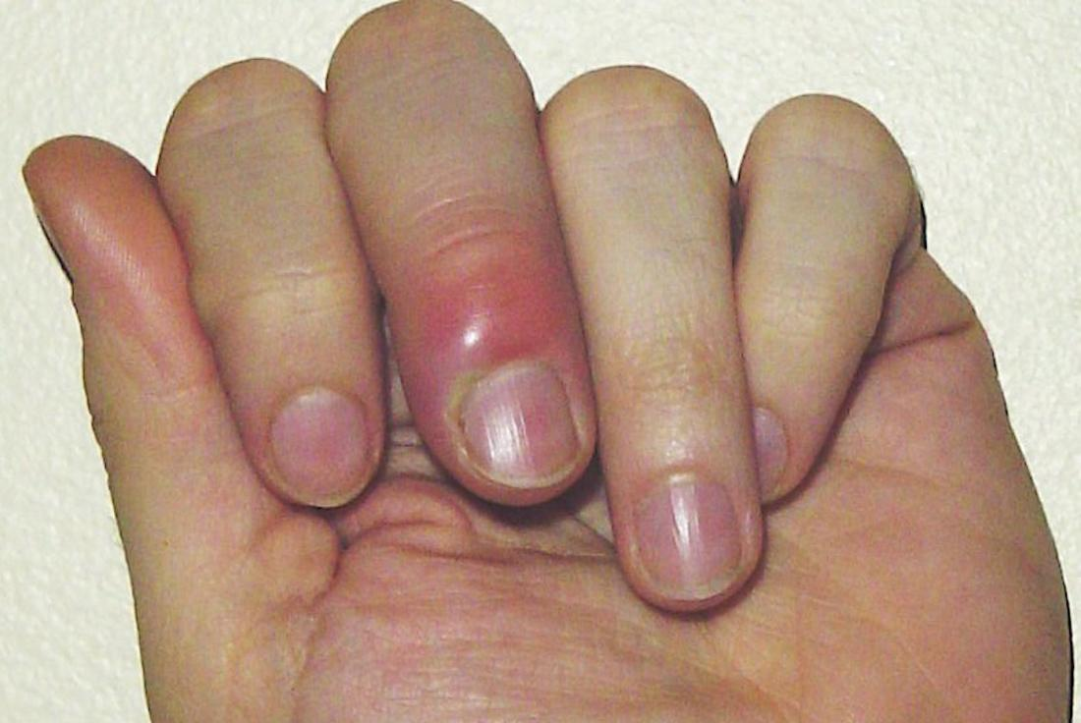
Paronychia

Slide 31
Eye concerns
Eye conditions
Chemical burns
Stye
Conjunctivitis
Blepharitis
Corneal Ulcers
Foreign body
Allergies

Slide 32
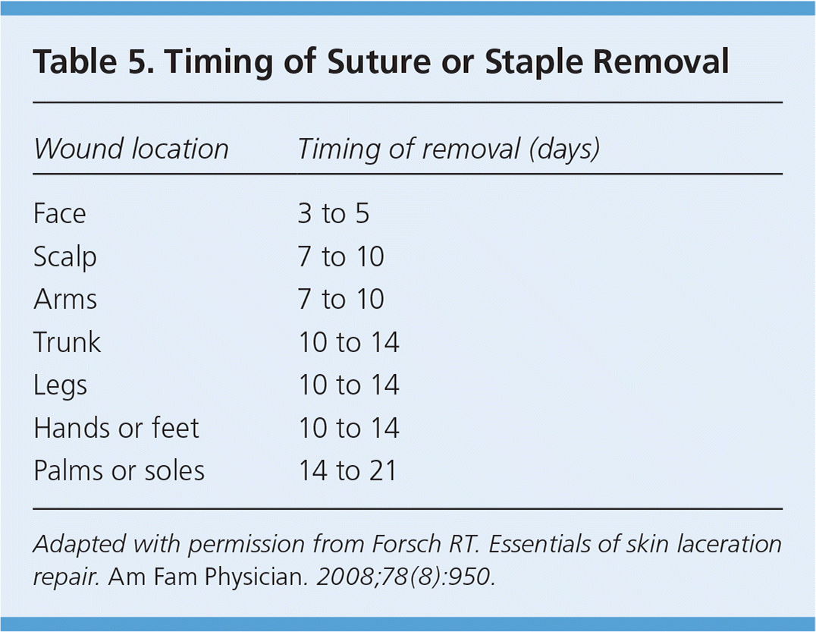
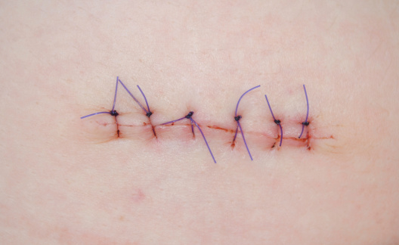
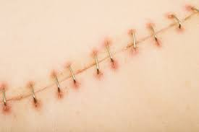
Suture removal

Slide 33
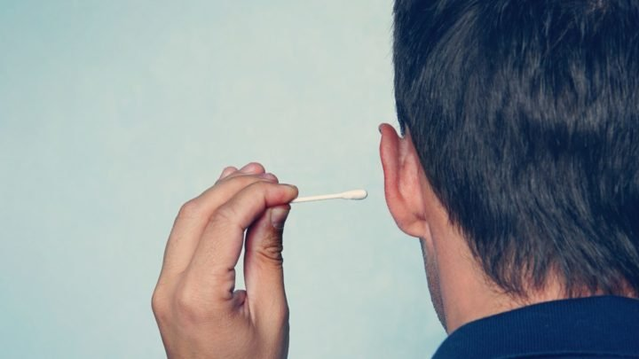
Foreign bodies

Slide 34
Follow up/ referrals
Physiotherapists
OT team
Orthopaedics
Practice nurse
TVN
Burns units
Ambulatory care
Pharmacy

Slide 35
Scenario
Patient A attends the GP surgery with wrist pain after she was playing tennis last week- she has no bony tenderness but is demanding an X-ray. She has done no self care- what would you do?
Patient B attends the GP with an abrasion after falling from his bike- how would we treat and dress this wound? Would we want to check anything else?

Slide 36
Any Questions?

Slide 37
Thank you!

