Slide 1
An introduction to history taking
Suzie Martin

Slide 2
Lesson Objectives
To be able to explain why consent is important and how we gain informed consent.
To be able to summarise the stages of history taking.
To be able to identify pneumonic tools used in history taking and illustrate how they are used.

Slide 3
Introduction
What is a patient history?
Information gathering surrounding the patient.
Communication between the clinician and the patient.
Can take place over the phone/face to face/ online by video chat.
Why is it important?
This builds the foundations to your investigations and gives clues to direct you through your consultation.
The better the history the more thorough the consultation and so the better outcome for the patient.
Bickley, Lynn S. (2016). Bates' guide to physical examination and history taking. Philadelphia :Lippincott Williams & Wilkins,

Slide 4
Consent
Consent for medical treatment is when a person gives permission before they receive any type of medical examination, test or treatment.
Types of consent
Informed
Implied
Written

Slide 5
How do we gain informed consent?
To gain informed consent a patient must have a full understanding of the proposed procedure.
Acceptations
A patient who is deemed to lack mental capacity will have a nominated person to consent on their behalf
Children usually have parental consent unless deemed as Gillick competent under the age of 16 years.
https://learning.nspcc.org.uk/child-protection-system/gillick-competence-fraser-guidelines

Slide 6
The environment of the interview
No distractions
Maintaining dignity and respect
Quiet area
Maintain confidentiality

Slide 7
SO…
Before we conduct our history taking, we must gain informed consent to ask these specific personal questions.
For example- Hello my name is Suzie, I am one of the nurses looking after you today. For me to continue I am going to need to take a history. This involves questions on health and social aspects of your life so we can conclude a treatment and management plan for you.
Is that okay? Do you have any questions?
Are you happy for me to continue?

Slide 8
The structure of history taking
Patient History
Presenting complaint
Past medial history
Medications
Allergies
Sexual history
Social History
Surgical History

Slide 9
PC
Presenting complaint-
Open the consultation- introduce yourself.
What can I help you with today?
I understand you’ve been having trouble with some back pain- could you tell me about it?

Slide 10
PNEUMONICS
SOCRATESU
OPQRSTU
OPHRA

Slide 11
SOCRATESU
S- Site – Where is the pain?
O- Onset- When did it start- what happened?
C- Character- Stabbing, burning, ache?
R- Radiation – Does the pain move?
A- Alleviating factors- What helps?
T- Timing – Does the pain come in the morning/ evening?
E- Exacerbations – What makes it worse?
S- Severity- pain score 1/10
U- What do you think it is?

Slide 12
OPQRSTU
O- Onset- when did it start?
P- Provokes- What makes it worse?
Q- Quality- Is it stabbing, burning or an ache?
R- Radiates- Does it move?
S- Severity- pain score x/10
T- Time – Does the pain come in the morning/evening
U- What do you think it is?

Slide 13
OPHRA
O- OTC- Over the counter medication
P- Prescribed medications
H- Herbal medications
R- Recreational drugs
A- ALLERGIES

Slide 14
PMHX
Past medical History.
Try to keep it relevant
Explain your question- Instead of: Do you have any past medical history?
You could say: Do you have any medical conditions a doctor has diagnosed you with or anything you regularly see the GP for?
- From experience people often say no…. Then when you ask about medications they have a huge list!

Slide 15
M/S
Medication
Surgical history

Slide 16
Medication
Allergies

Slide 17
FHX
Any Family history

Slide 18
SHX
Social History-
Occupation
Do they live in a house or 6th floor flat/ is there a lift/ stairs may be a challenge?
Do they live with anyone?
Are they a carer?
Do they have dependents?- ?Safeguarding?
Next of kin

Slide 19
Social History continued
Alcohol
Smoking
Diet
Exercise
Recreational drugs

Slide 20
SEXHX
Is this appropriate to the consultation?
LMP- Last menstrual period
Last unprotected sexual intercourse
Use of contraception
Sexually transmitted infection risk

Slide 21
Summary
PC- Why are they here?
PMHX- Previously diagnosed conditions?
M/S- Medications, Allergies, Surgeries
FHS- Diagnosed conditions in family members?
SHX- Lifestyle questions.
SexHX- Sexual history if appropriate
Is there anything else you’d like to tell me?

Slide 22
Glossary of terms
PC- Presenting complaint
PMHX- Past medical history
M/S- Medications and surgeries
FHX- Family history
SHX- Social history
SEXHX- Sexual history

Slide 23
Useful links
https://jmedicalcasereports.biomedcentral.com/articles/10.1186/s13256-015-0559-y
https://journals.rcni.com/nursing-standard/taking-a-patient-history-the-role-of-the-nurse-ns2012.02.26.24.41.c8946
https://www.youtube.com/watch?v=4wfjSfoHwl4

Slide 24
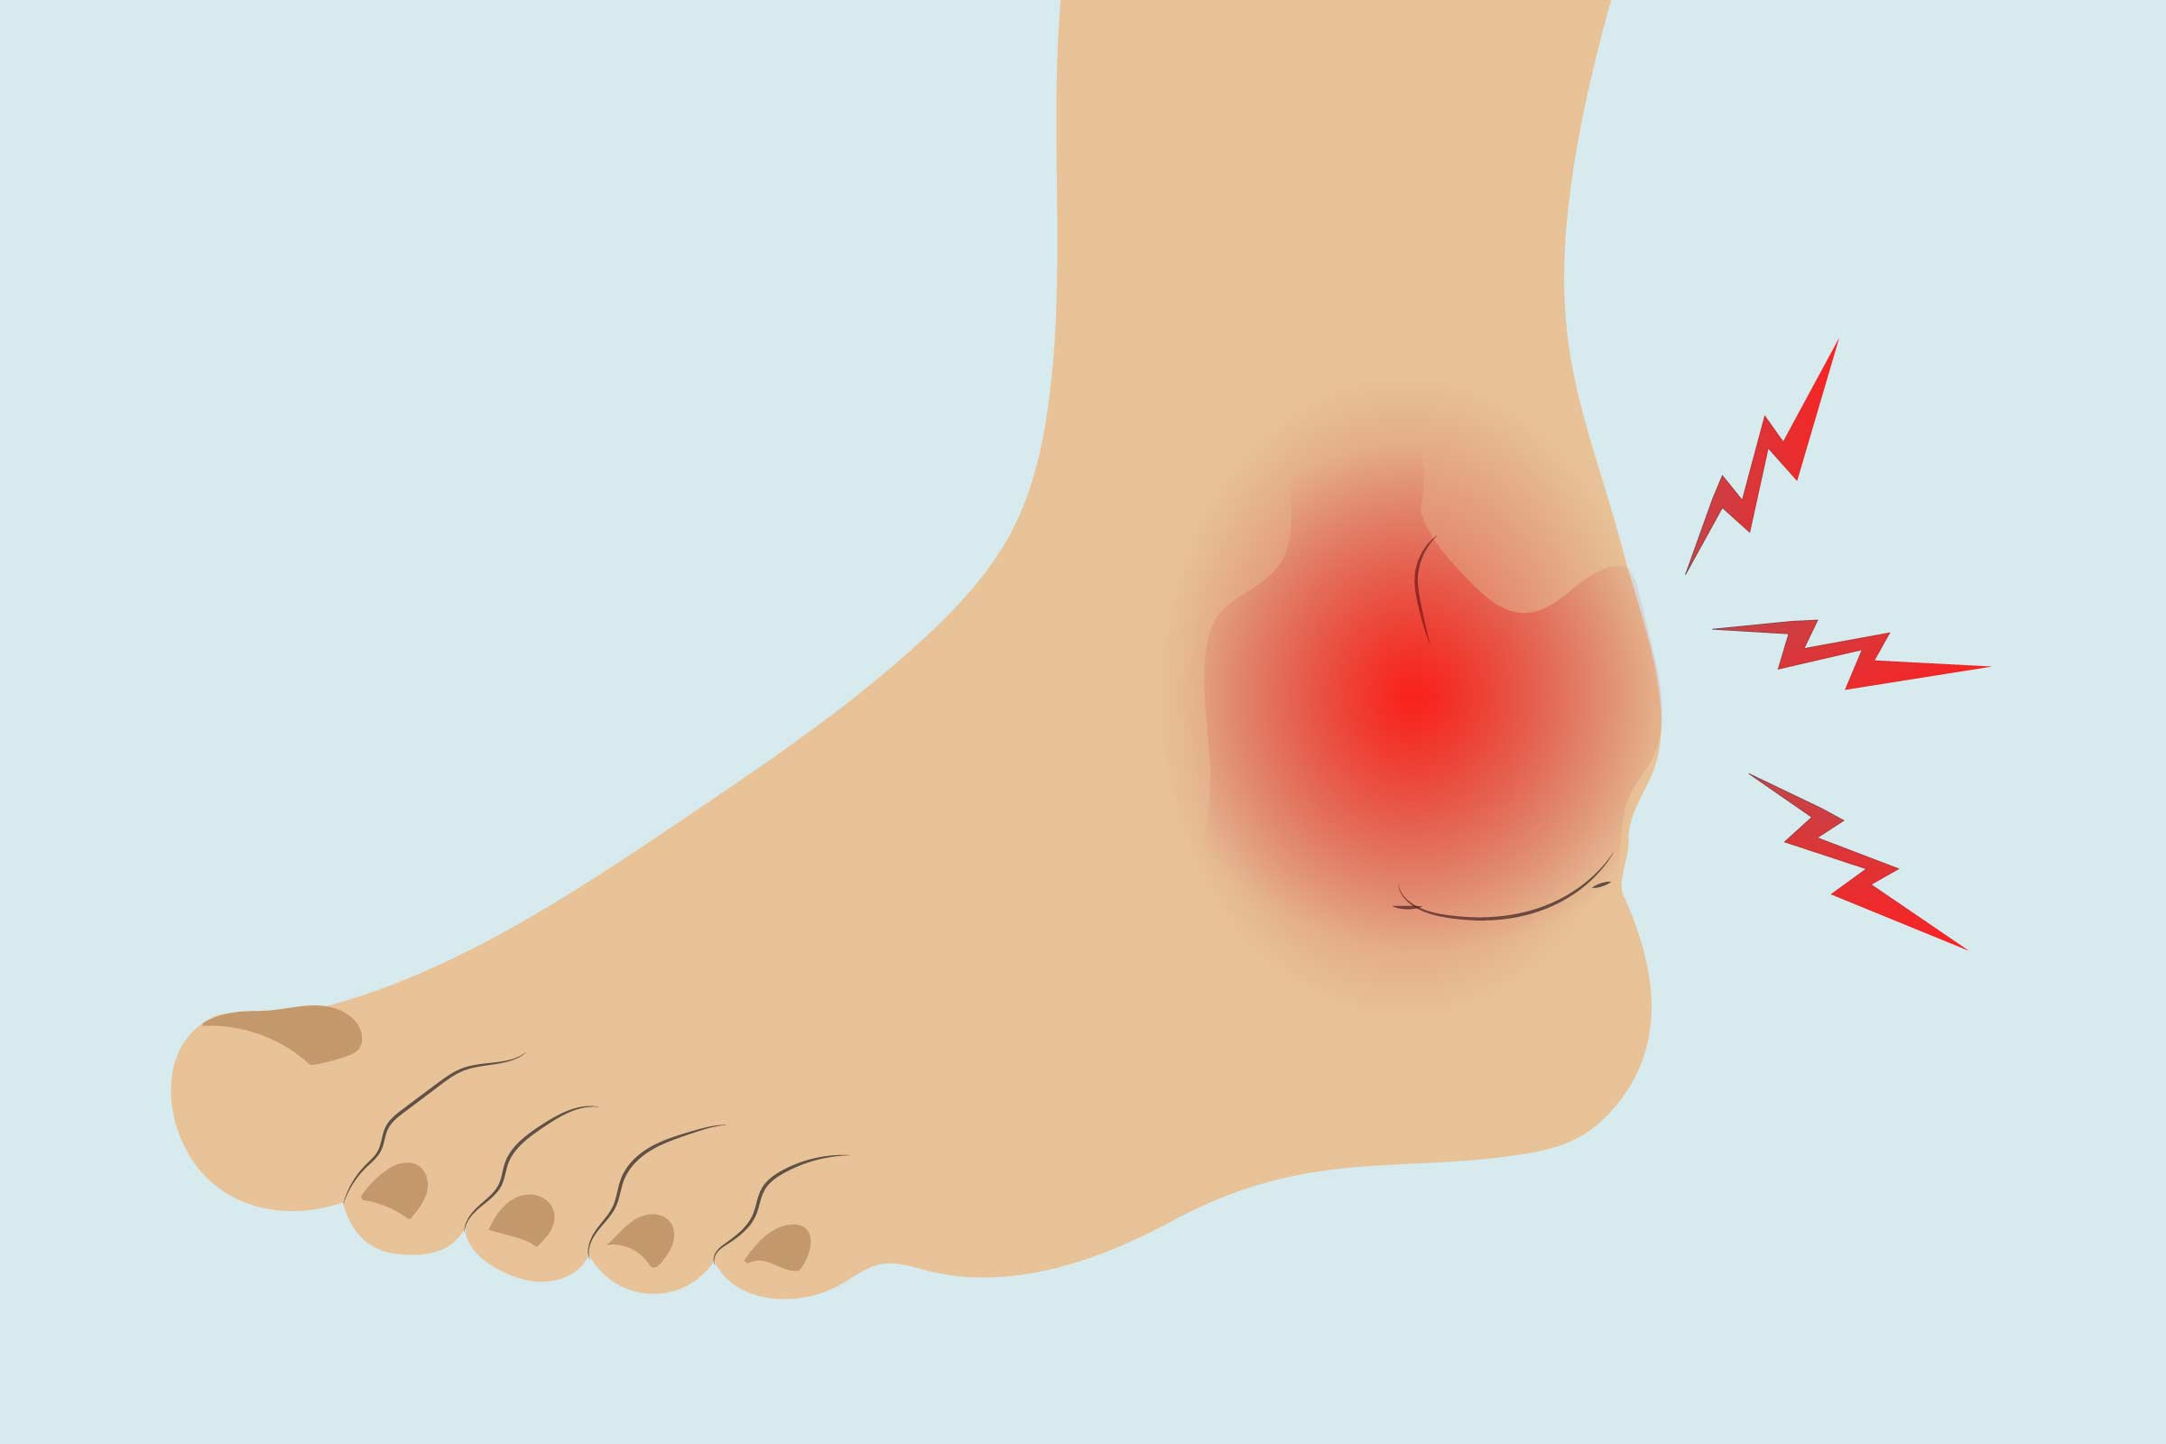
Scenario
Patient X attends the urgent treatment center with a painful ankle-
What do we need to ask for before taking the history?
Let's run through the history taking questions…
Which pneumonic tools might we use?

Slide 25
Questions

