Slide 1
Contraception, sexual health and woman’s health.
AHP603 General Practice Nursing 2021

Slide 2
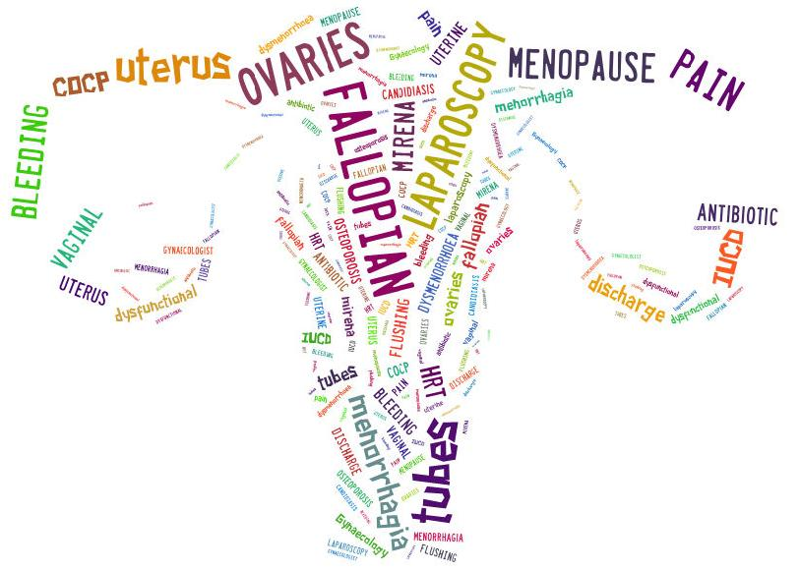
Recap on anatomy

Slide 3
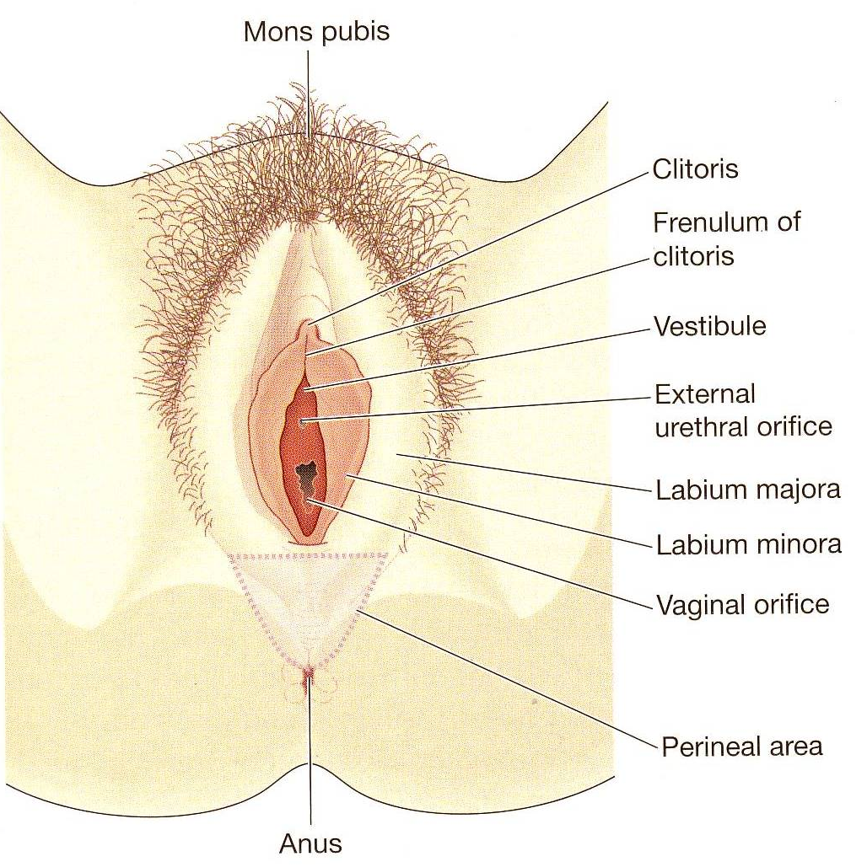
Female External Genitalia- vulva
Mons pubis-adipose tissue
Labia surround and protect
the vaginal opening
Perineum-vaginal opening
and the anus
Clitoris –erectile tissue and
nerves
Vestibule-urethral & vaginal
openings and the hymen

Slide 4
Side View
Urethra leads to the bladder and allows passage of urine
Vagina -passage of menstrual flow
receptacle for the penis during sexual intercourse
Just inside the lower vagina –Bartholin glands

Slide 5
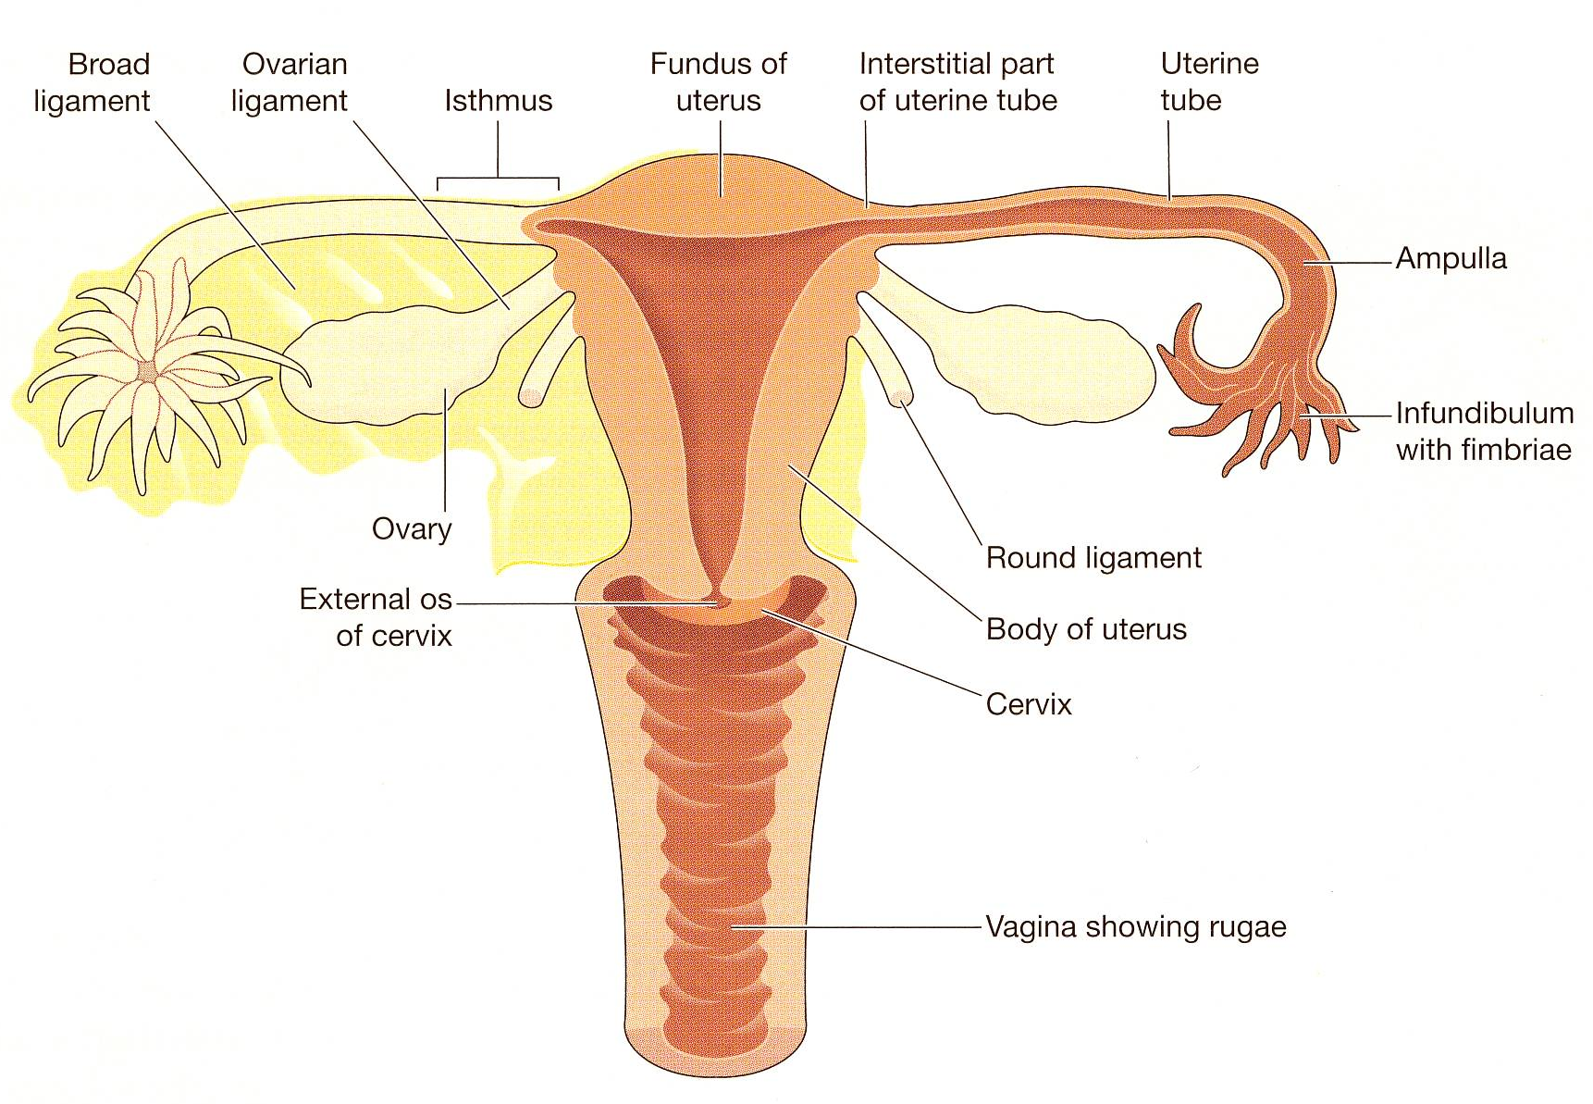
Front view

Slide 6
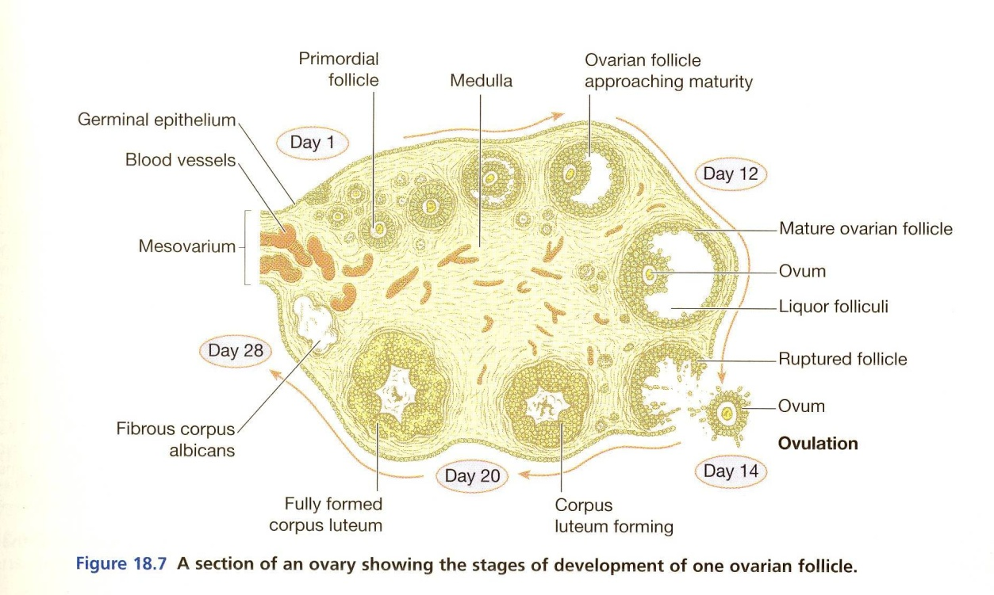
The Ovaries
Responsible for periodic release of gametes(eggs, oocytes) and production of estradiol and progesterone
Integrated in continuous,
repetitive process of follicle
maturation, ovulation and
corpus luteum formation
and regression
Notes:
Late 30s ,smaller oocytes and smaller follicles
Rise in FSH,decrease in inhibin B

Slide 7
The Cervix
Squamous epithelium
Crypt openings
Squamo-columnar junction
Everted Columnar epithelium
Transformation zone
Notes:
Normal multiparous cervix
1 Squamous epithelium 3 Squamo-columnar junction
4 Everted columnar epithelium 5 Transformation zone
6 Crypt openings in transformation zone

Slide 8
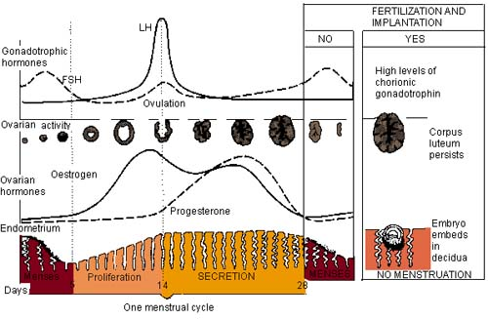
The menstrual cycle (12 mins)
https://www.youtube.com/watch?v=3Lt9I5LrWZw

Slide 9
Recap
The hypothalamus secretes Gonadotropin-releasing hormone which stimulates the pituitary gland to release LH and FSH.
LH and FSH stimulates the production of oestrogen.
Oestrogen – builds up the lining of the uterus and inhibits FSH.
LH also triggers ovulation, and the egg is released.
The remains of the follicle the egg is released from ‘dies’ (called the corpus lithium) and that releases progesterone.
Progesterone stops LH production.

Slide 10
If the egg implants…
The ovary keeps on producing progesterone and the body goes through pregnancy changes.

Slide 11
If the egg doesn’t implant
Progesterone and oestrogen levels fall and the lining of the uterus sheds.
A cycle is approximately 28 days long.
The fall in progesterone and oestrogen triggers the pituitary gland to start producing Gonadotropin-releasing hormone which starts the cycle again…

Slide 12
History taking
Questions we may ask patients relating to gynae history?

Slide 13
Gynaecological history
Risk of pregnancy
Date of last menstrual period – was it 'normal‘
Was it late or lighter than normal
Regularity and cycle length
Risk of current pregnancy – e.g. unprotected intercourse, forgotten pills, gastroenteritis and on contraceptive pills, recently taken Emergency contraception (EC)
Any breast tenderness,nausea and vomiting, urinary frequency or weight gain

Slide 14
Gynaecological history
Vaginal bleeding
Any abnormal bleeding - prolonged versus recent change?
Amount, colour, any clots
Any signs of shock
Associated symptoms, e.g. abdominal pain, fever, vaginal discharge, dyspareunia,
Factors that aggravate bleeding, e.g. exercise, intercourse
Any history of gynaecological problems

Slide 15
Gynaecological history
Vaginal bleeding
Any abnormal bleeding - prolonged versus recent change?
Amount, colour, any clots
Any signs of shock
Associated symptoms, e.g. abdominal pain, fever, vaginal discharge, dyspareunia,
Factors that aggravate bleeding, e.g. exercise, intercourse
Any history of gynaecological problems

Slide 16
Dysmenorrhea causes
Endometriosis
PID
Fibroids
Adhesions
Dyspareunia (painful intercourse)
PCOS
Copper coil

Slide 17
Primary dysmenorrhoea
no pelvic pathology
begins with the onset of ovulatory cycles six months to one year after the menarche
pain begins with the onset of the period and may last for 24-72 hours.
What non pharmacological treatments could be suggested?

Slide 18
Pharmacological
NSAIDs - inhibition of prostaglandin synthesis.
Ibuprofen is most often used due to its low incidence of side-effects.
Combined hormonal contraception
Desogestrel 75 micrograms
Depo-Provera
LNG-IUS; Mirena

Slide 19
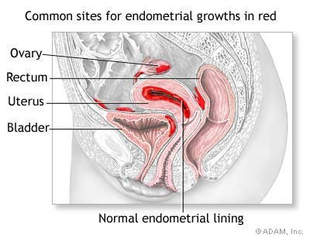
Endometriosis
Chronic oestrogen-dependent condition

Slide 20
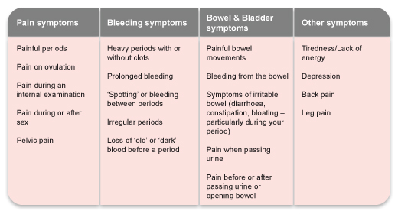

Slide 21
Endometriosis
10-15% of women of reproductive age
25%-40% in infertile women
Diagnosis usually in 30s
Genetic factors
Risk for 1st degree relatives x 6
Multiparity & oral
contraceptives-protective

Slide 22
Management
Surgical
Medical
Laparoscopy-ablation or excision
Drainage of cysts
Should relieve dyspareunia and dysmenorrhoea
May improve fertility in more serious disease
Contraceptive pill
Gonadotrophin-releasing hormone analogues
Levonorgestrel-releasing intrauterine device

Slide 23
Vaginal bleeding
Postcoital bleeding (PCB) - non-menstrual bleeding
Intermenstrual bleeding (IMB) - vaginal bleeding (other than PCB ) at any time during the menstrual cycle other than during normal menstruation
Breakthrough bleeding - irregular bleeding associated with hormonal contraception.

Slide 24
Postcoital bleeding
Infection.
Cervical ectropion - especially in those women taking the combined oral contraceptive pill COCP
Cervical or endometrial polyps
Vaginal cancer
Cervical cancer - usually apparent on speculum examination.
Trauma.

Slide 25
Postcoital bleeding

Slide 26
Intermenstrual bleeding
Pregnancy-related ectopic pregnancy gestational trophoblastic disease.
Physiological
1-2% spot around ovulation.
Hormonal fluctuation during the perimenopause

Slide 27
Intermenstrual bleeding
Vaginal causes
Adenosis.
Vaginitis (bleeding uncommon before the menopause).
Tumours.

Slide 28
Intermenstrual bleeding
Cervical causes
Infection - chlamydia, gonorrhoea.
Cancer (but bleeding is most often postcoital).
Cervical polyps.
Cervical ectropion.
Condylomata acuminata of the cervix

Slide 29
Intermenstrual bleeding
Uterine causes
Fibroids
Endometrial polyps
Cancer- endometrial adenocarcinoma, adenosarcoma and leiomyosarcoma
Adenomyosis (invasion of the myometrium by endometrial tissue)
Endometritis.

Slide 30
Breakthrough bleeding
New contraceptive method
Often settles without intervention
More common with progestogen-only methods
Smoking

Slide 31
Urgent referral.
Abnormal-looking cervix
Cervical polyp not easily removed in primary care
Pelvic mass
High risk of endometrial cancer- family history
Prolonged and irregular cycle
Taking Tamoxifen.
Women aged over 45 years with IMB
Women aged under 45 years with persistent symptoms or risk factors for endometrial cancer.

Slide 32
Abdominal pain
Women many of the same conditions that men have
Numerous gynaecological causes

Slide 33
Menorrhagia
menstrual blood loss interferes with a woman's physical, emotional, social and quality of life
can occur alone or in combination with other symptoms
33% of women
greater than 80 mls of blood loss per cycle.
1 in 20 women aged 30 to 49 years consult their GP
£7 million is spent in the UK in primary care.
2nd most common gynaecological condition to be referred to hospital

Slide 34
Treatment
First-line treatment This is the levonorgestrel-releasing intrauterine system (IUS) - Mirena®
Second-line treatment
Mefenamic acid inhibits prostaglandin synthesis
Tranexamic acid inhibits the dissolution of thrombosis that leads to menstrual flow
NSAIDs S/E - nausea, vomiting and diarrhoea
CHC
Third-line treatment
Norethisterone-
This can result in a significant reduction in menstrual blood loss

Slide 35
Gynaecological conditions
3 Life threatening-
Ectopic pregnancy
Ruptured ovarian cyst
Tubo- ovarian abscess
All have similar symptoms-virtually impossible to definitely diagnose in the pre-hospital environment
pre-hospital management same for all

Slide 36
Ectopic pregnancy
Ectopic-from the Greek “ektopis”-displacement
Extrauterine pregnancy
11.1 per 1000 pregnancies
Maternal deaths-3-4 each year-UK
Movement of fertilised egg is blocked or slowed through fallopian tube
Trophoblast can implant on any tissue-adequate blood supply

Slide 37
Aetiology
Often unknown
Pelvic Inflammatory Disease (PID)
Pelvic surgery
Fibriods,tumours or cysts
IUDs
Tubal damage
Assisted conceptions
Usually present from 5th-9th week of pregnancy

Slide 38
Symptoms and Signs
Amenorrhoea
Pain-lower abdomen-”stabbing “or “cramp-like”
Maybe referred to the shoulder
Vaginal bleeding-75% of cases
Fainting/collapse
Abdominal tenderness- elicited on the left, right or across the lower abdomen
Pelvic Tenderness-
Adnexal Mass

Slide 39
Diagnosis
Serum pregnancy test
Urinary pregnancy test
Transvaginal Ultrasound
absence of gestational sac within the uterine cavity
Presence of gestational sac outside the uterus
Demonstration of a live embryo with fetal heart activity outside the uterus
Free fluid or blood in the adjacent parts of the pelvis

Slide 40
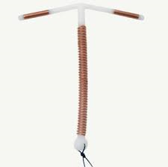
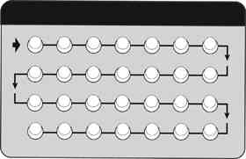
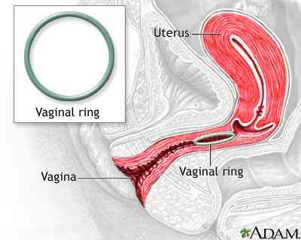
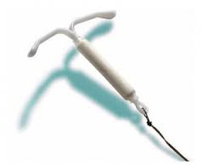
Contraception
LARCs
Short acting

Slide 41
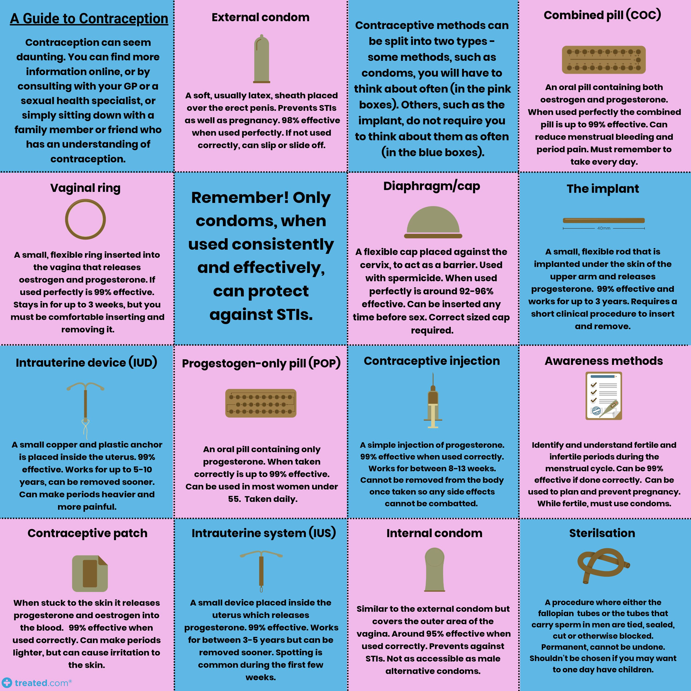

Slide 42
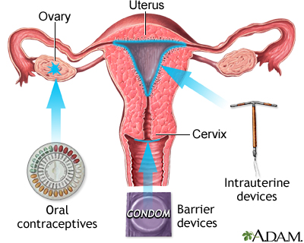

Slide 43
Fertility Awareness
The sympto-thermal method-most effective.
Temperature.
Cervical mucus.
Cervix
Calendar.
www.fertilityuk.org.
www.fertilityet.org.uk.

Slide 44
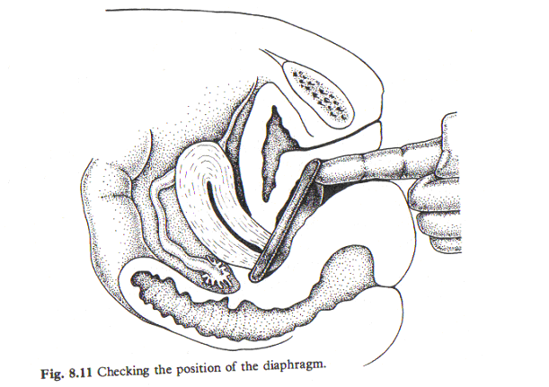
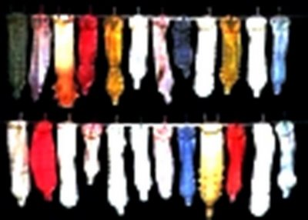
Barrier methods

Slide 45
Mirena IUS
Contains 52mg levonorgestrel
Released at 20 mcg per day
Cervical mucus changes
Changes in utero-tubal fluid impairs sperm migration
Endometrial changes
5 years / licensed for treatment of menorrhagia
Benefits include improving PMS and
dysmenorrhoea
May cause irregular bleeding initially
NHS price for Mirena £88

Slide 46
Intrauterine Device
Small copper & plastic device inserted through the cervix
positioned in the uterine cavity
The number of the device indicates the amount of copper in square mms e.g. CU 380 A
Polymer threads protrude through cervix for ‘checking’ and removal
Use as long as needed 40 +
Prevents fertilisation/implantation
T-Safe Cu 380 (£8.95) or TT 380 Slimline
Radio opaque

Slide 47
Other IUS
Jaydess®LNG-IUS
Kyleena
13.5mg levonorgestrel
May be easier to insert
Less pain at insertion ?
It has a distinctive silver ring at the top of the stem
Licensed only as a contraceptive device
NHS price £69.22
19.5mg levonorgestrel
Released at 17.5 mcg per day
Cervical mucus changes
Changes in utero-tubal fluid impairs sperm migration
Endometrial changes
5 years
silver ring
Blue removal threads

Slide 48
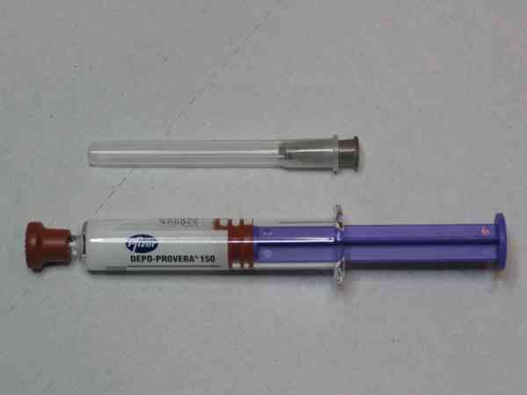
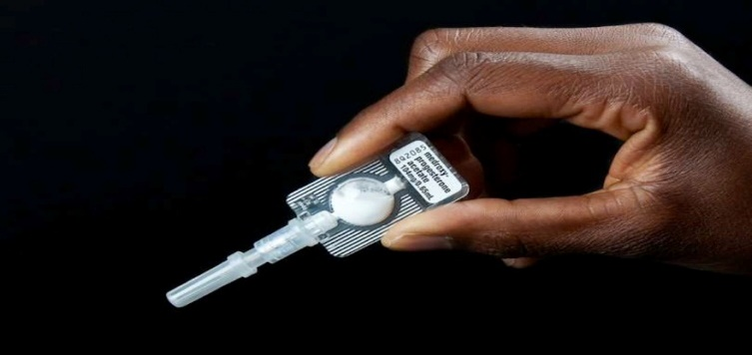
Progestogen-only injectables
Causes anovulation
Depo-Provera 150 mg-13/52
Advise- weight gain, fertility delay possible irregular bleeding or amenorrhoea
Subcutaneous Depot Medroxyprogesterone Acetate
104mg in 0.65ml suspension
Administered at intervals of 13/52

Slide 49
Nexplanon
68mg etonogestrel
3 years
Inhibits ovulation by suppressing LH surge
Thickens cervical mucus
The release rate decreases -
60–70 μg/day initially
25–30 μg/day at the end of the third year
To return if-
Unable to feel implant
Change in skin round implant site
Pain
Pregnancy
Develop any condition that would contraindicate use

Slide 50
Progesterone only pills
Taken daily
Same time
No pill-free interval
75ug desogestrel 75 μg
Cerezette, Cerelle,

Slide 51
Starting POP
The CEU supports starting the POP at any time during a woman’s menstrual cycle providing a woman is not pregnant or at risk of pregnancy. Where pregnancy cannot be excluded, for example, following use of EC, the CEU supports starting the POP in certain circumstances, for example, if the woman is likely to continue to be at risk of pregnancy or unlikely to return. More detailed guidance is available in the FSRH guidance on Quick Starting Contraception.20
Women can start the POP up to Day 5 of the menstrual cycle without the need for additional contraceptive precautions; thereafter 48 hours of additional precautions are required. When quick starting POP following a risk of pregnancy, a pregnancy test is advised no sooner than 3 weeks after the most recent episode of unprotected sexual intercourse (UPSI). When starting after either Day 5 of the menstrual cycle, Day 5 post-abortion, or Day 21 postpartum, consideration of EC and a pregnancy test ≥3 weeks after the most recent episode of UPSI may be required if there has been a risk of pregnancy.

Slide 52
Combined Pill- 3 modes of action
1-The hypothalamic-pituitary-ovarian axis
Suppress synthesis and secretion of FSH
Suppress the mid-cycle surge of LH
Inhibits the development of follicles/ovulation
2 Prevents changes in the endometrium
3 Thickens cervical mucus

Slide 54
Risks Concerns
Obesity
Smoking
Thrombophilia
Previous VTE
Migraines with aura
Chronic diseases
Enzyme inducing drugs
Reducing other medication
Cardiovascular: Arterial or venous
Venous thromboembolism (DVT,PE)
Myocardial infarction
Stroke
Hypertension

Slide 55
FSRH combined hormonal contraception communication 2014, MHRA 2014 | Risk of VTE per 10,000 women over one year
Non contraceptive users and not pregnant | 2
CHC containing ethinylestradiol plus levonorgestrel, norgestimate or norethisterone | 5-7
CHC containing etonogestrel (ring) or norelgestromin (patch) | 6-12
CHC containing ethinylestradiol plus gestodene, desogestrel or drospirenone | 9-12
In pregnancy | 29
Immediate postpartum period | 300-400

Slide 56
UKMEC
Risk factors
Document

Slide 57
Tailored regimens (2019)
Type of regimen | Period of CHC use | HFI
Shortened hormone free interval (HFI) | 21 days (21 active pills or 1 ring or 3 patches) | 4 days
Extended use (tricycling) | 9 weeks (3 x 21 active pills or 3 rings or 9 patches) | 4 or 7 days
Flexible extended use | Continuous use (21days) active pills or 3 rings or 9 patches until breakthrough bleeding occurs for 3–4 days | 4 days
Continuous use | Continuous use of active pills or rings or patches | none

Slide 59
Missed COC
https://www.google.com/url?sa=t&rct=j&q=&esrc=s&source=web&cd=&ved=2ahUKEwjBiZjTn_HuAhUQiFwKHaJUCxYQFjACegQIAxAC&url=https%3A%2F%2Fwww.fsrh.org%2Fdocuments%2Ffsrh-ceu-guidance-recommended-actions-after-incorrect-use-of%2Ffsrh-guidance-recommended-actions-after-incorrect-use-of-chc-march-2020.pdf&usg=AOvVaw2PPFcXWmzcfCC_oFsAO1D2

Slide 60
Who should be offered EC
Any woman who does not want to conceive if:
Any UPSI on any day of a natural cycle
UPSI from day 21 after childbirth (unless conditions for Lactational Amenorrhoea are met)
UPSI from day 5 after abortion, ectopic pregnancy
Any woman whose regular contraception has been compromised or used incorrectly.

Slide 61
EC methods

Slide 64
Management of EC
Soon as possible after UPSI
Assess LMP, calculate no. of hours since UPSI, any medications, relevant medical history, sexual history
Used before to assess any side effects
Explain how to take (can take it then and there)
Fraser guidelines for under 16s
Give written information and list of clinics to go if problems

Slide 65
Which methods should be offered
Cu-IUD should be offered to all women
It can be inserted up to 5 days after the first UPSI in a natural menstrual cycle, or up to 5 days after the earliest likely date of ovulation

Slide 66
Hormonal EC
Levonorgestrel
Ulipristal acetate
Inhibit ovulation
Only if given before luteinising hormone surge
Not effective after fertilisation
Inhibit ovulation
Suppresses lead follicles when given just before ovulation including during the LH surge
More effective-because risk of pregnancy is highest in the 2 days leading up to ovulation
? Effect after ovulation

Slide 67
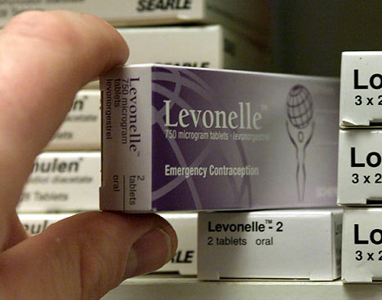
Emergency contraception-hormonal
Levonorgestrel
Ulipristal acetate
progesterone 1.5mg,licensed up to 3 days (72 hours)
a progesterone receptor modulator
30mg, is licensed up to 5 days (120 hours)

Slide 68
Hormonal EC
Levonorgestrel
Can quick start hormonal contraception
Within 24 hours of intercourse- 95% effective.
25-48 hours-85%
48-72 hours 58%
Effectiveness reduced if a woman has a BMI >25 kg/m2 or weight >70 kg
Ulipristal acetate
Cautions- severe asthma
No breastfeeding for 7 days
No quick starting contraception

Slide 69
EC
After taking LNG- start hormonal contraception immediately use condoms /abstain from sex until contraception becomes effective
Waiting 5 days after taking UPA before starting hormonal contraception use condoms/ abstain during 5 days waiting and then until their contraceptive method is effective
Can take UPA or LNG if UPSI earlier cycle as well as within the last 5 days
Do not disrupt an existing pregnancy/ associated with foetal abnormality
IUD -contraception

Slide 70
EC
Pregnancy test if UPSI earlier in the cycle
STI risk assessment - window periods
Antibiotic cover may be considered for Cu-IUD insertion
FSRH CEU guidance March 2017
Full guidance and algorithms available at:
http://www.fsrh.org/standards-and-guidance/current-clinical-guidance/emergency-contraception

Slide 71
Ruling out pregnancy
Healthcare practitioners can be reasonably certain that a woman is not currently pregnant if any one or more of the following criteria are met and there are no symptoms or signs of pregnancy:
► She has not had intercourse since the start of her last normal (natural) menstrual period,
since childbirth, abortion, miscarriage, ectopic pregnancy or uterine evacuation for gestational
trophoblastic disease.
► She has been correctly and consistently using a reliable method of contraception. (For the
purposes of being reasonably certain that a woman is not currently pregnant, barrier methods of contraception can be considered reliable providing that they have been used consistently and correctly for every episode of intercourse.)
► She is within the first 5 days of the onset of a normal (natural) menstrual period.
► She is less than 21 days postpartum (non-breastfeeding women).*
► She is fully breastfeeding, amenorrhoeic and less than 6 months postpartum.*
► She is within the first 5 days after abortion, miscarriage, ectopic pregnancy or uterine
evacuation for gestational trophoblastic disease.
► She has not had intercourse for >21 days and has a negative high-sensitivity urine
pregnancy test (able to detect human chorionic gonadotrophin (hCG) levels around 20 mIU/ml).

Slide 72
HRT
Hormone replacement therapy (HRT) is a treatment to relieve symptoms of the menopause.
- hot flushes
- night sweats
- mood swings
- vaginal dryness
- reduced sex drive
Osteoporosis

Slide 73
Forms
Pill
Patch
Cream
Implant
Ring pessary
- Drugs are mostly oestrogen and progesterone.

Slide 74
Risk factors
Breast cancer
Ovarian cancer
Womb / endometrial cancer
Blood clots
High BP
Liver disease

Slide 75
The role of the practice nurse
Where can patients get EC?
BMI
Blood pressure
Risk factors
Are they happy on the pill- would they consider LARC?
STI advice

Slide 76
Sexual health

Slide 77
Bartholin cyst
usually unilateral
3% of women
common age 20s.
drainage and marsupialisation of skin edges
Pus-sent for culture

Slide 78
Vaginal discharge
Thrush
The infective organism is a fungus that reproduces by budding
80-92% of cases are due to Candida albicans
Intravaginal antifungal
clotrimazole or
Miconazole pessaries
an oral antifungal-fluconazole or itraconazole.

Slide 79
Bacteria Vaginosis (BV)
Overgrowth of anaerobic organisms
Metronidazole 400mg orally bd for 5 days
or Clindamycin 300mg bd for 7 days, vaginal application
Treatment is advised during pregnancy
Metronidazole should be avoided in the first trimester

Slide 80
Viruses Bacteria
Gonorrhoea
Chlamydia
Syphilis
Herpes (HSV)
HPV (Genital warts)
Hepatitis

Slide 81
Parasites
Trichomonas
Pubic Lice
Notes:
Parasites are not necessairly caught through sexual intercourse, and are treated with medication.

Slide 82
HPV (Genital warts)
A cutaneous manifestation of infection with the epidermotropic, sexually transmitted human papillomavirus (HPV). There are >100 of these double-stranded-DNA papovaviruses

Slide 83
Chlamydia Trachomatis
Female – Usually asymptomatic
vaginal discharge, menstrual irregularities IMB / PCB, dysuria or pelvic pain
Urine/self swab from females for NAAT
Treatment
Azithromycin 1g stat

Slide 84
Gonorrhoea
Incubation period 3 –5 days
Transmission direct inoculation during sexual contact
Primary sites- mucous membranes of urethra, endocervix, rectum and pharynx.
70% women asymptomatic
Treatment
Ceftriaxone 500mgs IM
PLUS
Azithromycin 1g stat

Slide 85
Pelvic inflammatory disease (PID)
Infection of the upper genital tract
Usually results from ascending infection from the cervix
It is a common and serious complication of some STIs
Untreated can lead to infertility, ectopic pregnancy, abscess formation and chronic pelvic pain.

Slide 86
Syphilis
Primary
Secondary
Primary chancre- painless lesion usually lasts 3-8 weeks
Painless enlarged localised lymph nodes
Organism
Treponema pallidum
Generalised body rash
generalised enlargement of lymph nodes
lesions of mouth and throat
headache
malaise
anorexia
low grade fever
usually 6-8 weeks after appearance of Primary chancre

Slide 87
PID
Symptoms | Signs
Bilateral lower abdominal pain. | Lower abdominal tenderness (usually bilateral)
Deep dyspareunia | Mucopurulent cervical discharge and cervicitis seen on speculum examination.
Abnormal vaginal bleeding (postcoital, intermenstrual or menorrhagia). | Cervical motion tenderness and adnexal tenderness on bimanual vaginal examination.
Purulent vaginal or cervical discharge | Fever above 38°C (but may be apyrexial).

Slide 88
Treatment
Severely ill
Antibiotic treatment
Treatment ceftriaxone 500 mg as a single intramuscular (IM) dose, followed by doxycycline 100 mg orally twice-daily and metronidazole 400 mg twice-daily, for 14 days.
Broad-spectrum antibiotics for C. trachomatis, N. gonorrhoeae and anaerobic infection is recommended.
Intravenous (IV) therapy
pyrexia above 38°C, clinical signs of tubo-ovarian abscess, signs of pelvic peritonitis or pregnancy.
Initial treatment with doxycycline, single-dose IV ceftriaxone and IV metronidazole

Slide 89
Foreign Bodies
Items may be lost, stuck or forgotten in the vagina or anus
Tampons- may cause Toxic Shock Syndrome
Condoms –need to give EC
Sex toys
Bottles

Slide 90
Asymptomatic Testing
Self swab for GC/CT
Bloods for HIV/STS
PT (if necessary)
Urine for GC/CT
Bloods for HIV/STS
MSM – extra swabs from throat and rectal
Include Hepatitis screening & vaccination

Slide 91
Symptomatic Testing
Vaginal examination, which may include a speculum
Wet & dry slides for infections that can be diagnosed on the day (thrush, BV & TV)
Genital examination, which may include swabbing from the penis & testicular examination
Slide testing for GC & NSU
MSM – rectal examination

Slide 92
Working with young people

Slide 93
Legislation and Guidance
2002
Education Act 2002
2002
National Chlamydia Screening Programme
2003
Sexual Offences Act 2003
2004
Bichard Inquiry 2004
2004
Children Act 2004
2004
Choosing Health 2004

Slide 94
Drivers
Tackling teenage pregnancy
Local government’s new public health role
A Framework for Sexual Health Improvement March 2013
NICE public health guidance 51 Contraceptive services with a focus on young people up to the age of 25 March 2014 guidance.nice.org.uk/ph51

Slide 95
Fraser Competence
What is the difference between Fraser Competence and Gillick Competence?
Gillick Competence applies to the under 16s and their capacity to consent to their own treatment
Fraser Guidelines –contraception and the criteria the health professional must satisfy him/her self that the under 16 meets to prescribe contraception.
Principles apply to other treatments
Specifically for doctors but considered to apply to other health professionals

Slide 96
Questions

Slide 97
Thank you

