Slide 1
Cancer management in primary care
Mohammad and lung cancer

Slide 2
Lesson Objectives
To be able to identify pathways in primary care regarding cancer management.
To be able to list the roles of the practice nurse within cancer management in primary care.
To have a better understanding of risk factors associated with lung cancer and presentations of patients.

Slide 3
Patient- Harry
85 years old
Lung cancer
Wife is his carer
6 children

Slide 4
5 Year forward view
Set out a strategy for more investment in primary care in order to shape future services.
The Cancer strategy-
1. Prevention and public health
2. Earlier diagnosis
3. Patient experience
4. Living with and beyond cancer
5. Investing in modern, high quality services
6. Overhauling processes for commissioning, accountability and provision.

Slide 5
Patients living with cancer
Patients living with cancer will be followed up in primary care for reviews by the general practitioner or practice nurse.
They may also visit other members of the multidisaplinarary team such as phlebotomists, health care assistants, occupational therapists or physiotherapists.

Slide 6
What does a cancer review look like in primary care?
Transform our approach to support people living with and beyond cancer: We recommend accelerating the roll-out of stratified follow up pathways and the “Recovery Package”. The aim should be that by 2020 every person with cancer will have access to elements of the Recovery Package, and stratified pathways of follow-up care will be in place for the common cancers. A national quality of life measure should be developed by 2017 to ensure that we monitor and learn lessons to support people better in living well after treatment has ended.

Slide 7
Statistics on increasing risk of cancer
33% of cancer cases world wide are related to smoking.
12% of cancer cases world wide are related to alcohol.
13% of the worlds adult population is obese
https://www.cancerresearchuk.org/health-professional/cancer-statistics/worldwide-cancer/risk-factors#heading-Three

Slide 8
Prevention and public health
Obesity
Cervical screening – screening uptake
Breast screening
Exercise
Smoking cessation
Health promotion
Alcohol advice- NHS health check
Prostate cancer- early diagnosis- need for training.

Slide 9
How to achieve better cancer management
Early diagnosis Promoting earlier recognition of signs and symptoms of cancer, earlier referral, and best practice (often streamlined) diagnostic pathways to improve outcomes for patients.
Living with and beyond cancer By commissioning and promoting stratified pathways of care and the cancer recovery package to tailor support to needs and increase self-management.
End of life Supporting earlier conversations about end of life care, and ensuring that support is in place so that people can be cared for and die in the place of their choice.

Slide 10
Continued
Patient experience and engagement Working with patients and the public to co-design services that meet people’s needs and provide good experiences of care and support.
Cancer education Promoting access to cancer education to raise awareness of the role primary care can play in supporting people with cancer and reducing variation in patient experience and outcomes.
Carers support Working closely with Local Authorities to ensure that carers needs are identified and met to support their wellbeing, and through them support people living with cancer.

Slide 11
Cancer Care Reviews (CCR)
The Quality and Outcomes Framework (QOF) requires all patients diagnosed with cancer to receive a CCR by their GP or nurse within six months of the GP being notified of the patient’s diagnosis. Many GPs believe that the CCR should not be a one-off intervention. Some CCGs have used local improvement schemes to support training for quality CCRs, including training to enable practice nurses to be more involved in CCRs. Local improvement schemes have also been used to support longer appointment times and to provide on going support to patients through HNAs and care and support planning similar to the approaches used for other long-term conditions. The quality of CCRs could be reviewed and addressed through audits or variations to QOF.

Slide 12
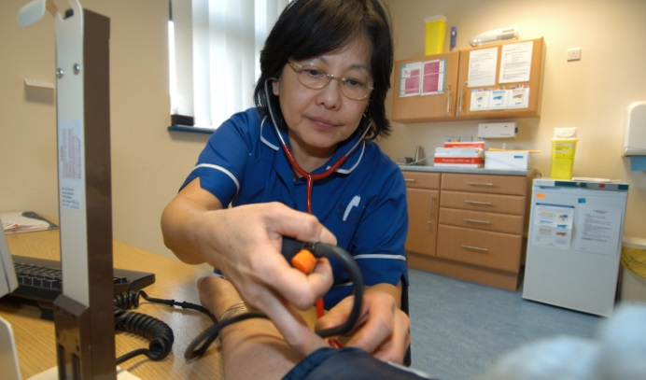
Cancer care reviews involve
Cancer diagnosis discussed- patients understanding.
Discussion on treatment
Discussion on lifestyle advice
Medication review
Information leaflets offered
Need for mental health support

Slide 14
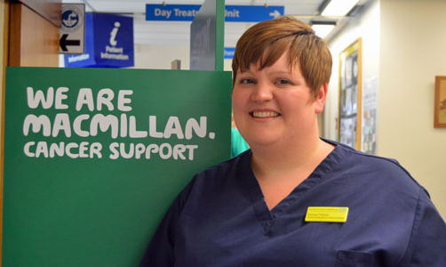
Primary Care top tips for effective cancer review

Slide 15
1
Consider the most appropriate way to contact the patient-
Virtual consultation
Telephone consultation

Slide 16
2
Appointment slots and follow up appointments.
Dedicated time.
Powerful messages that we are there for the patient.

Slide 17
3
Involve the family.
Patients may appreciate having other family members involved in their care.

Slide 18
4
Templates for your system- EMIS

Slide 19
5
Information leaflets

Slide 20
6
Check patients understanding of their treatment.

Slide 21
7
Structure your treatment-
Discuss their diagnosis
Review medications
Check support network
Agree a date for the follow up or next review
Give the patient the opportunity to raise concerns.

Slide 22
8
Be aware of support services and referral services available to you.

Slide 23
9
Use the review as an opportunity for health promotion.

Slide 24
10
Do you need to share information with the clinical nurse specialist or oncology team to improve personalisation of care/ holistic assessment?

Slide 25
Primary care role relating to Harry.
Smoking cessation
Reviews and follow up appointments if needed.
Talking therapies

Slide 26
Discussion

Slide 27
Questions

Slide 28
Thank you

