Slide 1
Vaccinations in general practice- an overview
Suzie Martin
KEC

Slide 2
Lesson objectives:
To have a better understanding of vaccinations available throughout the lifespan in general practice.
To be aware of the ‘cold chain’ and other protocols involved in vaccine administration including documentation
To update knowledge on injection technique.
To be able to aid the healthcare professional in practice in vaccinating patients (for example getting the equipment ready- getting plasters out/ vaccination leaflets ready).

Slide 3
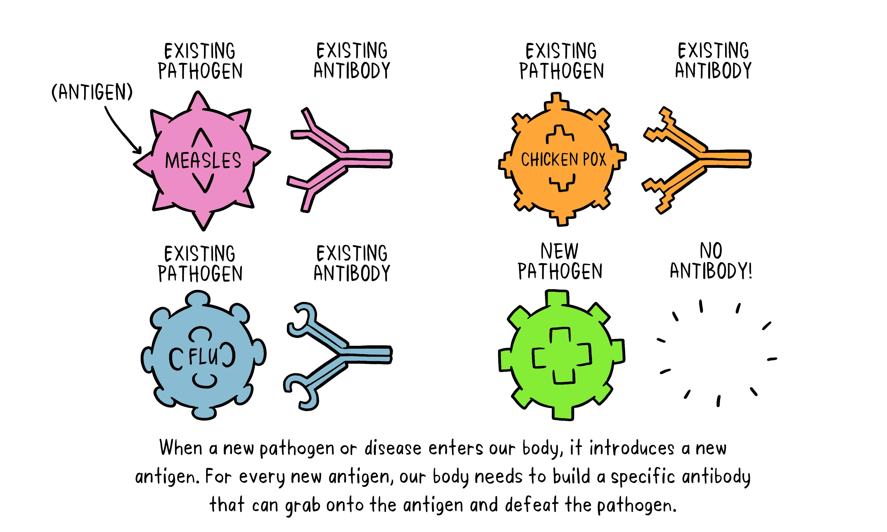
How do vaccines work?

Slide 4
Vaccines
Notes:
They can do this by modifying the virus to make it weakened and therefore the virus will not take over. OR a more groundbreaking method using DNA modification. This is relevant for the new Pfizer vaccine- in simple terms they use the genetic code of the virus to produce MRNA- this is then injected and the body uses the MRNA to replicate antibodies.

Slide 5
Can anyone think of other ways we gain immunity?

Slide 6
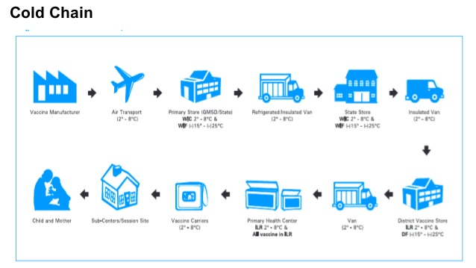
Vaccine Storage
The cold chain:

Slide 7
Fridge monitoring
MOST vaccines are stored between 2-8 degrees
Vaccine fridges are specific for vaccine storage and not for your lunch!

Slide 8
What vaccinations do we have in General Practice?
Has anyone seen any being given?

Slide 9
Childhood immunisations
DTaP diphtheria, hepatitis B, Hib (Haemophilus influenzae type b), polio, tetanus, whooping cough (pertussis).
Pneumococcal
Meningitis B
TB (in some areas)
MMR (LIVE)
Rotavirus (LIVE)
Meningitis C
Meningitis ACWY
HPV
AGES: 8 weeks, 12 weeks, 16 weeks, 1 year, 3years 4 months, age 12, age 14.
Notes:
Live vs inactivated

Slide 10
Are there any groups you wouldn’t give a live vaccine to?

Slide 11
FLU
Over 65 Flu jab
Under 18-64 Flu jab
2years to 18years nasal flu spray (LIVE)
Why are there three different types?
The over 65 vaccine has a adjunct included which boosts immune response.

Slide 12
Who gets the flu jab?
Adults over the age of 50 years.
Adults who are pregnant
Front line health and social care workers
Carers
People who live with high-risk corona virus patients.
People who have certain health conditions (e.g. asthma/COPD)
BMI of 40 and above

Slide 13
Other Vaccinations you may see…
Over 65 years- pneumococcal vaccination
Shingles vaccination – 70 or 78 years old (not over 80)
Travel injections- Tetanus, Hepatitis A, Typhoid, Rabies, Yellow fever and Japanese encephalitis to name a few.
Chicken Pox vaccination (private)

Slide 14
Informed consent for vaccination-
What do we need to include?

Slide 15
Legal protocols
PSD
Vaccinations can be given under a patient specific directive that is signed by a doctor (it’s a bit like a prescription). The vaccination is given to that person alone and is not licensed for anyone other than who is named on the PSD.
PGD
Vaccinations can be given to a group of people who fit a certain criteria. The nurse can assess people and if they fit the criteria, the nurse can give that vaccination without a prescription.

Slide 16
What checks do we do?
Right patient
Right dose
Right site
Right vaccine
Right time and right to give
Right route

Slide 17
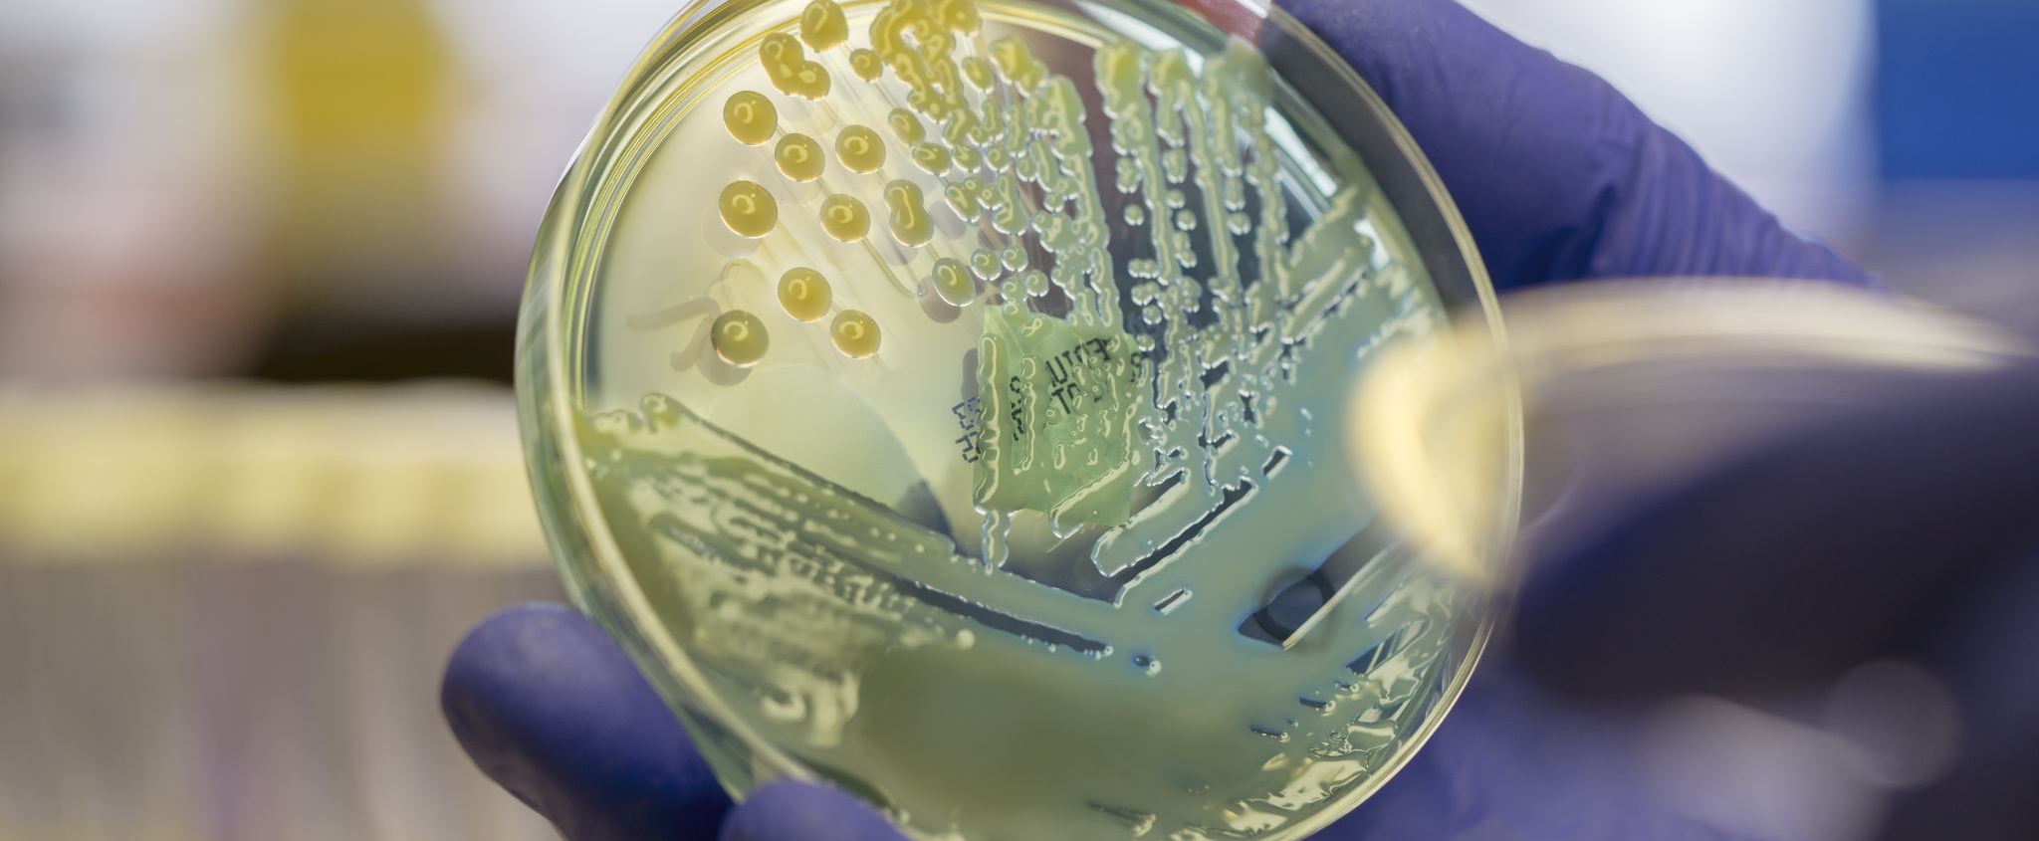
Infection control!

Slide 18
Injection technique…

Slide 19
Injection sites
Adults- deltoid muscle
Babies under one- thigh
Babies over one thigh/arm

Slide 20
Reducing pain
Recommended
Position appropriately according to age
Administer rapidly; no aspiration
Administer multiple vaccines; least painful first
Administer Rotarix first as sucrose helps pain
Nasal spray first
Parent or carer to hold child
Encourage BF / distraction
Not recommended
Topical anaesthetics
Warming
Rubbing
Oral analgesics
Simultaneous injections

Slide 21
Document!
Site,
EXP date
Vaccination name and brand
Batch number
Patient name
Any side effects immediately after
Any vaccine spillages
When the next dose is due
Have you given the patient an info leaflet?

Slide 22
Scenario 1
George is 14 years old and missed his tetanus vaccination at school because he was very worried about having as it would hurt.
How can we reassure George?

Slide 23
Scenario 2
You walk into the clinical room first thing in the morning and there is a vaccine left out on the side.
What should you do?

Slide 24
Scenario 3
The nurse asks you to get the room ready for a childhood imms clinic.
What could we get out to help her?

Slide 25
Reflections discussion

Slide 26
Any questions

