Slide 1
Wound Care
IPL

Slide 2
Objectives
To understand our roles within primary care with regards to wound care.
To be able to list the signs of infection and steps in would cleaning.
To be able to recite wound dressings and what they are used for.
To have a better understanding of wound pathology

Slide 3
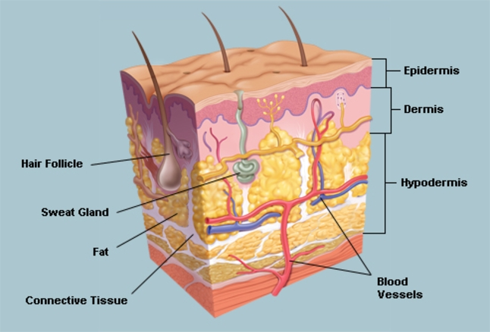
Anatomy of the skin

Slide 4
Epidermis
The outer skin layer that is in direct contact with the environment
Contains skin pigment (melanin) that gives colour to the skin
Contains a water repellent protein called keratin.
Cells constantly change and regenerate

Slide 5
Dermis
Contains no skin cells
Composed of collagen
Provides strength to the skin
Provides a reservoir storage area for water
Contains a specialist network or nerves and nerve endings for sensation of pain, pressure, touch and temperature
Contains hair follicles
Collagen makes the skin stretchable and elastic

Slide 6
Subcutaneous Layer
Is not part of the skin itself, but supplies the major blood vessel and nerved to the skin above
Loose sponge texture
Ideal side for rapid and ‘pain-free’ absorption of injected medications (SC)

Slide 7
Functions of the skin
Protection- Barrier against bacteria, foreign matter, dehydration and UV light.
Sensation- Sense organ
Movement without injury
Excretion- Regulating the volume and chemical content of sweat
Vitamin D production
Immunity
Temperature regulation

Slide 8
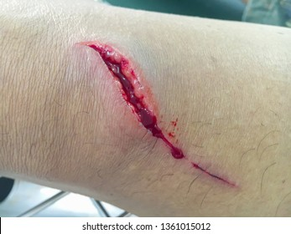
What is a wound
A break in the skin or mucus membrane

Slide 9
What is a leg ulcer
A wound below the knee that takes more than 2 weeks to heal

Slide 10
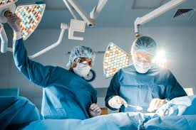
Causes of wounds
Surgical
Trauma
Pressure
Shearing force
Friction
Poor circulation

Slide 11
Risk factors
Broken skin
Age
Poor nutrition
Stress
Hereditary
Disease process
Medical therapies- radiation/ steroids

Slide 12
Types of wound…

Slide 13
Intentional
Created for therapy
Surgical wounds
Drainage wounds

Slide 14
Unintentional
Restulting from trauma

Slide 15
Open wound
Broken skin

Slide 16
Closed wound
Tissues are injured but the skin is intact

Slide 17
Clean wound
No foreign bodies
No clinical signs of infection

Slide 18
Contaminated wound
Foreign bodies- dirt
High risk of infection

Slide 19
Infected wound
Red
Hot
Swollen
Exudate- green
Odour
Painful

Slide 20
Chronic wound
Chronic wounds are defined as wounds that fail to proceed through the normal phases of wound healing in an orderly and timely manner. Often, chronic wounds stall in the inflammation phase of healing.

Slide 21
Partial thickness
Epidermis and dermis of the skin is broken
Superficial wound

Slide 22
Full thickness
Epidermis, dermis and subcutaneous tissue are involved- may involve muscle and bone

Slide 23
Abrasion
A scrape/ graze

Slide 24
Contusion
A closed wound caused by a blow to the body

Slide 25
Incision
An open wound with clean straight edges

Slide 26
Laceration
Open wound with torn tissues and jagged edges

Slide 27
Penetrating wound
Skin and underlying tissue are pierced

Slide 28
Puncture wound
Open wound from a sharp object

Slide 29
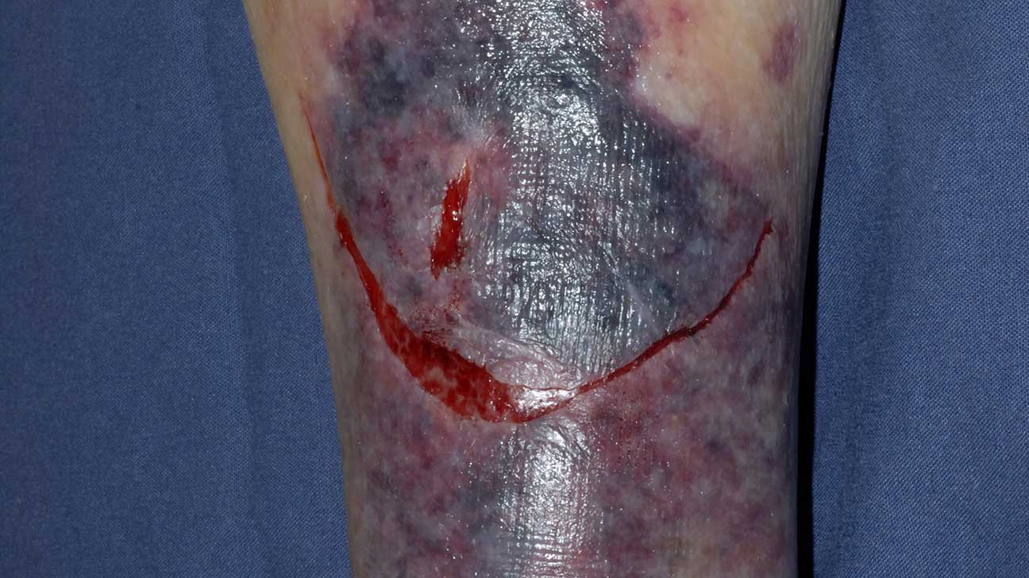
Skin tears
Occur frequently in the elderly due to thinning of the skin with age
Often caused by scraping against wall or door handle when falling
How would you treat a skin tear?

Slide 30
Stages of wound healing

Slide 31
Inflammatory stage
Blood vessels constrict and platelets stop bleeding forming clots to scabs
Inflammatory response- increased blood flow and vascular permeability causing redness and oedema
Whit blood cells arrive and clean cell of debris

Slide 32
Proliferative
Closure begins
Fibroblasts with vitamin C and B for repair
Collagen- provides strength and structure
Epithelial cells- duplicate damaged cells

Slide 33
Maturation stage
Final stage of wound healing and may last for one year and the scar strengthens

Slide 34
Types of wound healing
Primary intention- Incision edges of a clean surgical incision remain close, tissue loss is minimal and skin quickly regenerates
Secondary intention- Open wound with tissue loss and jagged edges, there is a gap between the edges, granulation tissue gradually fills in the area of defect with scar tissue.
Tertiary intension- Surgical wounds are often left open 3-5 days and then stapled of sutured.

Slide 35
What influences wound healing

Slide 36
What may influence wound healing?
Age
Nutrition
Obesity
Wound stress
Oxygen availability – circulation
Smoking
Drugs
Chronic diseases
Infection

Slide 37
Documentation
Take a history – WHY?
Wound location
Wound size and depth- is it tracking?
Wound appearance- signs of infection
Any exudate
And odour
Surrounding skin
Pain
Anything else?

Slide 38
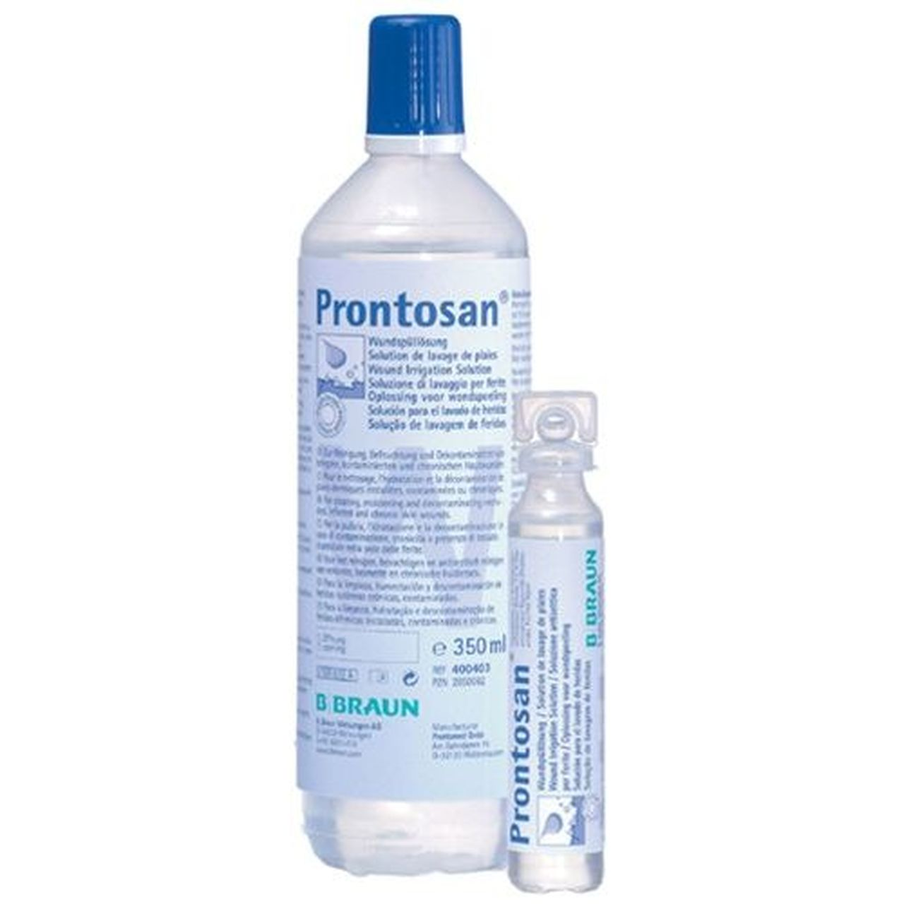
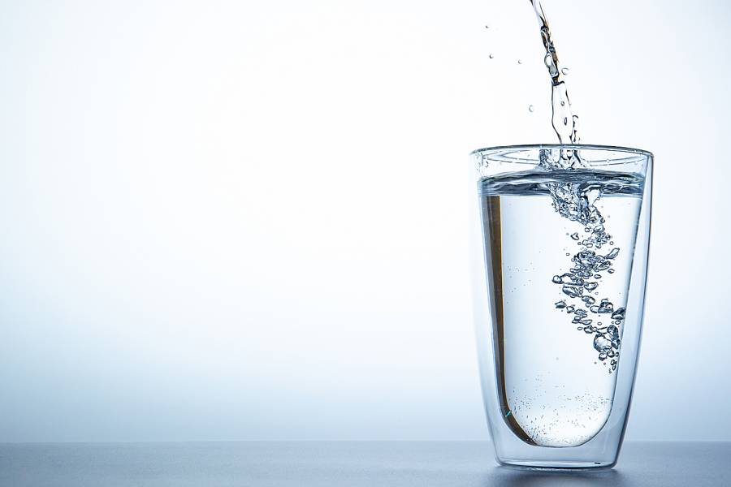
Water or saline for wound cleaning?

Slide 39
Wound cleaning and ADL’s
If a patient is at home with an open wound and cleansing is required, showering is the preferred method of irrigation – and it may also increase the patient’s sense of wellbeing (Fernandez and Griffiths, 2012). Patients whose wounds are located in the pelvic region – such as excised pilonidal sinuses or episiotomy wounds – are generally encouraged to shower daily and after every bowel movement (Harris et al, 2016); this is because the wound can be easily contaminated with faecal material.

Slide 40
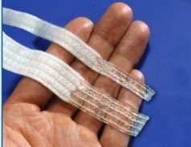
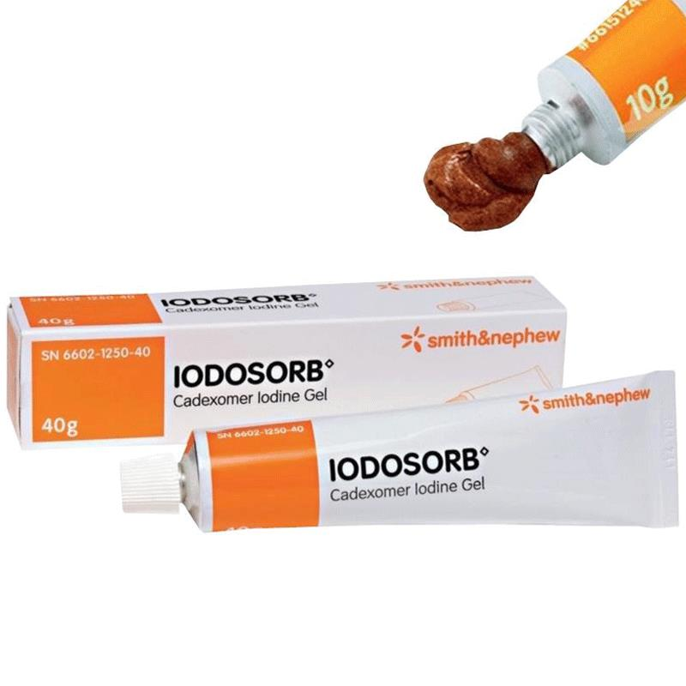
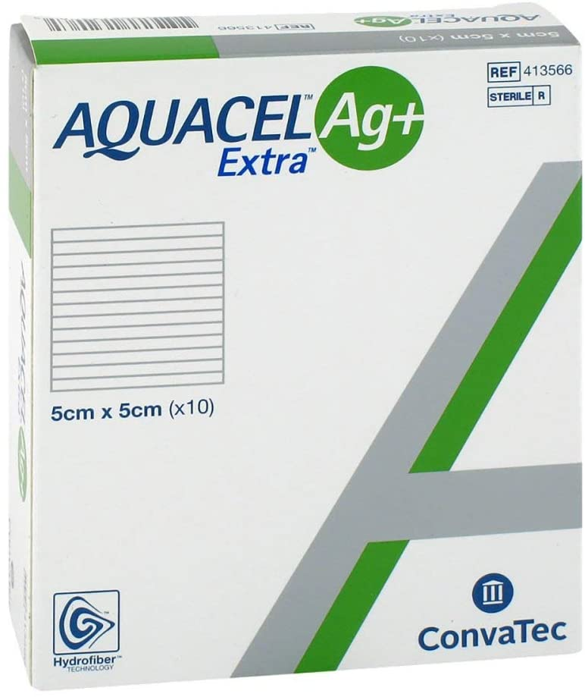
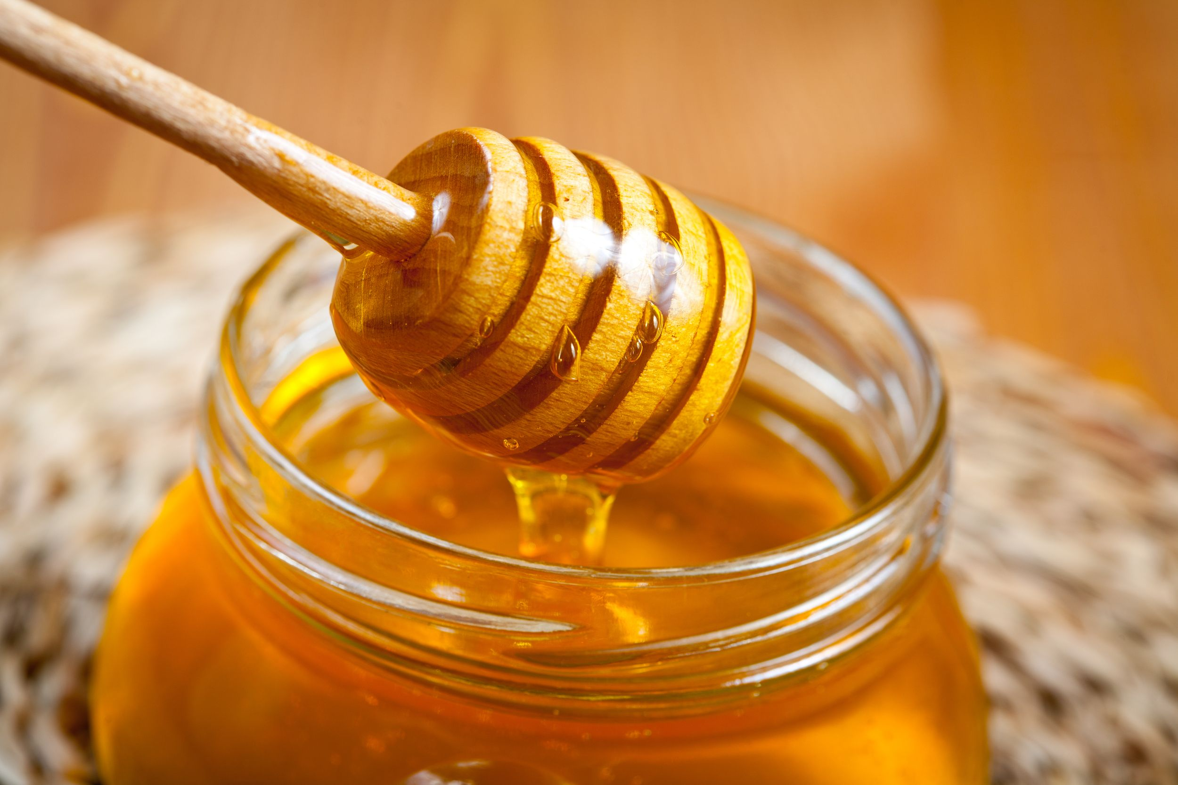
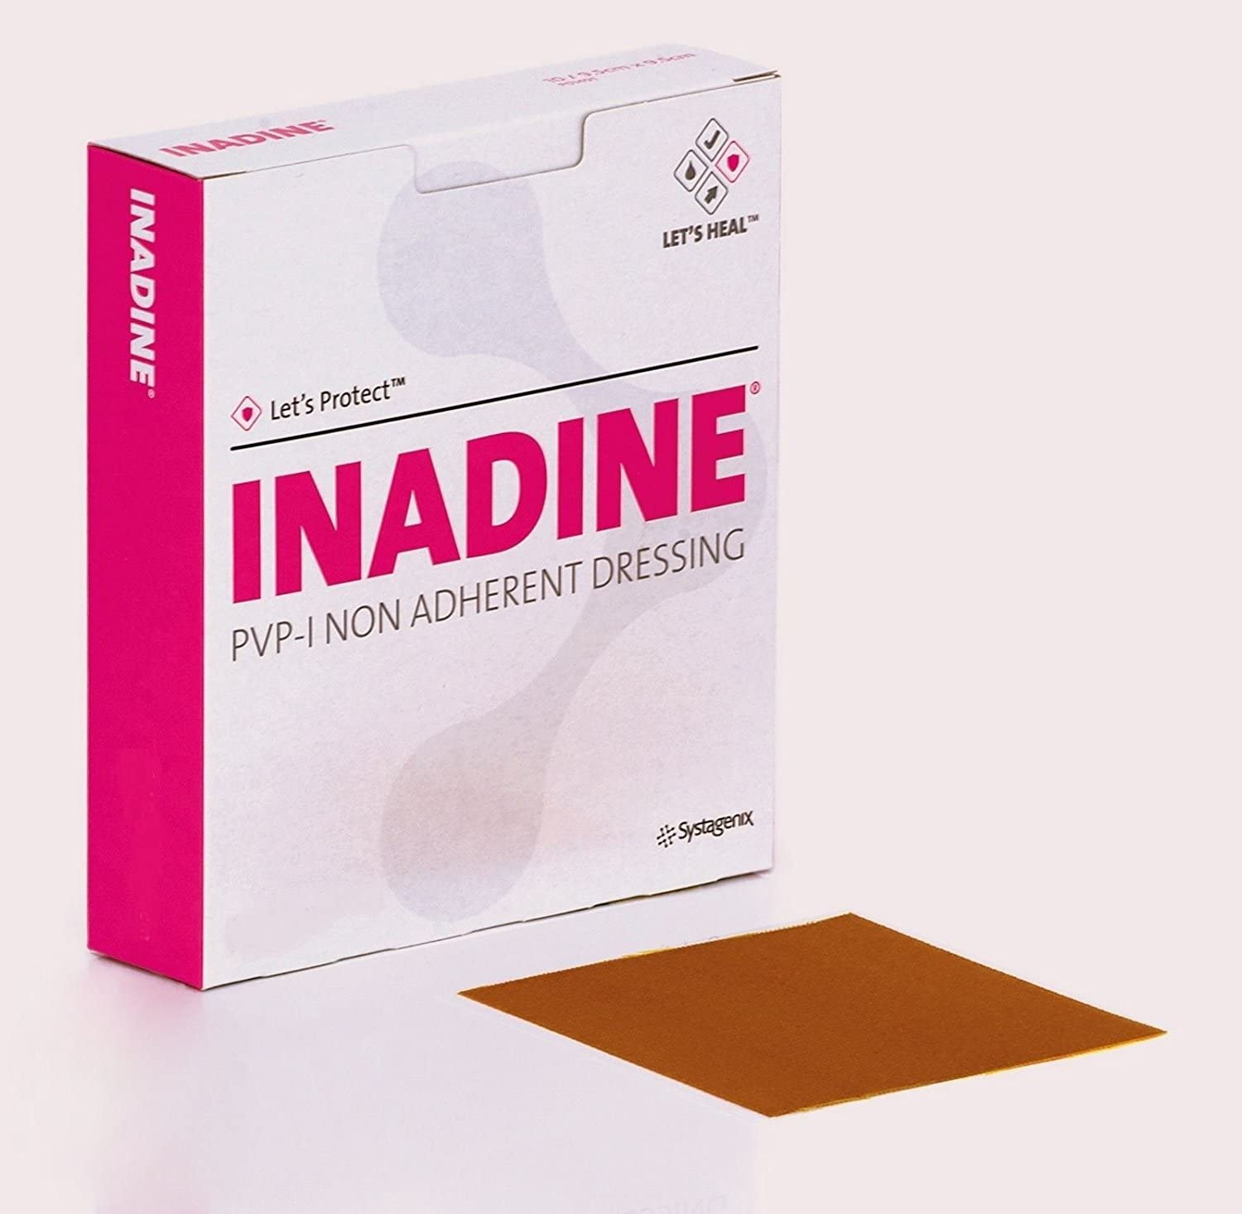
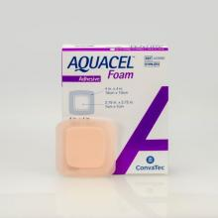
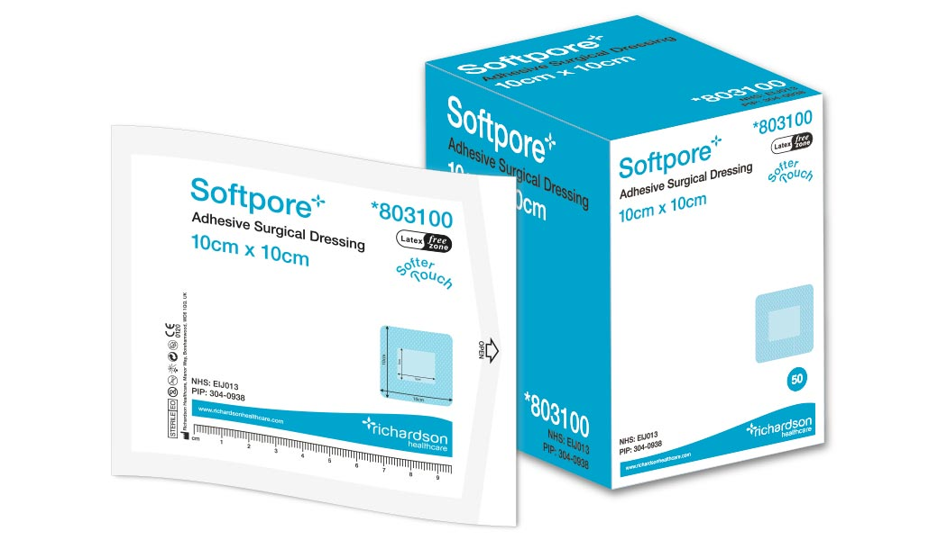
Dressings

Slide 41
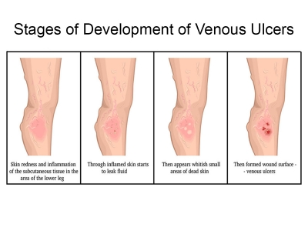
Venous wounds
Occur due to damage to the veins and a insufficient return of blood back to the heart.
Poor circulation
Blood clots
Weight
Lack of exercise
Smoking

Slide 42
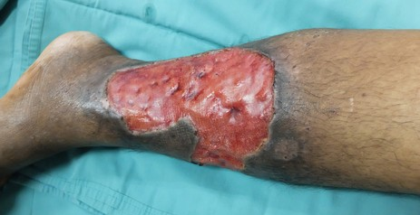
Arterial wounds
Occur due to damage to the arteries and so a lack of blood flow to the area.
Damage to arteries
Smoking
Obesity
Heart failure / cardiac conditions

Slide 44
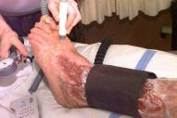
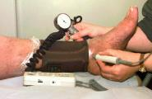
Doppler

Slide 45
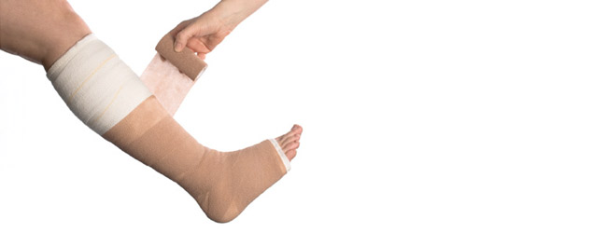
Compression bandaging

Slide 46
Questions

Slide 47
Thank you

