Slide 1
Cardiac care in general practice
IPL

Slide 2
Lesson Objectives
To gain a further understanding of the services provided for patients with cardiac conditions in primary care.
To review some cardiac medications that may be observed in practice.
To refresh knowledge of the anatomy and physiology of the heart.

Slide 3
Statistics
17.9 million people due each year due to CVD.
CVDs are the number 1 cause of death globally: more people die annually from CVDs than from any other cause.
Most cardiovascular diseases can be prevented by addressing behavioural risk factors such as tobacco use, unhealthy diet and obesity, physical inactivity and harmful use of alcohol using population-wide strategies.

Slide 4
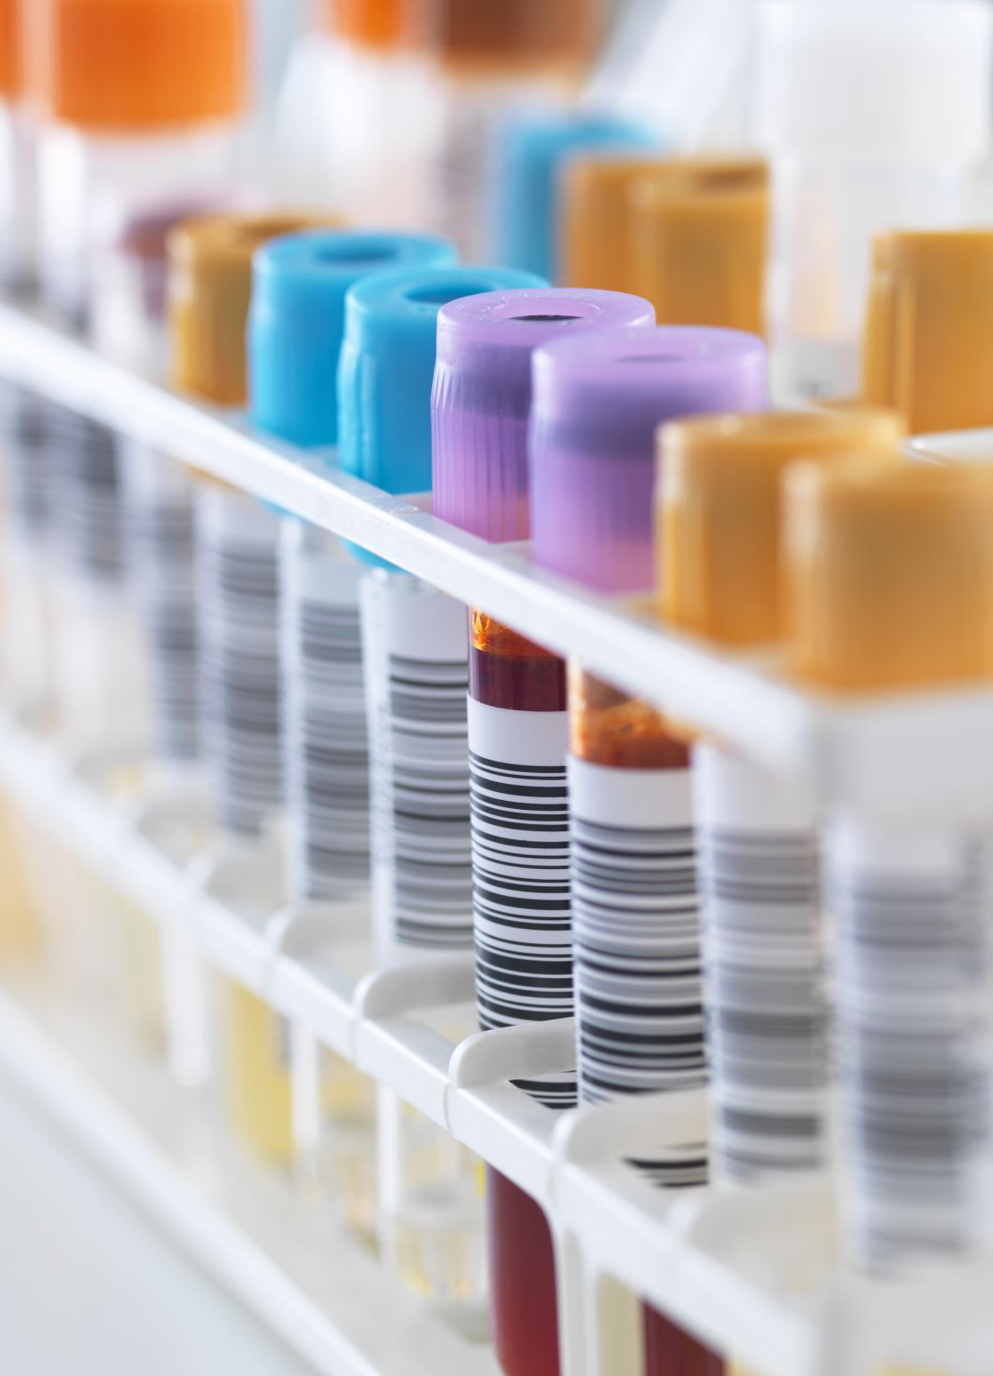
What is Cardiovascular disease
Cardiovascular diseases (CVDs) are a group of disorders of the heart and blood vessels.

Slide 5
Some common cardiovascular diseases…
Coronary heart disease – disease of the blood vessels supplying the heart muscle;
Cerebrovascular disease – disease of the blood vessels supplying the brain;
Peripheral arterial disease – disease of blood vessels supplying the arms and legs;
Rheumatic heart disease – damage to the heart muscle and heart valves from rheumatic fever, caused by streptococcal bacteria;
Congenital heart disease – malformations of heart structure existing at birth;
Deep vein thrombosis and pulmonary embolism – blood clots in the leg veins, which can dislodge and move to the heart and lungs.

Slide 6
Symptoms of CVD
Pain or discomfort in the centre of the chest;
Pain or discomfort in the arms, the left shoulder, elbows, jaw, or back.
In addition, the person may have trouble breathing or shortness of breath; feeling sick or vomiting; feeling light-headed or faint; breaking into a cold sweat; and becoming pale. Women are more likely to have shortness of breath, nausea, vomiting, and back or jaw pain.

Slide 7
Stroke symptoms
Stroke: the most common symptom of a stroke is sudden weakness of the face, arm, or leg, most often on one side of the body. Other symptoms include sudden onset of:
Numbness of the face, arm, or leg, especially on one side of the body;
Confusion, difficulty speaking or understanding speech;
Difficulty seeing with one or both eyes;
Difficulty walking, dizziness, loss of balance or coordination;
Severe headache with no known cause; and
Fainting or unconsciousness.

Slide 8
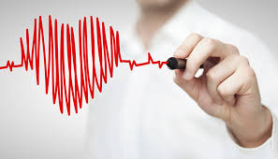
The Cardiac Cycle
https://www.youtube.com/watch?v=h3SGzuggxxk

Slide 10
So, what do we do in primary care?
Blood pressure checks
Cardiology referrals
ECG
24 Hour Blood Pressure
Medication reviews

Slide 11
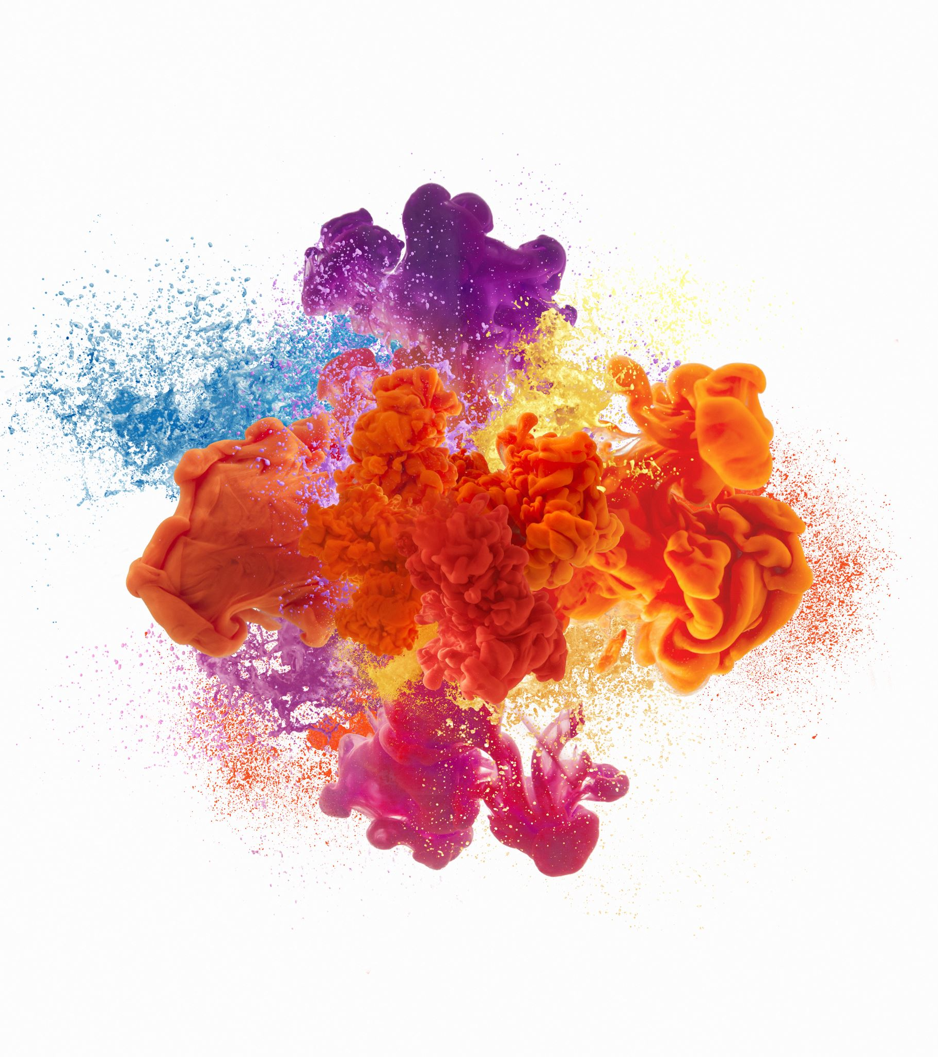
What is blood pressure?

Slide 12
Definition
The blood pressure is the pressure of the blood within the arteries. It is produced primarily by the contraction of the heart muscle. Its measurement is recorded by two numbers. The first (systolic pressure) is measured after the heart contracts and is highest. The second (diastolic pressure) is measured before the heart contracts and lowest. A blood pressure cuff is used to measure the pressure. Elevation of blood pressure is called "hypertension".

Slide 13
If a patient asked…
The pressure of the blood exerted on the blood vessels by the heart.
The top number is the highest pressure as the heart beats and contracts.
The bottom number is the lowers pressure as the heart relaxes and refills with blood.

Slide 14
The ‘normal’ range of BP?

Slide 15
What counts as high?

Slide 16
What counts as low?

Slide 17
What's normal for the patient?

Slide 18
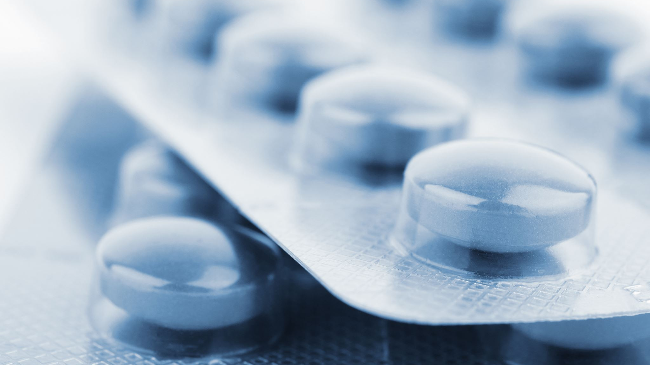
A patient in A&E vs a patient in the GP and blood pressure…

Slide 19
Symptoms of hypertension:
Severe headaches.
Nosebleed.
Fatigue or confusion.
Vision problems.
Chest pain.

Slide 20
Symptoms of hypotension…
Dizziness or light-headedness.
Nausea.
Fainting (syncope)
Dehydration and unusual thirst.
Lack of concentration
Blurred vision.

Slide 21
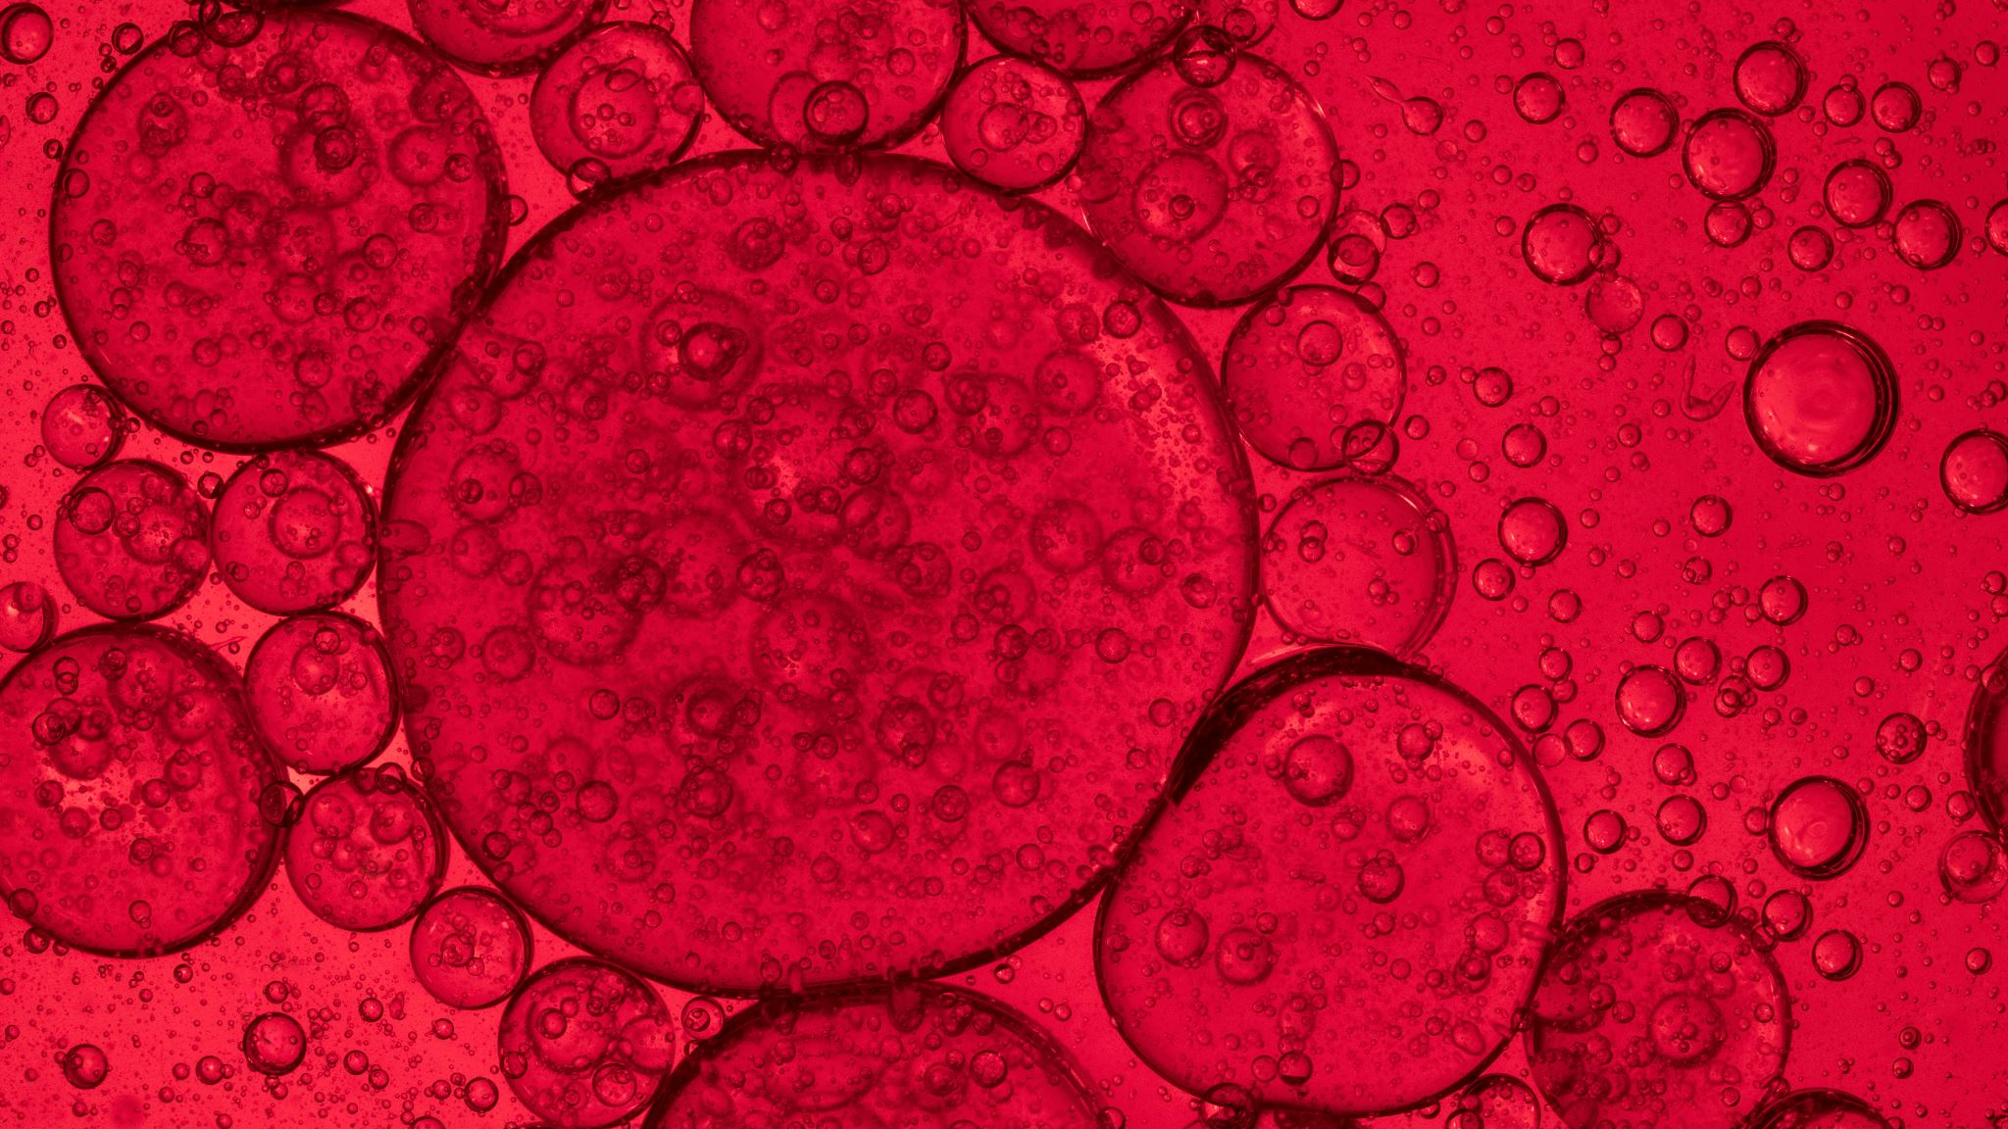
Who can we not use a blood pressure machine on?

Slide 22
Risk Factors
Diabetes.
Unhealthy Diet.
Physical Inactivity.
Obesity.
Too Much Alcohol.
Tobacco Use.
Genetics and Family History.

Slide 23
The Role of the Practice nurse
Offer support to patients with health promotion- not lecture them.
NHS screening- CVD risk score.
Referral to services.
Initiate medication if needed.
Plan follow up visits.
Initiate emergency protocols if needed.

Slide 24
CVD risk score
Offered for individuals aged 40-74
Take a family history of CVD, blood pressure, the patients’ cholesterol, BMI and alcohol unit intake.
Put this into the screening tool and a percentage risk for that patient will be generated.
If <10% – at low risk of developing CVD.
If 10-20% – moderate risk.
If >20% – high risk.

Slide 25
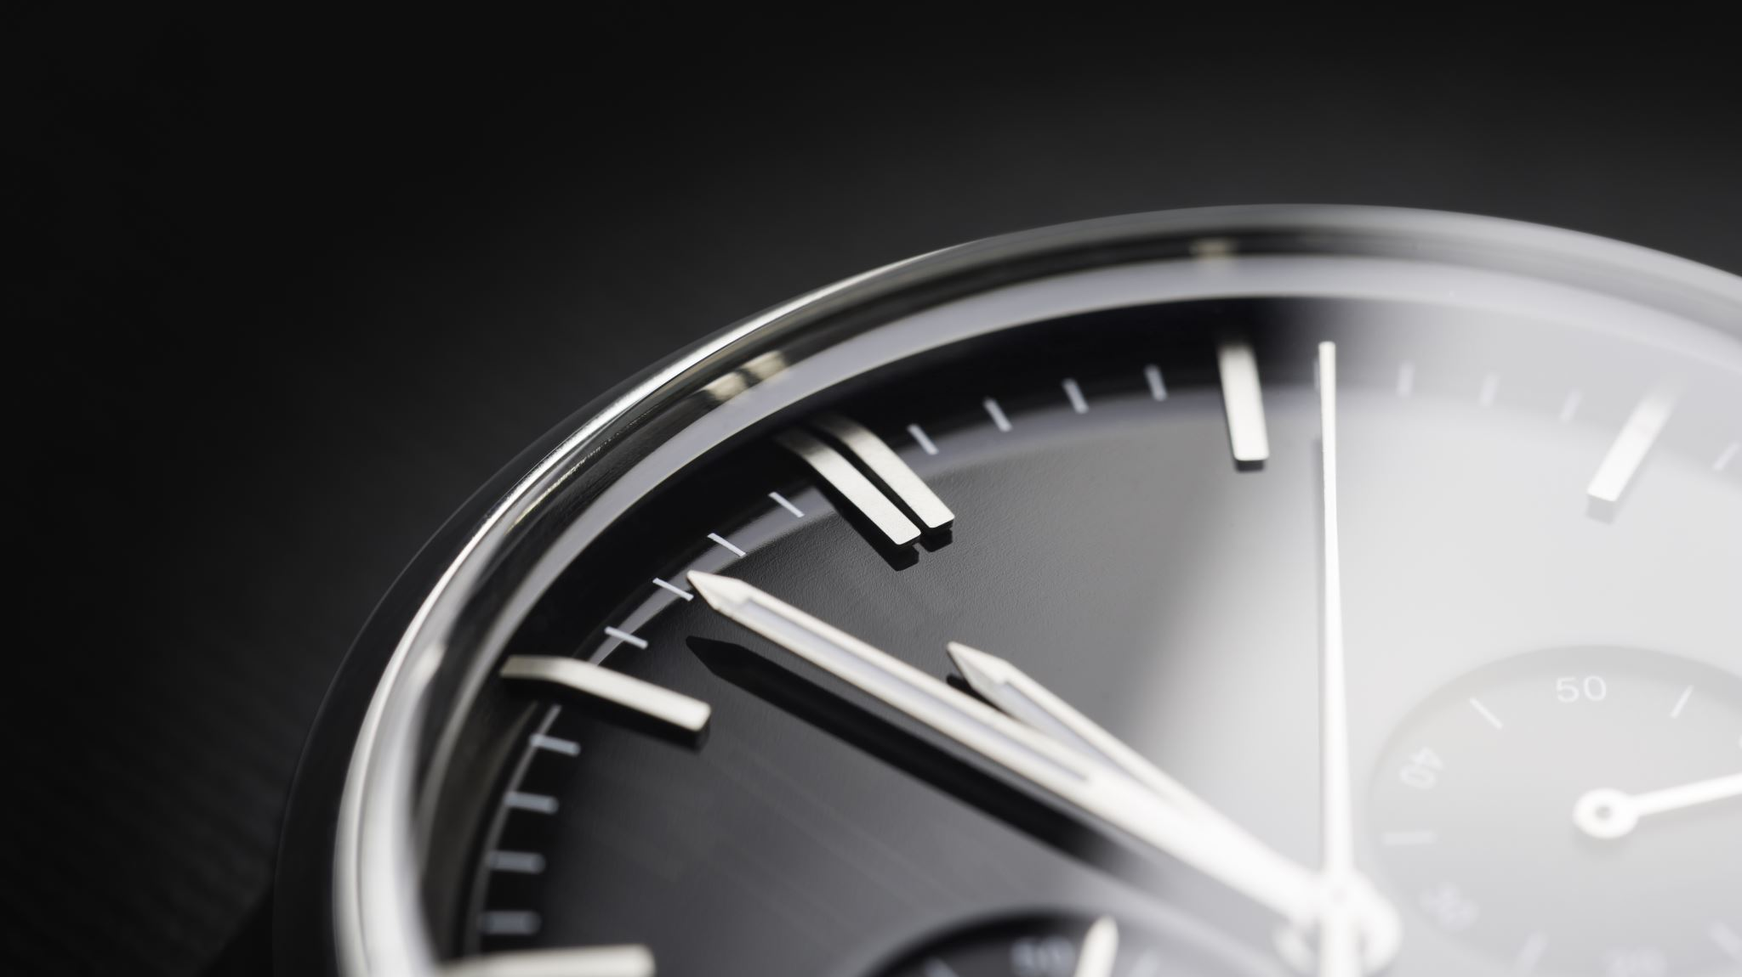
24 Hour Blood pressure

Slide 26
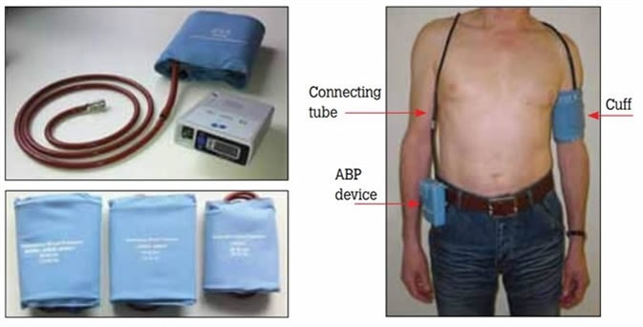
Can you think of another way we can monitor BP at home?

Slide 27
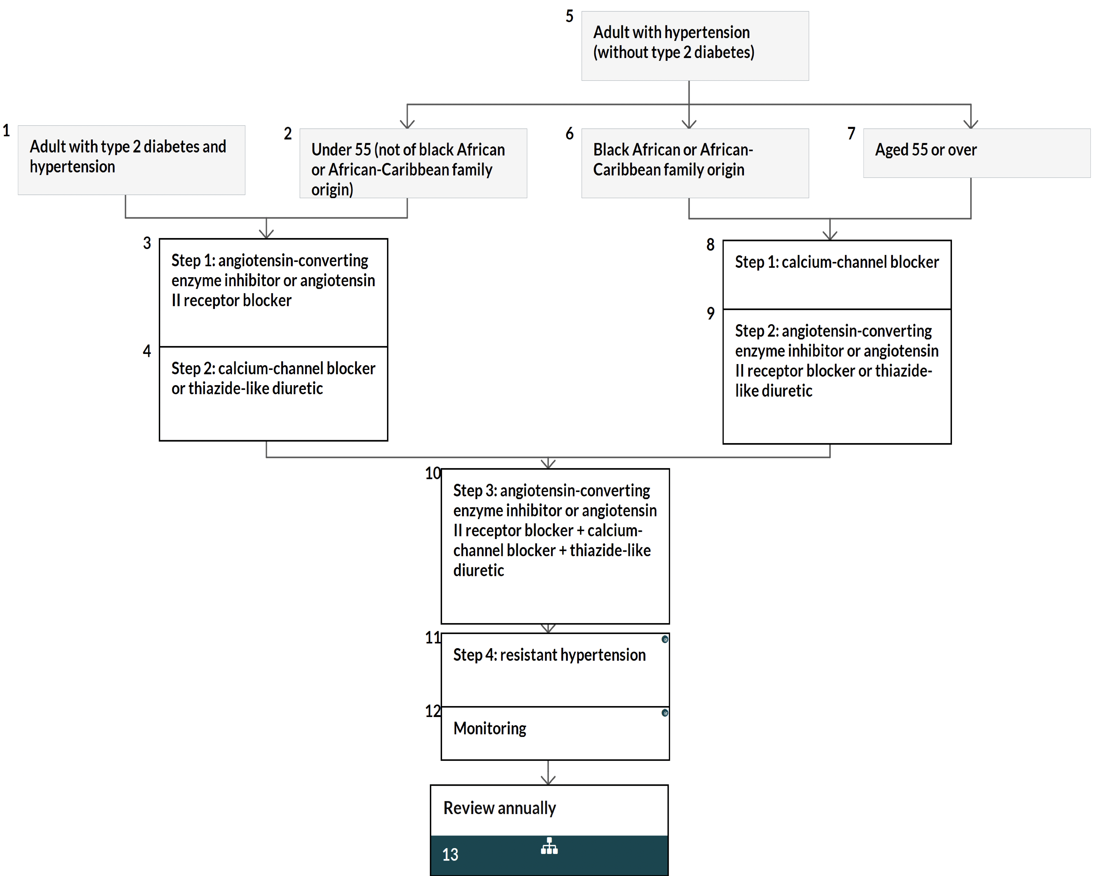
Hypertension protocol…

Slide 28
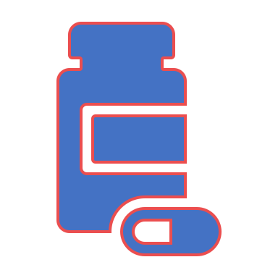
Common medications…

Slide 29
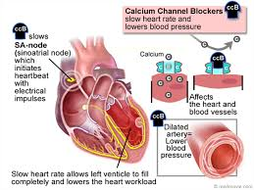
Amlodipine: Calcium Channel Blocker

Slide 30
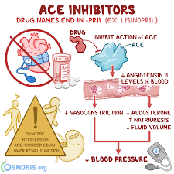
Ramipril- ACE inhibitor (Angiotensin converting enzyme)

Slide 31
Diuretics

Slide 32
Diuretics, sometimes called water pills, help rid your body of salt (sodium) and water. Most of them help your kidneys release more sodium into your urine. The sodium takes with it water from your blood, decreasing the amount of fluid flowing through your veins and arteries. This reduces blood pressure.

Slide 33
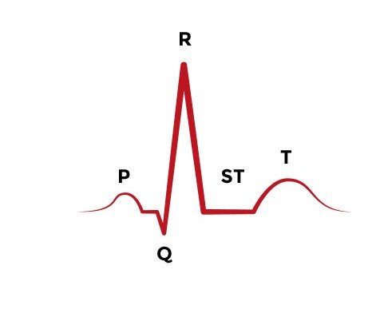
An ECG
https://www.youtube.com/watch?v=1k4B_fIX_t0

Slide 34
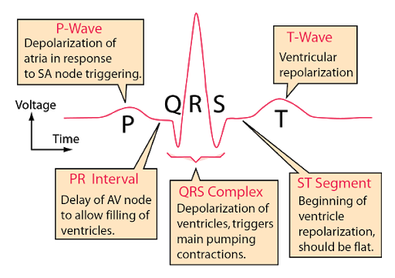

Slide 35
The Atriums contract pushing blood into the ventricles.
Pause for the electric signal to get to the ventricles.
The ventricles contract to push the blood to the lungs or rest of the body.
Pause for electrical signal to relax.
T wave- Ventricles are relaxing.

Slide 36
Depolarization vs Repolarization
Depolarization with corresponding contraction of myocardial muscle moves as a wave through the heart.
Repolarization is the return of the ions to their previous resting state, which corresponds with relaxation of the myocardial muscle.

Slide 37
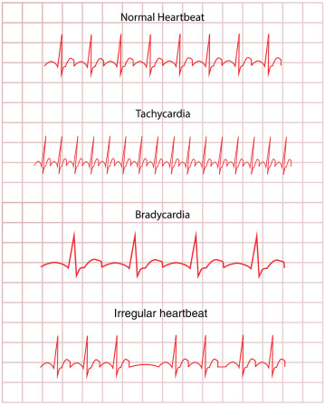
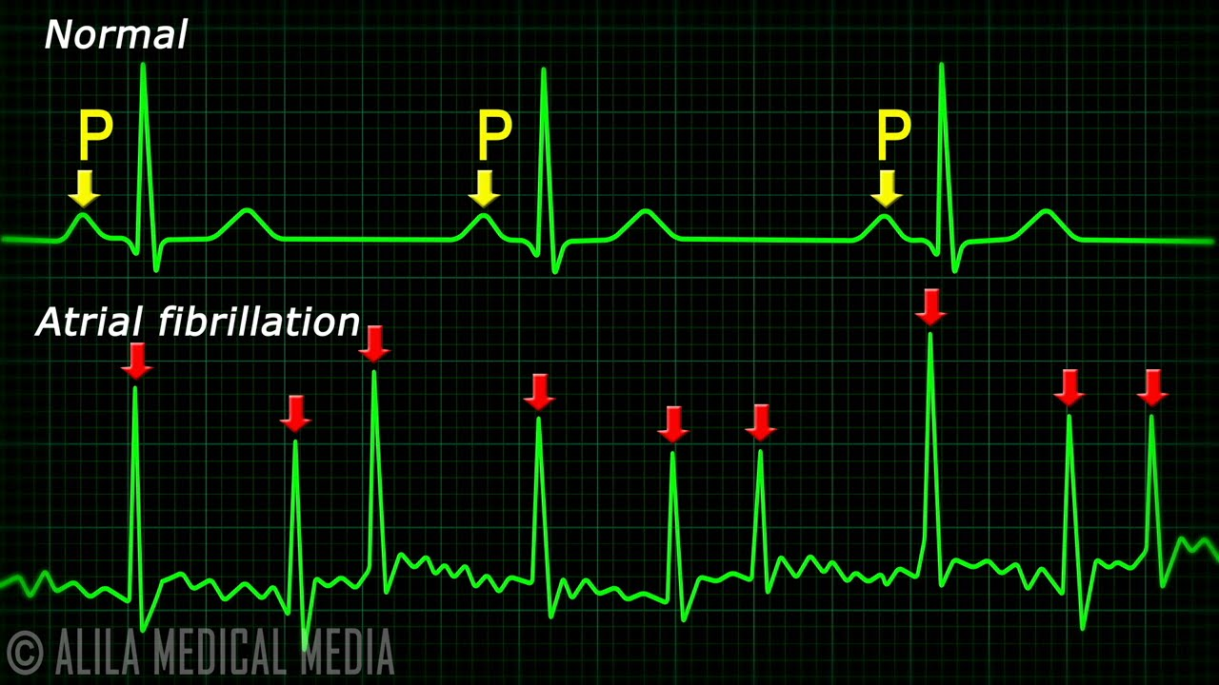
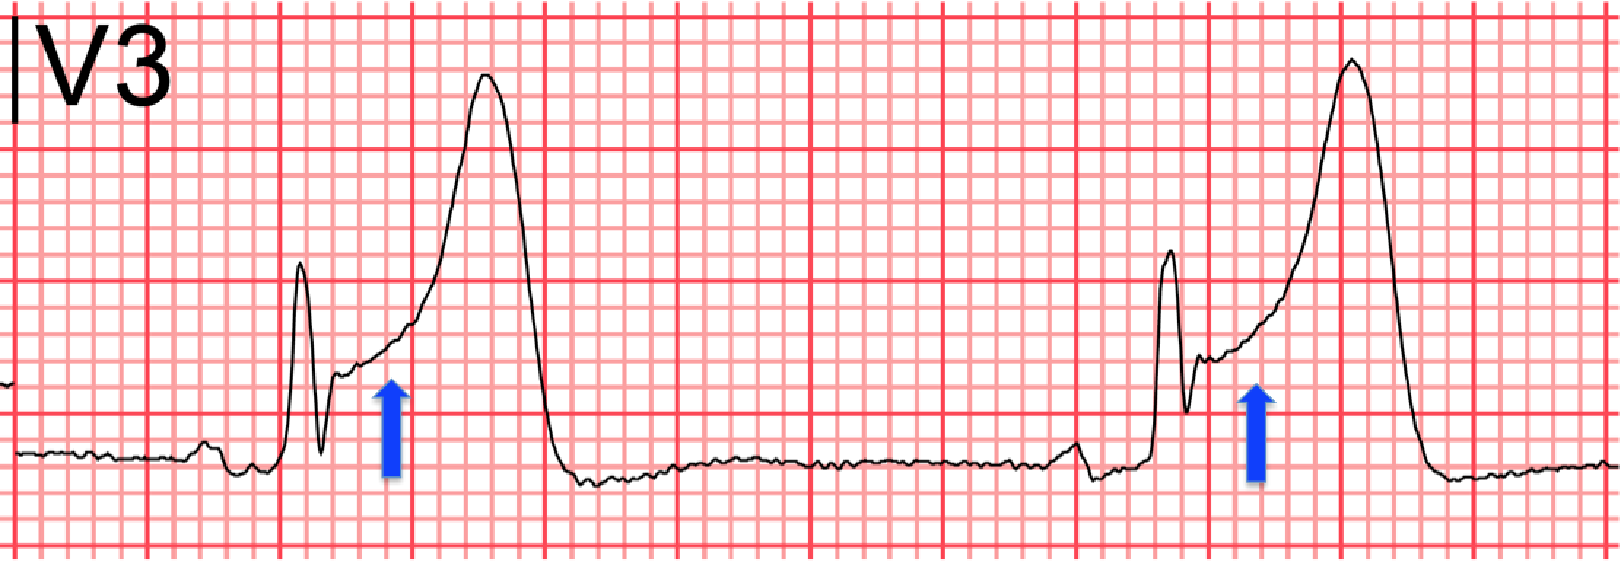

Slide 38
The role of the practice nurse
Conducting ECG- interpreting ECG findings
Alerting the GP to ECG findings- in most practices the ECG must be signed by the GP and then scanned onto the patients notes.
The ECG could be used as a base line.
Patients with acute chest pain should be seen in A&E.

Slide 39
Health promotion and self care
Smoking cessation – advise patients not to start smoking if they are a non-smoker. Strongly discourage any children or teenagers from starting. If a patient does smoke, stopping is the most important thing they can do to protect their heart.
Becoming more active – advise patients to take part in physical activity and exercise but be realistic. If they are housebound or restricted physically, they will not be able to do much, so encourage physical activity around the house as they are able.
Make small achievable dietary changes – reduce portion size, increase fruit and veg, trim visible fat, reduce salt, cook more healthily. They shouldn’t buy food they know is unhealthy. They may benefit from seeing a dietitian for an individualised plan.
Reducing alcohol intake – and encourage non-drinkers never to start. Apart from containing ‘empty’ calories, it can lead to weight gain and can increase triglycerides.
Signing up to campaigns as part of community and support networks – any changes they make are long term and may need motivation from others on the same path. Suggest they use health apps on their phones and devices to set themselves goals.

Slide 40
Referrals and further tests
Echo test.
Chest MRI
Chest X-ray

Slide 41
Questions

Slide 42
Thank you

