Slide 1
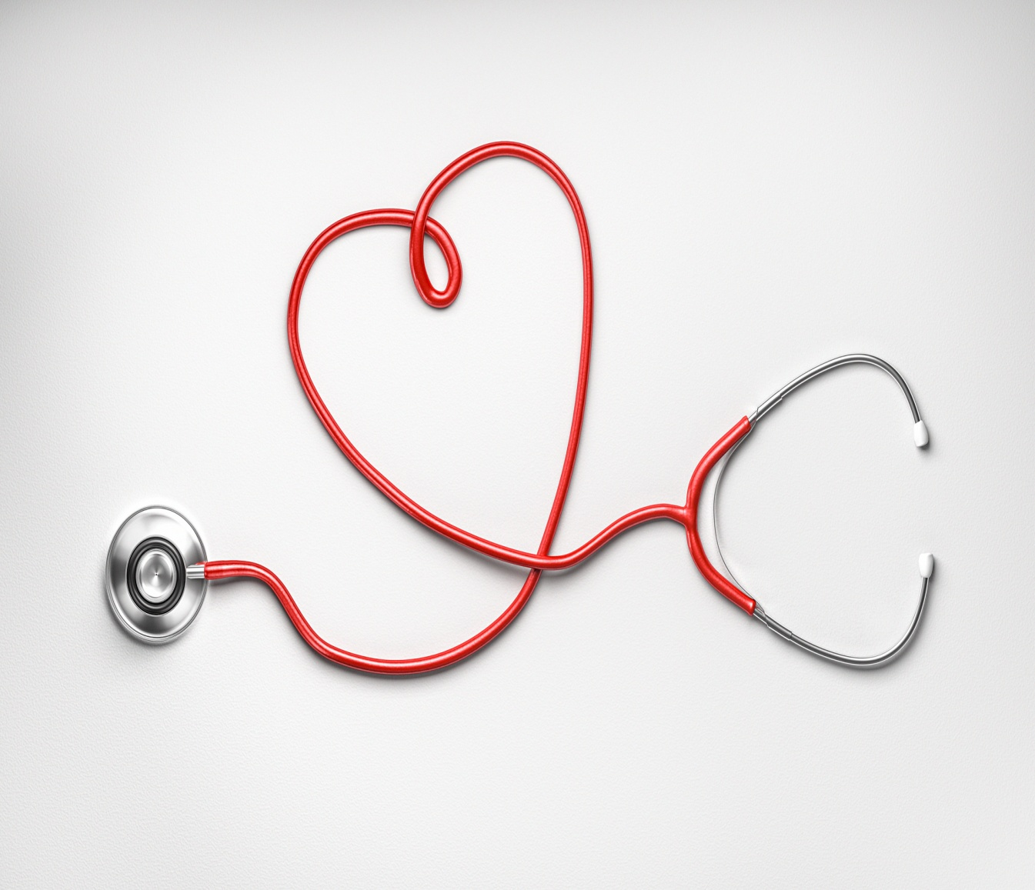
Cardio Vascular Disease

Slide 2
What is CVD?
A general term for conditions affecting the heart or blood vessels.
Including Coronary heart disease, angina, heart attack, congenital heart disease, hypertension, stroke and vascular dementia.
Associated with a build-up of fatty deposits inside the arteries –atherosclerosis –and an increased risk of blood clots.
One of the main causes of death and disability in the UK
Largely preventable with a healthy lifestyle.
Largest cause of death globally.

Slide 3
Epidemiology
Affects 7 million people in the UK
Responsible for 1 in 4 premature deaths in UK
Accounts for the largest gap in health life expectancy.
The most deprived 10% of the population are almost twice as likely to die as a result of CVD than those in the least deprived 10% of the population
There is a North/South divide with higher rates in the North of England.

Slide 4
Risk Factors
You are more at risk if you have Atrial Fibrillation
High B/P
High cholesterol
A history of diabetes
Smoker
BAME
People living with severe mental illness

Slide 5
Coronary Heart Disease (IHD)
Sometimes called Ischaemic heart disease.
Often first time a patient knows they have is when they have a heart attack.
Caused by a build up of plaque in the walls of the arteries that supply blood to the heart and other parts of the body.
Plaque (cholesterol) build up causes the inside of the arteries to narrow over time and either partially or completely block off.
This process is called atherosclerosis.

Slide 6
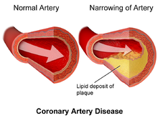
Coronary Heart Disease

Slide 7
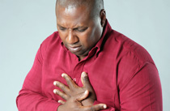
Angina
Chest pain often described as a tight, dull, heavy sensation that may spread to arms, neck, jaw or back.
Usually triggered by physical exertion or stress.
Generally stops within few minutes of rest.
Caused by partial blockage to coronary arteries reducing blood flow to the heart.

Slide 8
Angina
Stable – most common, caused by physical exertion, lasts few minutes, goes away when rests
Unstable – pain at rest or when not exercising, pain can be strong and long lasting, come back again and again. Can be a signal of an impending heart attack.
Vasospastic – rare, happens at night due to coronary arteries going into spasm and narrowing causing less blood flow to the heart.
Microvascular – often referred to as cardiac syndrome X. Chest pain with physical exercise, stress or anxiety. Comes in spasms in the smallest coronary arteries.

Slide 9
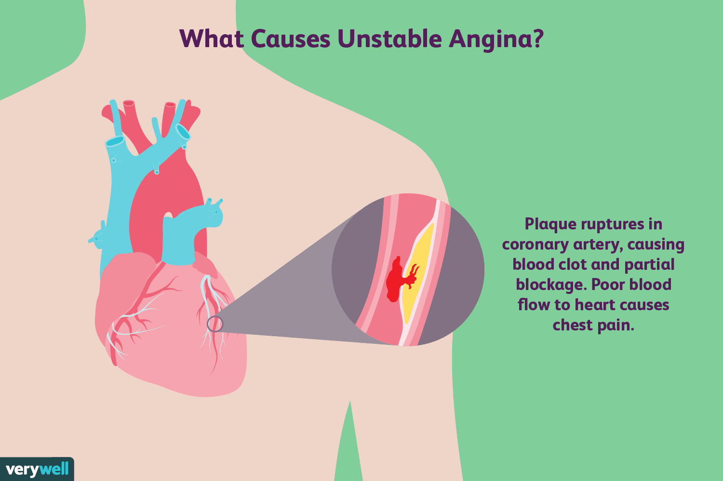
Stable vs. Unstable Angina
Stable angina is when you get angina symptoms during moderate physical activity or when you are pushing yourself physically. These symptoms go away with rest and/or medication.
Unstable angina is when you get angina symptoms while doing very little or resting. This can happen to people who have never experienced angina before

Slide 10
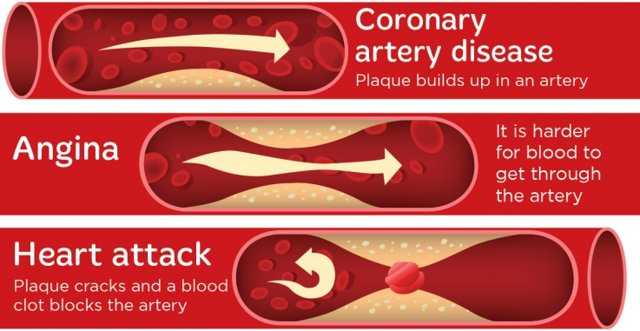

Slide 11
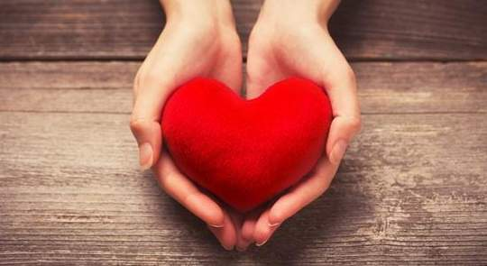
Risk factors
Unhealthy diet
Lack of exercise
Smoking
Increasing age
Family history of atherosclerosis or heart problems

Slide 12
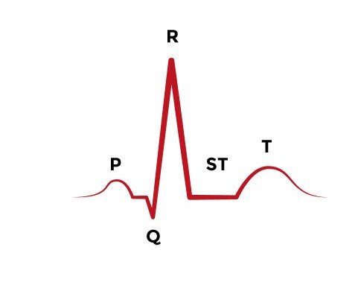
Tests
An electrocardiogram (ECG) checks the heart rhythm.
An exercise ECG
A Coronary angiography- highlights blood vessels that may be narrow.
Bloods- Troponin- enzyme released when heart tissue dies (in secondary care)

Slide 13
Management of Angina
Medication such as nitrate sprays which open the coronary arteries, e.g GTN.
Medication to prevent attacks such as beta blockers (bisoprolol) which reduce the rate of the heart or calcium channel blockers that would increase the blood flow to the heart (amlodipine).
Medication to control underlying conditions such as high cholesterol or hypertension, such as statins and aspirin.
Some patients may need surgery such as coronary artery bypass surgery.

Slide 14
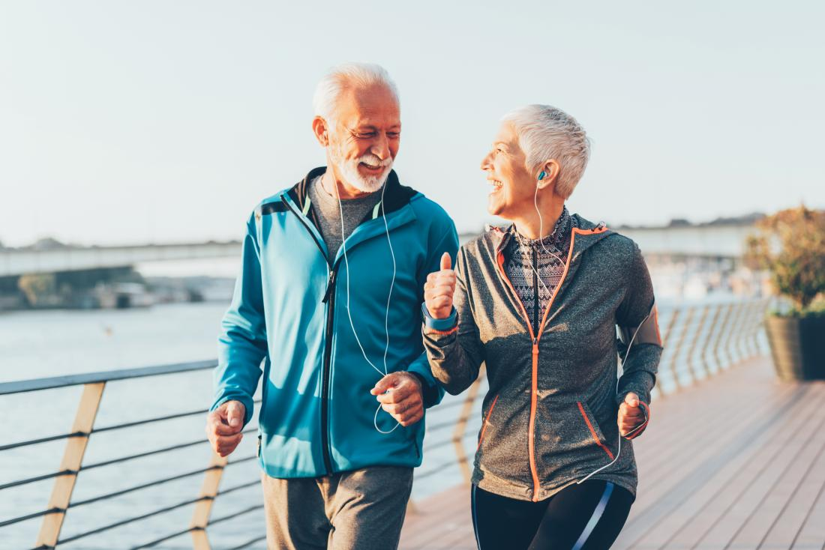
Self care
Diet
Exercise-
Smoking – Smoking cessation

Slide 15
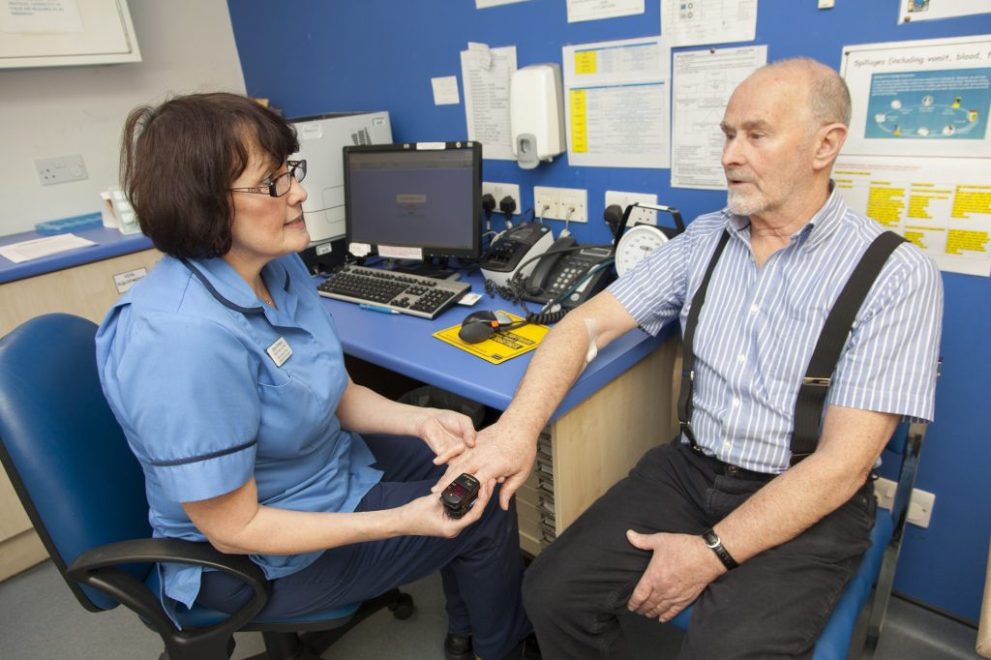
The role of the PN
Promote healthy lifestyle changes- diet and exercise.
Practice nurses can check BMI- body mass index
Check blood pressure and monitor changes.
Can take routine ECGs.
Conduct NHS Health Check

Slide 16
Heart Attack (MI)
Myocardial Infarction
Medical emergency
Patient experiences chest pain which spreads to arms (usually left), neck, jaw, back and tummy.
Feeling of overwhelming anxiety
Short of breath
Sweating
Nausea and or Vomiting
Light-headedness/dizziness
NOTE: Women often have different symptoms to men.

Slide 17
Symptoms in Women
Chest pain but not always
Pain or pressure in lower chest or upper abdomen
Jaw, neck or upper back pain
Nausea or vomiting
Shortness of breath
Fainting
Indigestion
Extreme fatigue

Slide 18
Management
Call 999
If in surgery you can administer aspirin 300mg if directed by a doctor and GTN spray.
Have resuscitation equipment to hand.

Slide 19
Role of the Nurse
Conducting ECG
Alerting the GP to ECG findings- in most practices the ECG must be signed by the GP and then scanned onto the patients notes.
The ECG could be used as a base line.
Patients with acute chest pain should be seen in A&E.

Slide 20
Congenital Heart Defects

Slide 21
What is Blood Pressure?
The blood pressure is the pressure of the blood within the arteries.
It is produced primarily by the contraction of the heart muscle. Its measurement is recorded by two numbers.
The first (systolic pressure) is measured after the heart contracts and is highest.
The second (diastolic pressure) is measured when the heart is at rest and lowest.
A blood pressure cuff is used to measure the pressure.

Slide 22
What is normal?
normal blood pressure is considered to be between 90/60mmHg and 120/80mmHg
high blood pressure is considered to be 140/90mmHg or higher
low blood pressure is considered to be 90/60mmHg or lower
If your reading is between 120/80mmHg and 140/90mmHg, you may be at risk of developing high blood pressure.

Slide 23
Symptoms of Hypertension
Severe Headache
Nosebleed
Fatigue or confusion
Vision Problems
Chest pain

Slide 24
Symptoms of Hypotension
Dizziness or light headedness
Nausea
Fainting (syncope)
Dehydration or Unusual thirst
Lack of concentration
Blurred vision

Slide 25
How to take a Blood Pressure

Slide 26
24 Hour Blood Pressure monitoring ABPM

Slide 27
Home Blood Pressure Monitoring
Patient records their blood pressure at various times of the day over a set period of time.
Readings are then reviewed.
Used when patient cannot tolerate ambulatory blood pressure monitoring (APBM)

Slide 28
Tips to take a blood pressure?
Record morning and evening over a period of weeks
Do not take directly after waking up – wait ½ hour
Do not take immediately after eating – always take ½ hour before eating or drinking
Avoid caffeine
Put the cuff on bare skin, do not roll sleeve up always take arm out of sleeve.
Sit quietly during monitoring
Rest arm at the level of the heart
Take 2/3 measurements about 2-3 mins apart to get accurate readings, record the lowest.

Slide 30
Hypertension
Hypertension is a condition when the patients blood pressure is raised.
A 3rd of adults in the UK have undiagnosed hypertension.
If untreated can lead to conditions such as MI and stroke
1 in 20 patients with hypertension are due to health conditions such as diabetes, kidney disease, long term kidney infections.
Medications such as NSAIDS, steroids and the contraceptive pill can cause high blood pressure.

Slide 31
Diagnosing Hypertension

Slide 32
Management

Slide 33
Common Medications
Ace inhibitors – drugs ending in ..pril eg lisinopril
Work on the renin-angiotensin-aldosterone system (RAAS) to reduce blood pressure

Slide 34
ACE Inhibitors (Angiotensin converting enzyme inhibitors)

Slide 35
Calcium channel Blockers
Drugs that end in …ipine
Work by reducing the amount of calcium entering the cells of the heart and blood vessel walls.
Calcium is necessary to contract the muscle linings of the blood vessels (smooth muscle). It passes into the cells via ion channels (like pores).
These pores are blocked by the drug, calcium not able to enter resulting in relaxation of the muscle walls, this improves the blood flow to the heart and blood vessels. Causes vasodilation.

Slide 36
Calcium Channel Blockers

Slide 37
Role of the Nurse

Slide 38
CVD Risk Score
Offered to individuals aged 40-47
Take family history of CVD, blood pressure, patients cholesterol level, BMI and alcohol intake
Use screening tool such as Qrisk 2
Gives a score:
If <10% low risk of developing CVD;
If 10-20% moderate risk
If >20% high risk

Slide 39
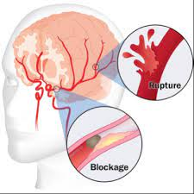
What is a stroke?
There are two types of stroke:
Ischaemic stroke when the blood supply to the brain is stopped due to a clot.
Haemorrhagic stroke when a blood vessel supplying the brain bursts.
Management depends on the type
of stroke and the area of the brain
involved.

Slide 40
Symptoms of Stroke
The main symptoms of stroke can be remembered with the word FAST:
Face – the face may have dropped on 1 side, the person may not be able to smile, or their mouth or eye may have dropped.
Arms – the person with suspected stroke may not be able to lift both arms and keep them there because of weakness or numbness in 1 arm.
Speech – their speech may be slurred or garbled, or the person may not be able to talk at all despite appearing to be awake; they may also have problems understanding what you're saying to them.
Time – it's time to dial 999 immediately if you see any of these signs or symptoms.

Slide 41
Stroke symptoms
Other symptoms include:
Numbness of the face, arm, or leg, especially on one side of the body;
Confusion, difficulty speaking or understanding speech;
Difficulty seeing with one or both eyes;
Difficulty walking, dizziness, loss of balance or coordination;
Severe headache with no known cause; and
Fainting or unconsciousness.

Slide 42
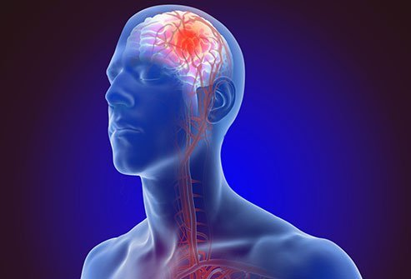
Transient Ischaemic Attack
Often called a mini-stroke where the blood supply to the brain is temporarily interrupted, can last a few minutes or persist for up to 24hrs.
Needs referral as can often herald a full stroke.

Slide 43
Vascular Dementia
A common type of dementia caused by reduced blood flow to the brain
Affects around 150,000 people in the UK
Can be a sudden onset or slow over a period of time.
No Cure but symptoms can be slowed down.

Slide 44
Health Promotion and Self Care
Smoking cessation – advise patients not to start smoking if they are a non-smoker. Strongly discourage any children or teenagers from starting. If a patient does smoke, stopping is the most important thing they can do to protect their heart.
Becoming more active – advise patients to take part in physical activity and exercise but be realistic. If they are housebound or restricted physically, they will not be able to do much, so encourage physical activity around the house as they are able.
Make small achievable dietary changes – reduce portion size, increase fruit and veg, trim visible fat, reduce salt, cook more healthily. They shouldn’t buy food they know is unhealthy. They may benefit from seeing a dietitian for an individualised plan.
Reducing alcohol intake – and encourage non-drinkers never to start. Apart from containing ‘empty’ calories, it can lead to weight gain and can increase triglycerides.

Slide 45
Health Promotion and Self Care
Signing up to campaigns as part of community and support networks – any changes they make are long term and may need motivation from others on the same path. Suggest they use health apps on their phones and devices to set themselves goals.

Slide 46
Questions

Slide 47
Scenario
Polly is a 46 year old female, she presents at surgery with chest pain.
She has been triaged by the GP and asked to attend for an ECG and bloods.
The Receptionist tells you that Polly is in the waiting room and does not look well.
You have a full clinic and are already running late!

Slide 48
Polly
Chest pain started suddenly, has been coming and going over the last 2/7.
Polly says it is a dull ache and thinks it is getting more frequent.
The pain tends to be worse in the evenings, it makes her feel sick. It does radiate to her left jaw.
Polly has tried paracetamol but it does not help, she has also tried gaviscon which did not help.
She rates the pain as being 6-7/10.

Slide 49
History
Polly has no significant medical history.
She does not take any medications
She smokes 20 cigs/day and drinks 12 units/week
She does not take recreational drugs
She does not have any allergies
Bloods done last year showed a slightly raised cholesterol.

Slide 50
Social History
Polly lives with her husband and 2 small children in a house
She is a Primary School Teacher
She is fully independent and does not have any carers
She is not a carer other than to her children

Slide 51
What are you going to do?

Slide 52
Consultation
Polly walks into the consultation room, she looks grey and is sweating and comes across as slightly short of breath.
What do you do next?

Slide 53
Examination
Blood pressure : 110/82
HR 62
Sats: 96%
Temp: 37.5
RR: 20
Cap refill <2 secs
Pale grey, sweating/sob
HS 1&2 heard

Slide 54
What are you going to do?
Initially you could perform an ECG – is there anyone available to interpret appropriately
Call 999 for ambulance
As the nurse what else would you do?
The ambulance comes – what do they do?

Slide 55
…a week later
A week later the GP shows you a discharge summary for Polly
She had a STEMI which resulted in her having 5 stents. She is now home and doing well

Slide 56
Reflection
How do you feel about this scenario?
What would you do differently?
Would you make any changes to the care you gave?

Slide 57
Thank you

