Slide 1
Asthma in primary care
IPL

Slide 2
Lesson Objectives
To understand the diagnosis, management and treatment options for patients with asthma in primary care.
To be able to discuss the emergency treatment pathway for patients having an asthma attack.
To be able to identify different asthma medications.

Slide 3
What is Asthma?
Asthma is a long-term condition that affects your airways – the tubes that carry air in and out of your lungs.
It usually causes symptoms such as coughing, wheezing and breathlessness.
If you come into contact with one of your asthma triggers, it can make your symptoms worse and even bring on an asthma attack.
It is a variable condition, symptoms can come and go related to triggers.

Slide 4
What is Asthma?

Slide 5
What is it?

Slide 6
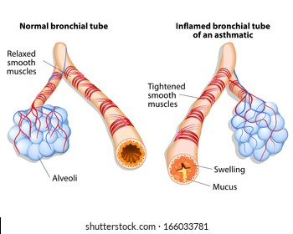

Slide 7
Who gets asthma?
In the UK, around 5.4 million people are currently receiving treatment for asthma. That's one in every 12 adults and one in every 11 children.
Asthma affects more boys than girls. Asthma in adults is more common in women than men.
It tends to run in families, especially when there's also a history of allergies and/or smoking.

Slide 8
Is it a chronic condition?
Asthma is a lifelong condition; most people who have asthma will always have asthma.
But if you’ve been diagnosed with asthma as a child, your asthma might improve or disappear completely as you get older, particularly if the asthma was mild.
Even if asthma goes away it can come back later in life, perhaps because you’ve come into contact with new triggers in your job, or you’ve moved to an area with more air pollution for example. Hormonal changes such as pregnancy and menopause can also bring it on again.
But the good news is that even though asthma doesn’t go away there are lots of safe and effective treatments available to help you stay symptom-free.
If you’ve tried taking all the usual treatments in the right way, but you’re still having symptoms, your GP can refer you to a specialist to see if you have severe asthma. This kind of asthma only affects around 4% of all people with asthma. An asthma specialist can help you find the right treatments for you, for example monoclonal antibodies.

Slide 9
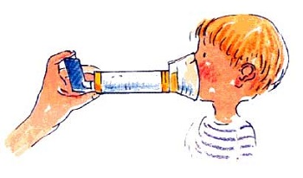
How serious is asthma?
Tragically, three people die every day because of asthma attacks and research shows that two thirds of asthma deaths are preventable.
The reassuring fact is that most people with asthma who get the right treatment - and take it correctly - can manage their symptoms and get on with what they want to do in life.

Slide 10
Types of asthma…
Allergic asthma: also known as extrinsic asthma. When the symptoms are induced by a hyper immune response to the inhalation of a specific allergen.
Non-Allergic asthma: also known as intrinsic asthma. This is triggered by the presence of irritants in the air that are not related to allergies.
These irritants stimulate parasympathetic nerve fibers in the airways causing broncho-constriction and inflammation.

Slide 11
Symptoms of asthma
Wheezing,
SOB
Cough
Chest tightness
Mucus

Slide 12
How is asthma different to COPD?

Slide 13
Asthma Triggers: Allergens
Allergens:
Animal dander from feathered or furry pets
Cockroach droppings
Dust mites
Molds
Pollen
Notes:
Triggers are things that cause symptoms of asthma, which can lead to an asthma attack or episode. These include allergens which are things you are allergic to such as: - animal dander from feathered or furry pets, - cockroach droppings,
- dust mites,
- molds, and
- tree, grass and weed pollens

Slide 14
Asthma Triggers: Irritants
Irritants:
Environmental tobacco smoke or second hand smoke
Air pollution
Chemicals and strong smells
Notes:
Other triggers include irritants, such as environmental tobacco smoke, air pollution, chemicals and strong smells.
Environmental tobacco smoke or second hand smoke – which increase the number of asthma episodes and the severity of symptoms in an estimated 200,000 to 1 million children annually.
Air pollution – a potent mix of ground level ozone, sulfur dioxide, particulate matter and nitrogen oxide
Chemicals or strong smells, including paint/cleaning solutions, chalk dust, lawn and turf treatments, gasoline fumes

Slide 15
Additional Triggers
Weather changes
Upper respiratory infections
Cold air
Strong emotions
Exercise
Notes:
Additional Triggers:
- weather changes - upper respiratory infections, such as the common cold or flu
- cold air - strong emotions, like crying and even laughter, and - what concerns you most – exercise
A newly-mowed field, freshly-sprayed turf or a just-refinished gym floor may mean you need to temporarily change the location of practice or physical education class.

Slide 16
Exercise Induced Asthma (EIA)
Is a narrowing of the airways that occurs 5-20 minutes after activity
Is present in the vast majority of individuals with asthma
Notes:
Even though exercise is important for everyone, it can cause asthma symptoms in the vast majority of individuals with asthma and…12% of those who are undiagnosed with asthma will experience symptoms. It’s important for every school staff member to recognize symptoms that occur with exercise {exercise-induced asthma (EIA)} and know how to help.
EIA, also sometimes called exercise-induced bronchospasm (EIB), is a narrowing of the airways that occurs 5-20 minutes after activity.

Slide 17
What Happens in EIA
Breathing in cool, dry, and unfiltered air through the nose
Airways narrow, reducing the air flow
Harder to move air in and out of the lungs
Coughing, wheezing, and difficulty breathing
Notes:
Exercise-induced asthma (EIA) occurs when students are breathing faster to meet their bodies’ oxygen needs during intense exercise. Since most people tend to breathe through their mouth when exercising, air doesn’t have a chance to be warmed and humidified by the nose before it goes into the lungs. This results in cool, dry and unfiltered air reaching the lungs. This cool blast of air can cause the already “twitchy” airways to narrow, called bronchospasm. This causes the student to struggle to move air in and out of lungs. The airways react by producing more mucus and become inflamed and swollen, which further reduces the flow of air.
The result is a student, who is coughing, wheezing, and can’t breathe or participate in activities.
Exercise that exposes the student to cold air, such as ice hockey, is more likely to trigger asthma symptoms than exercise involving warm and humid air, such as swimming.

Slide 18
Quick-Relief Inhaler Use to prevent EIA
Use 10-15 minutes before warm-up as a pre-treatment
Shake inhaler for 5 secs, take 1 puff, hold breath for 5 seconds, exhale for 5 seconds
Wait 1-2 minutes and repeat as noted on the asthma action plan
Generally advised to use a spacer device.
Notes:
Have the student:
use his/her quick-relief inhaler 10-15 minutes before warm-up as a pre-treatment
take 1 puff, hold breath 10 seconds, then exhale
wait 1-2 minutes and repeat as noted in their asthma action plan.
Some students have been taught by their healthcare professionals to place the inhaler in their mouths while others hold the inhaler opening two-fingers width away from the mouth.
Still other students may use a spacer or holding chamber which traps the puff of medication until the student inhales it. This ensures that they inhale all of the medicine into their lungs.

Slide 19
In an Emergency
Ask the student to stop the activity and sit down (not recline)
Follow the emergency plan on that student’s asthma action plan
Ask someone to contact the parents/guardians and call for help while you stay with the child
Notes:
In an emergency you should:
ask the student to stop the activity and sit down (not recline)
follow the emergency plan on that student’s asthma action plan
ask someone to contact the parents/guardians and call for help while you stay with the child
Call 911 if:
If there is no improvement after 15 minutes
Lips and/or fingernails are blue.
After the emergency has passed:
Follow up with parents or guardians to prevent future episodes,
Discuss with your team if any changes need to take place for the future.

Slide 20
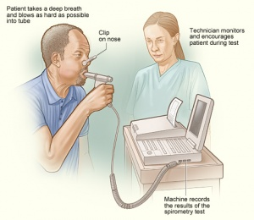
Diagnosis
Spirometry AND – peak flow diary
FeNO testing in Secondary Care.

Slide 21
Diagnosis
Spirometry is often normal, may show an obstructive picture .
Reversibility testing
Values will return to normal post bronchodilator , positive reversibility
Peak flows taken over a number of weeks will show variability.
20% variability diagnostically positive for asthma.
FeNO testing, Fractional inhaled nitric oxide.
Undertaken in hospital
Used when doubt about diagnosis.

Slide 22
Management of Asthma –step wise approach
Step One
Relievers:
Use of short acting bronchodilators, SABA
Salbutamol
Terbutaline
Taken as needed, usually has rapid effect,
Step Two
Maintenance therapy
Usually inhaled corticosteroids.
Taken twice daily
Clenil

Slide 23
Step Three
Sometimes asthma is difficult to control, if controlled is not gained with ICS at maximum dose Leukatriene Receptor Antagonists (LTRA) can be added, e.g Montelukast
If these do not help then long acting bronchodilators can be added, usually in combined inhalers, e.g Fostair

Slide 24
Step wise approach.

Slide 25
Long-Term Control Medicines
Also called controllers/preventers
Prevent lung inflammation, but will not help during an asthma attack
Must be taken for several days before positive effects are noted
Such as Clenil, combined inhalers
Notes:
Your students may need one of two types of medicines. The first are long-term control medicines.
These are also called “controllers.” They are powerful in preventing the inflammation associated with asthma, but will not help during an episode. Corticosteroids are just one of several groups of medicines under the “long-term control” category and they are the source of much misunderstanding. These steroids are NOT the same as the anabolic steroids that are abused by some athletes.
Long-term control medicines must be taken for several days before positive effects are noted. They must be taken consistently and as prescribed, for maximum benefit. Unfortunately, sometimes students stop taking them because they do not see an immediate benefit from their use.

Slide 26
Quick-Relief Medicines
Sometimes called rescue medicines/relievers
Relax the muscles around the airways and decrease the narrowing of the airways
Provide immediate relief lasting several hours
Used to treat asthma attacks
Used to prevent and treat EIA
Such as Salbutamol/terbutaline
General consensus now to use more steroid inhaler rather than reliever
Notes:
The second type of asthma medicine are quick-relief medicines. They are sometimes called rescue medicines and provide immediate relief which lasts for several hours. They relax the muscles around the airways and decrease the narrowing of the airways, which contributes to the wheezing, coughing and tightness of an asthma episode. They are also important as a pre-treatment or prevention before a physical activity or exercise begins.
Overuse and incorrect use are major concerns for students who may use their quick-relievers more than prescribed. Some may need to take long-term control medicines to avoid over using their quick-relief medicines. Students should have convenient access to their asthma medicines before, during and after school.
Make sure all medicines have the students’ names on them. Don’t allow them to be shared.

Slide 27
Asthma Attacks
If one or more of the following symptoms are present the patient is having an asthma attack:
Coughing or wheezing
Difficulty breathing, shortness of breath
Difficulty in talking, cannot complete an full sentence
Difficulty walking due to shortness of breath
Chest tightness
Notes:
A student may still have an asthma attack even though he/she pre-treated and warmed-up. Remember that asthma attacks are never the same for any two students.
If your student has one or more of the following symptoms you need to stay calm and follow his/her emergency plan immediately:
coughing or wheezing
difficulty breathing, shortness of breath
difficulty in talking and walking due to shortness of breath
chest tightness or pain

Slide 28
Managing an asthma attack in Primary Care.

Slide 29
The Role of the Practice nurse/ GP
The asthma review:
Height and weight- BMI
Blood pressure check
Peak flow test
Discussion on asthma triggers
Discussion on asthma medication
Discussion on inhaler technique
Asthma Control Test (ACT) score
Mental health considerations
Personalised Asthma Plan.

Slide 30
Asthma Control Test

Slide 31
Asthma Plan
A written personalised action plan that is tailored to the individual
Enables them to recognise when their asthma is getting worse and what action to take to help.
See Asthma UK for examples.
NICE Guidance NG8O

Slide 32
Asthma Action Plan
Asthma Action Plan 1
Asthma Action Plan 2

Slide 33
Self care
Pulmonary rehabilitation
Smoking cessation
Exercise
Diet
Asthma management plan

Slide 34
Your roles relating to asthma…
Pharmacist
Paramedic
Physiotherapist
Occupational therapist
Nurse

Slide 35
Breathing Pattern Disorder (BPD)
BPD most commonly known as Dysfunctional Breathing refers to a group of breathing disorders where there is an alteration in the normal patterns of breathing that can result in intermittent or chronic (long-term) respiratory and non-respiratory symptoms. Breathing should change, based on what we challenge ourselves with: for example, exercising.

Slide 36
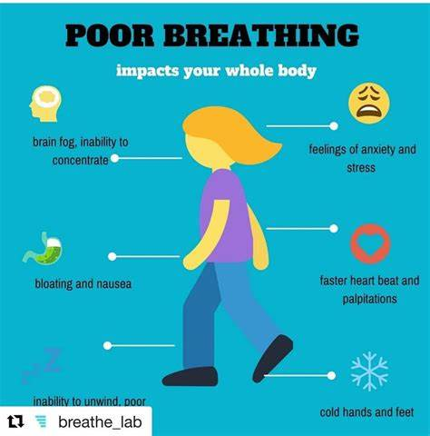
Your breathing should have equal effort from your upper chest and your diaphragm/abdominal region. If this is not the case dysfunction breathing can occur and become long standing (chronic) where your symptoms of breathlessness persist. Often this is not a sudden change and will happen over a long period of time. You can sometimes have a pattern of over breathing even when the body does not demand it. This then leads to your body adapting to this, often in a counterproductive way. You may experience symptoms such as a racing heart, tingling fingers, chest and throat tightness, chest pain and light headedness

Slide 37
BPD- Signs and Symptoms
What are the possible signs and symptoms of BPD?
Inability to take deep breath
Sensation of not enough air in the chest
Tightness around chest or throat
Chest pain
Yawning
Sighing
Dizziness of light headedness
Blurred vision
Sensation of fast or irregular heart beats
Bloating feeling in the stomach
Tingling fingers
Cold hands or feet

Slide 38
BPD
How might I know if my breathing pattern is affected or wrong?
If I am breathing through my mouth
If my breathing is noisy
If I am breathing too fast or shallow
If my upper chest moves outwards more than my tummy during my in-breath
If I am frequently yawning and sighing
If I am finding difficulty co-ordinating my breathing during talking and or eating
If I am having muscular tension, aches/pains mainly around shoulder, neck and jaw
If I am feeling exhausted all the time and finding difficult to concentrate

Slide 39
BPD Management
Being aware and recognising the pattern, symptoms and triggers is the first step in managing this. Once aware of these things and seeing a specialist respiratory physiotherapist, this will then help educate you and advice on strategies that may help. In some cases seeing a clinical or health psychologist may also be helpful and this is something you can discuss in clinic.

Slide 40
Questions…

Slide 41
Resources
Asthma UK
BTS Guidelines
GINA Guidelines
NHS Guidelines – Breathing Disorders

Slide 42
Thank you

